Slide 1
Hydraulic fracturing in australia’s northern territory
Dr Howard Smith
Northern Land Council
Darwin, Australia
Energy Future The Role of Impact Assessment Centro de Congresso da Alfândega | Porto, Portugal 27 May - 1 June 2012

Slide 2
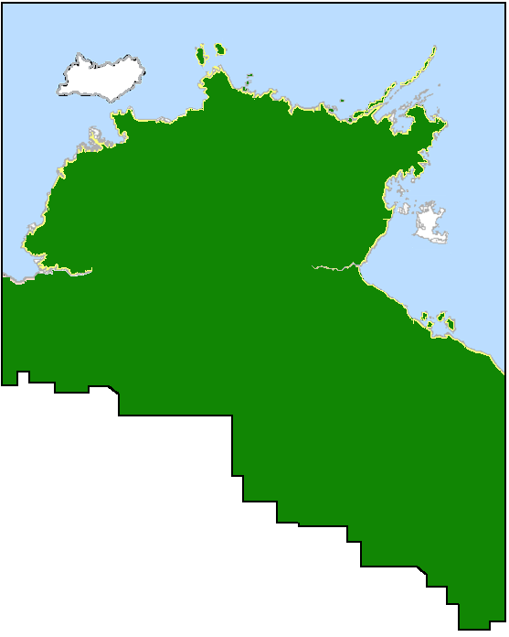
Hydraulic Fracturing in Australia’s Northern Territory
The Northern Land Council is a statutory body created by the Australian Federal Government to deal with issues related to management of land by the Aboriginal people of the top end of Australia’s Northern Territory.
We deal with land that is subject mainly to 2 types of tenure – freehold and “Native Title”.
Hydraulic fracturing of shales is a process that is new to our Aboriginal constituents.
We were caught by surprise at the rapid increase in the number of applications seeking to use the process on Aboriginal lands in our jurisdiction .
The NLC travelled to the USA to gather information about all aspects of hydraulic fracturing and the on-shore oil and gas industry.
Energy Future The Role of Impact Assessment Centro de Congresso da Alfândega | Porto, Portugal 27 May - 1 June 2012

Slide 3
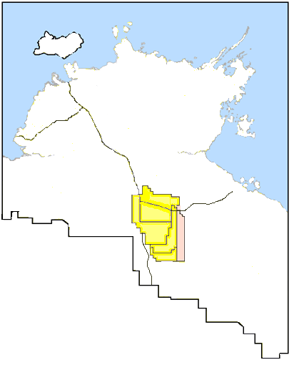
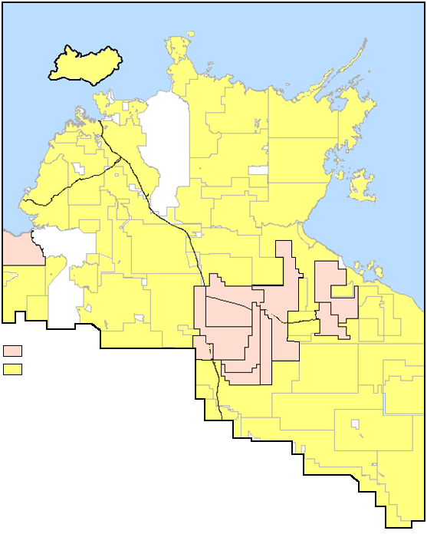
Hydraulic Fracturing in Australia’s Northern Territory
The situation in 2001 The situation in 2011
Granted
Application
Granted
Application
Energy Future The Role of Impact Assessment Centro de Congresso da Alfândega | Porto, Portugal 27 May - 1 June 2012

Slide 4
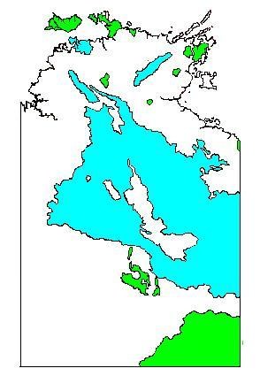
Hydraulic Fracturing in Australia’s Northern Territory
FIGURE 2: Major aquifers of the Northern Territory.
Environmental Concerns
Many Aboriginal communities are remote and rely almost exclusively on groundwater aquifers for their water supplies.
The most prospective areas also coincide with the most valuable water supplies in the Northern Territory.
The most significant environmental concern we have is with the security and the integrity of water.
Multiple wells will have a cumulative and widespread impact.
There are fears that improperly constructed wells will leak chemicals, oil and/or gas into aquifers – even well after abandonment.
Energy Future The Role of Impact Assessment Centro de Congresso da Alfândega | Porto, Portugal 27 May - 1 June 2012

Slide 5
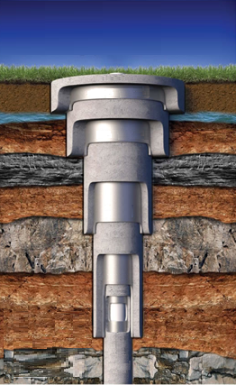
Hydraulic Fracturing in Australia’s Northern Territory
FIGURE 3: Minimum standard of well design sought by the NLC.
Controls
It is possible to refuse access to freehold land, but not where only Native Title rights are held.
We are currently negotiating with the Government to develop better legislation and regulation to control the industry.
We negotiate with companies to ensure that our agreements require them to build the wells to the highest possible standards.
We also seek them to test well integrity during construction, at regular periods during operations and immediately prior to abandonment.
We have an interest in developing the industry, but don’t want outcomes like we have seen or heard about elsewhere.
Energy Future The Role of Impact Assessment Centro de Congresso da Alfândega | Porto, Portugal 27 May - 1 June 2012

Slide 6
Hydraulic Fracturing in Australia’s Northern Territory
Social Concerns
We are also concerned about the ‘resource curse’ - oil and gas production will lead to the release of large amounts of cash into impoverished areas.
We see work opportunities in the future but recognise that Aboriginal people in the affected areas lack sufficient capacity to participate effectively.
Controls
We recognise the need to develop improved systems to cope with the large amounts of royalties and other income expected.
Through our agreements we seek a minimum percentage of local employment.
We are investigating the feasibility of an industry specific local training centre.
Energy Future The Role of Impact Assessment Centro de Congresso da Alfândega | Porto, Portugal 27 May - 1 June 2012

Slide 7
Hydraulic Fracturing in Australia’s Northern Territory
Cultural Concerns
So far we have come across three cultural concerns of significance.
Water has a special significance to Aboriginal people.
Drilling and fracturing beneath sacred sites needs to be dealt with on a case by case basis.
The extraction of oil and/or gas from shale beneath another clan groups lands could be considered a form of ‘cultural assault’ or theft of property.
Controls
Controls to protect water have already been discussed.
We’re not yet sure how to place controls over drilling beneath sacred sites or other clan group lands where this might be a concern.
Energy Future The Role of Impact Assessment Centro de Congresso da Alfândega | Porto, Portugal 27 May - 1 June 2012

Slide 8
Hydraulic Fracturing in Australia’s Northern Territory
THANK YOU FOR LISTENING
The presenter can be contacted via howard.smith@nlc.org.au.
Energy Future The Role of Impact Assessment Centro de Congresso da Alfândega | Porto, Portugal 27 May - 1 June 2012

