Slide 1


Informed consent in australia’s northern territory
Dr Howard Smith
Northern Land Council
Darwin, Australia
Energy Future The Role of Impact Assessment Centro de Congresso da Alfândega | Porto, Portugal 27 May - 1 June 2012

Slide 2
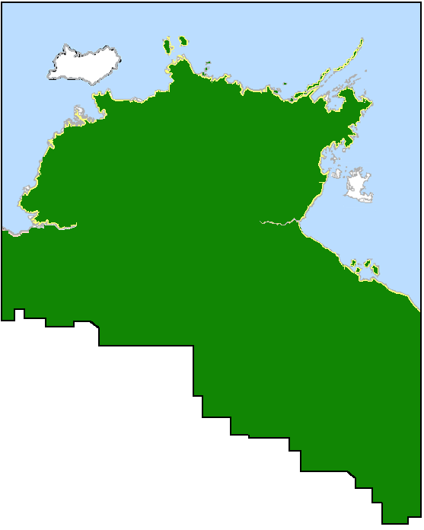
Informed consent in Australia’s Northern Territory
The Northern Land Council is a statutory body created by the Australian Federal Government to deal with issues related to management of land by the Aboriginal people of the top end of Australia’s Northern Territory.
We deal with land that is subject mainly to 2 types of tenure – freehold and “Native Title”.
Development of industry on both types of tenure requires Agreements with traditional (or customary) Aboriginal landowners.
The key to our success is to ensure that all relevant parties are included in the discussions so that free, prior and informed consent is obtained.
Energy Future The Role of Impact Assessment Centro de Congresso da Alfândega | Porto, Portugal 27 May - 1 June 2012

Slide 3
Informed consent in Australia’s Northern Territory
FIGURE 1: General process used for organising meetings required for collection of information and obtaining free, prior and informed consent.
We must remain aware of any external events, especially ceremony.
We must remain aware of any tensions between clan groups
We must remain sensitive to the different needs of men and women – especially where information related to spiritual matters or gender specific ceremonies is to be discussed.
Energy Future The Role of Impact Assessment Centro de Congresso da Alfândega | Porto, Portugal 27 May - 1 June 2012

Slide 4
Informed consent in Australia’s Northern Territory
FIGURE 2: Process used for negotiating access agreements where Aboriginal freehold rights exist.
First phase requires us to provide technical information in an easily understood format. A decision to veto the project can be made here.
Second phase requires us to negotiate the terms of the agreement, including identification of which area of land will be made accessible
Third phase requires us to present the terms of the agreement. A decision to veto the project can also be made here.
Fourth phase requires us to provide feedback on progress of the project, usually on an annual basis.
Energy Future The Role of Impact Assessment Centro de Congresso da Alfândega | Porto, Portugal 27 May - 1 June 2012

Slide 5
Informed consent in Australia’s Northern Territory
FIGURE 3: Process used for negotiating access agreements where Native Title rights exist.
First phase requires us to negotiate the terms of the agreement, including identification of which areas of land will be made accessible.
Second phase requires us to provide technical information and then the terms of the agreement. There is no right to veto the agreement, but it may be possible to renegotiate some of the terms
Third phase requires us to provide feedback on progress of the project, usually on an annual basis.
Energy Future The Role of Impact Assessment Centro de Congresso da Alfândega | Porto, Portugal 27 May - 1 June 2012

Slide 6
Informed consent in Australia’s Northern Territory
FIGURE 4: A practical example of the process used for a special project – incorporating traditional knowledge into mine closure.
First phase requires us to obtain relevant traditional knowledge from the custodians and develop a nexus with the modern scientific view.
Second phase requires us to address a series of 3 questions – if a negative answer is found for any of them, we need to seek suitable alternatives.
This represents a collaborative approach between traditional owners and a major mining company in addressing major environmental impacts.
Energy Future The Role of Impact Assessment Centro de Congresso da Alfândega | Porto, Portugal 27 May - 1 June 2012

Slide 7
Informed consent in Australia’s Northern Territory
Our consultation processes are designed to meet the cultural needs of the traditional Aboriginal owners whom we represent.
Wherever possible, we hold our consultations on the affected land.
Technical information is broken down into plain English and interpreters are used where available.
Visual aids and tools are an important part of our consultation process.
We encourage discussions to be held in language by traditional Aboriginal landowners where decisions are to be made.
We seek to hold consultations free of pressure of time (even though this is not always possible).
Finally, our consultation practices continue to evolve with changing cultural patterns and the needs of our traditional owners.
Energy Future The Role of Impact Assessment Centro de Congresso da Alfândega | Porto, Portugal 27 May - 1 June 2012

Slide 8
Informed consent in Australia’s Northern Territory
THANK YOU FOR LISTENING
The presenter can be contacted via howard.smith@nlc.org.au.
Energy Future The Role of Impact Assessment Centro de Congresso da Alfândega | Porto, Portugal 27 May - 1 June 2012

