Slide 1


Stewardship and the ranger uranium mine
Dr Howard Smith
Northern Land Council
Darwin, Australia
Energy Future The Role of Impact Assessment Centro de Congresso da Alfândega | Porto, Portugal 27 May - 1 June 2012

Slide 2
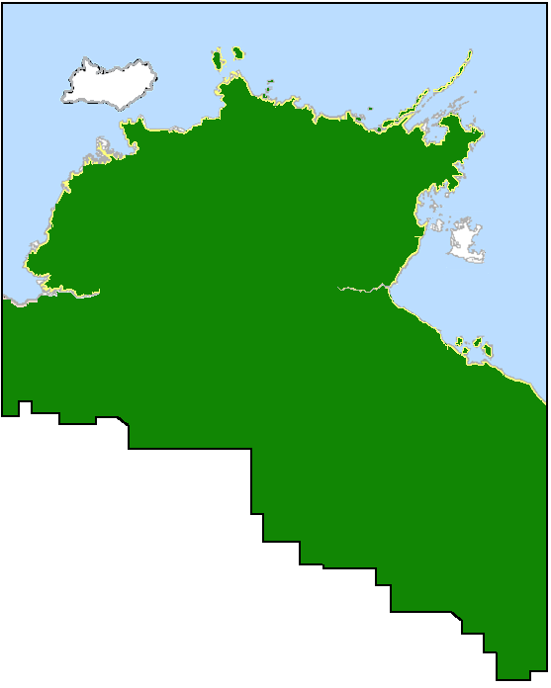
Stewardship and the ranger uranium mine
The Northern Land Council is a statutory body created by the Australian Federal Government to deal with issues related to management of land by the Aboriginal people of the top end of Australia’s Northern Territory.
Ranger Mine
We deal with land that is subject mainly to 2 types of tenure – freehold and “Native Title”.
Ranger Uranium Mine is located on Aboriginal freehold land and is a contiguous part of the cultural landscape of Kakadu National Park.
Ranger Uranium Mine has some strict specific environmental requirements for rehabilitation and closure.
In partnership with the mine operators, we are developing a rehabilitation and post-closure stewardship plan that involves traditional owners.
Energy Future The Role of Impact Assessment Centro de Congresso da Alfândega | Porto, Portugal 27 May - 1 June 2012

Slide 3
Stewardship and the ranger uranium mine
The Environmental Requirements
The Environmental Requirements are set by the Australian Federal Government and designed primarily to protect Kakadu National Park from exposure to radionuclide wastes for 10,000 years.
As a result, the company must ensure that operations at Ranger are undertaken in such a way as to be consistent with the following primary environmental objectives.
(a) maintain the attributes for which Kakadu National Park was inscribed on the World Heritage list;.......
Subject to subclauses 2.2 and 2.3, the company must rehabilitate the Ranger Project Area to establish an environment similar to the adjacent areas of Kakadu National Park such that, in the opinion of the Minister with the advice of the Supervising Scientist, the rehabilitated area could be incorporated into the Kakadu National Park.
Mirarr determine this to mean that any restoration works must consider the cultural attributes of Kakadu National Park or else incorporation is impossible.
Prior to 2007, dealing with impacts on cultural attributes was not really considered important, but is now becoming an important part of Stakeholder Engagement not only at Ranger, but at other mines in Australia
Energy Future The Role of Impact Assessment Centro de Congresso da Alfândega | Porto, Portugal 27 May - 1 June 2012

Slide 4
Stewardship and the ranger uranium mine
The Consultation Process
We needed to find a way to work with the company to ensure that the cultural requirements of the Mirarr traditional landowners were also met.
As there was already a lot of environmental rehabilitation planning being done, we tried to integrate traditional ecological knowledge as the first step to a wider cultural outcome.
There was some significant resistance to the inclusion of people’s belief systems into the process.
However, we were able to link together traditional ecological knowledge and western science to determine a set of potentially useable closure criteria that would be acceptable to the company and to Mirarr.
Energy Future The Role of Impact Assessment Centro de Congresso da Alfândega | Porto, Portugal 27 May - 1 June 2012

Slide 5
Stewardship and the ranger uranium mine
Linking traditional knowledge and western science to develop practical closure criteria
Environmental Parameter | Cultural Considerations | Key Closure Criteria | Scientific Considerations
Topography | Protection of existing sacred and ceremonial sites | Post-mining landform design. | Erosion Geotechnical Stability Slope Aesthetics Levels of contaminants in soil Drainage
 | Recreation of damaged sacred and ceremonial sites
 | Recreation of cultural landscape
 | Recreation of natural landscape
 | Access for cultural activities
Rivers and water bodies |  | Water quality and human health | Water chemistry Ecotoxicology Physical water parameters
 | Spiritual implications
 | Sources of food and potable water
Riparian zones |  | Water quality and biota health
 |  | Contaminant levels in arboreal foods | Plant Chemistry
 | Sources of traditional medicines and craft materials | Correct vegetation patterns Correct species Removal of weeds | Abundance Biodiversity
 | Presence of fauna used for food or ceremony
Energy Future The Role of Impact Assessment Centro de Congresso da Alfândega | Porto, Portugal 27 May - 1 June 2012

Slide 6
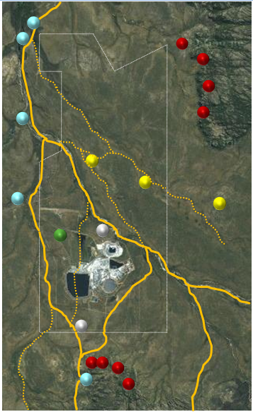
Stewardship and the ranger uranium mine
Cultural Landscaping
The cultural landscape reflects how Mirarr used the environment prior to mining and how it integrates into Kakadu National Park.
It was derived using archived information, living memory and other archaeological and anthropological reports available from the mining company.
We see patterns of movement through yellow lines.
Blue dots are camping areas.
Yellow and red dots show ceremonial areas and art sites.
White dots show archaeological sites where stone was used.
The green dot is a burial site.
Energy Future The Role of Impact Assessment Centro de Congresso da Alfândega | Porto, Portugal 27 May - 1 June 2012

Slide 7
Stewardship and the ranger uranium mine
Risks to culture
Here we sought to use standard methodology to identify risks to culture – but from the Aboriginal perspective.
5 main categories where cultural activities were placed at risk were identified.
A total of 15 sub-categories were also identified.
Each of these may have multiple risks.
Energy Future The Role of Impact Assessment Centro de Congresso da Alfândega | Porto, Portugal 27 May - 1 June 2012

Slide 8
Stewardship and the ranger uranium mine
Seeking Practical Outcomes
So far the approach is largely untested.
It will be difficult to engage Mirarr and start re-establishing their connection with the land after close to 40 years of mistrust.
7 small projects have been proposed by the Mine Operators as the first steps towards re-establishing trust and connection with the land.
We are aiming for the following outcomes:
The cultural tools developed will be found to be suitable for closure of the mine;
Some legacy issues will be addressed;
Traditional Knowledge will be formally incorporated into the closure process for the mine;
Suitable measuring tools will be developed;
An enduring partnership with Mirarr can be established; and
Capacity within Mirarr to act as stewards of the post-closure environment will be created.
Energy Future The Role of Impact Assessment Centro de Congresso da Alfândega | Porto, Portugal 27 May - 1 June 2012

Slide 9
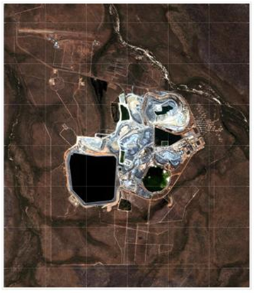
Stewardship and the ranger uranium mine
Practical Outcomes
Several Pilot Projects have been designed to test our work and help develop stakeholder engagement systems that will be suitable for closure of the whole mine.
Restoration of Magela Creek Riparian Zones.
Progressive rehabilitation of Land Application Areas.
Closure of Pit #1.
Rehabilitation of Ranger access tracks.
Source: Environmental Research Institute of the Supervising Scientist, 2008
Energy Future The Role of Impact Assessment Centro de Congresso da Alfândega | Porto, Portugal 27 May - 1 June 2012

Slide 10
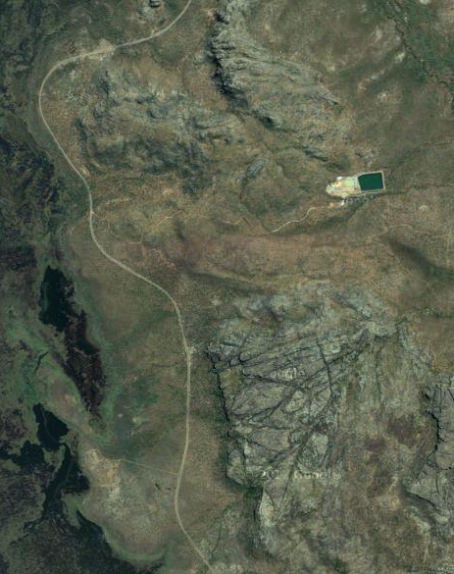
Stewardship and the ranger uranium mine
Practical Outcomes
Removal of the Interim Water Management Pond.
Completion of the programme for removal of bores from the Almudj – Boiweg sacred site complex (Mine Valley).
Rehabilitation of the remnants of the Djarr Djarr Mining Camp.
Source: Google Earth, 2012
Energy Future The Role of Impact Assessment Centro de Congresso da Alfândega | Porto, Portugal 27 May - 1 June 2012

Slide 11
Stewardship and the ranger uranium mine
THANK YOU FOR LISTENING
The presenter can be contacted via howard.smith@nlc.org.au.
Energy Future The Role of Impact Assessment Centro de Congresso da Alfândega | Porto, Portugal 27 May - 1 June 2012

