Slide 1
Biodiversity and energy developments: assessment of direct and indirect impacts
Jack Krohn

Slide 2
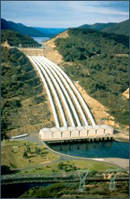
Traditional Victorian power generation
⬆ Yallourn coal-fired power station
Snowy Mountains scheme hydro power plant →
Notes:
Discussion will focus on experience in Victoria, but will make some reference to information from elsewhere.
Various forms of power generation:
*coal-fired (massive deposits of low sulphur brown coal in Latrobe Valley, considered relatively clean by world coal standards until climate change and carbon emissions became an issue),
natural gas-fired,
*hydro (Snowy Mountains scheme a major employment and national development project following WW2),
*

Slide 3
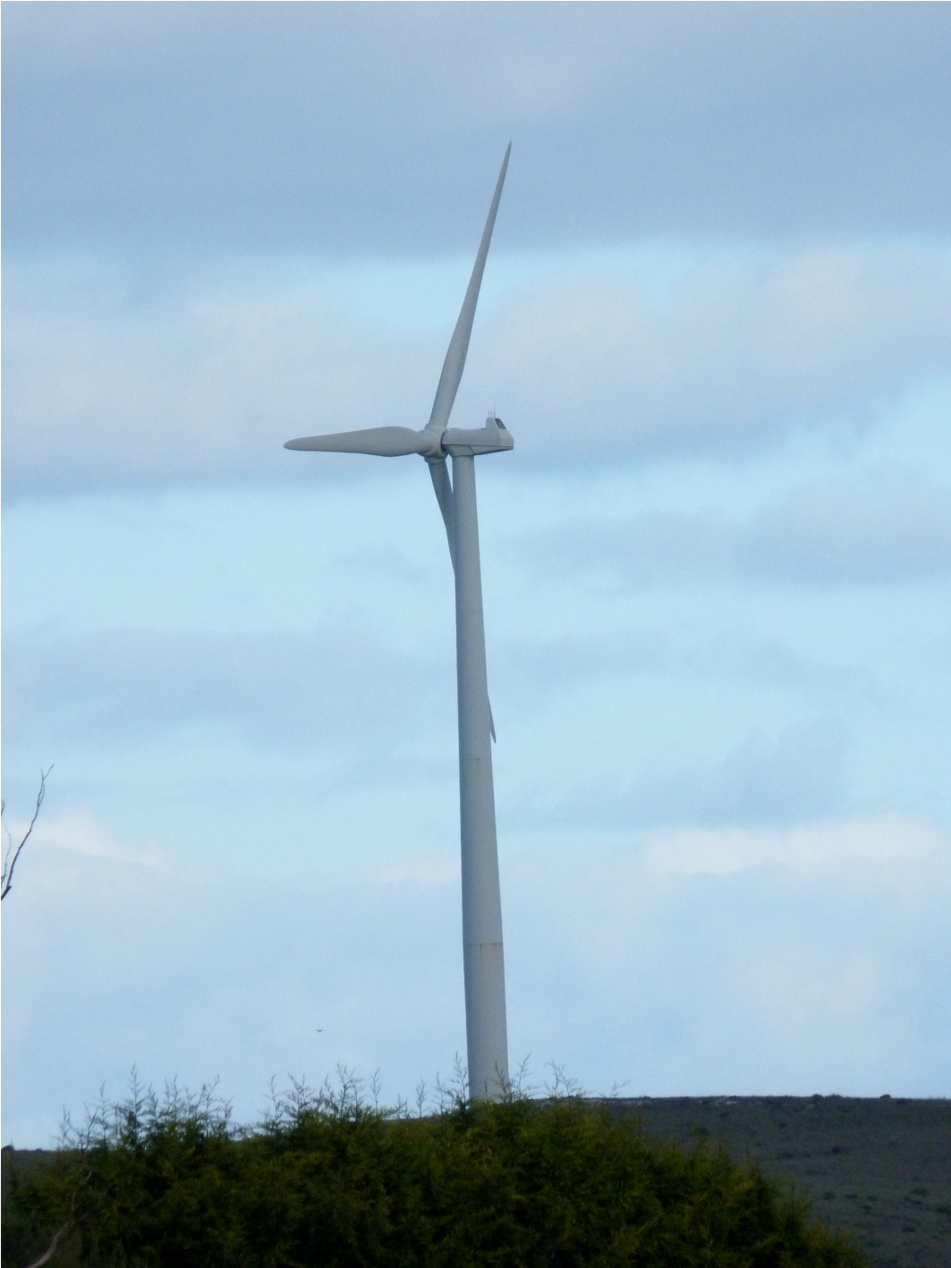
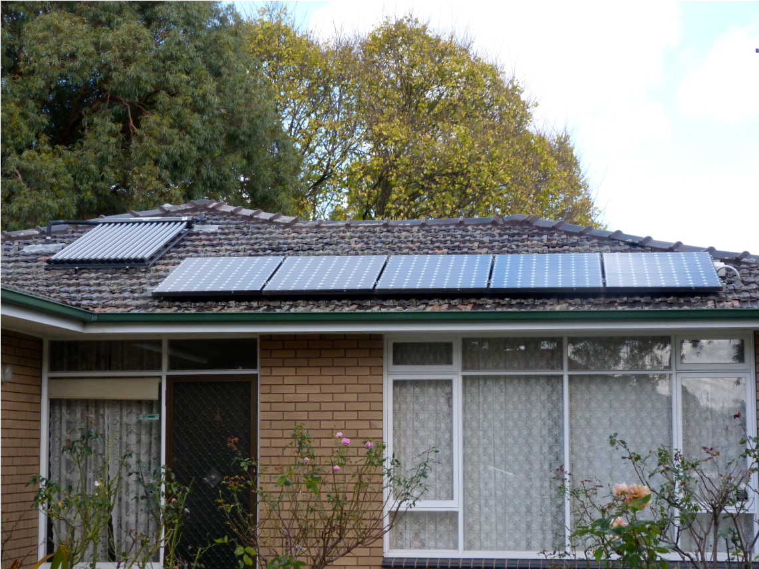
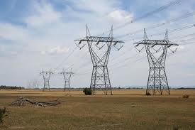
Notes:
*wind, started in late 1990s, expanding;
other (eg *solar, tidal, geothermal etc).
All (even rooftop solar power) require distribution infrastructure. *Essential to consider connection, distribution & reticulation. Characteristic of energy developments (relative to other forms of development that are commonly subject to impact assessment) is combination of site element plus linear element.

Slide 4
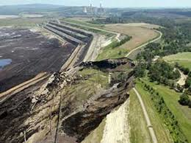
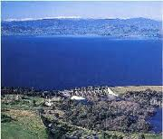
Direct impacts on biodiversity
Wind farm bird strike rates
Altamont:1.94/ MW/ year
Various raptors
PESUR, Tarif : 3.08/ MW/ year
Griffon Vultures, Common Kestrels
Navara: 8.17/ MW/ year
Griffon Vultures
Zeebrugge: 19.57/ MW/ year
Little, Common, Sandwich Terns
Notes:
*Direct impacts – removal of habitat for plant construction, mining of fuel, *storage of water (dams).
Wind power has created focus on bird-strikes by turbines. All are recognisable impacts, and methodologies exist to enable quantification. *Collisions with wind turbines have been quantified at “notorious” locations eg
*Altamont, California
*Spain (Tarifa & Navara) –
*mostly large birds, casualty rates around 0.2-0.6 collisions/ turbine/ year, 0.05 – 2 collisions/ MW/ year.
*Some different results eg terns at Zeebrugge (6/ turbine, 20/ MW/ year) – smaller turbines, smaller birds breeding so more journeys
Some (but lesser) attention to bird (& bat) collisions with power transmission lines.
Conference posters include three on wind farm collision issues, two on powerline collision issues – encouraging, but overall powerlines more ubiquitous in the world landscape and probably the more significant impact, if not as dramatic

Slide 5
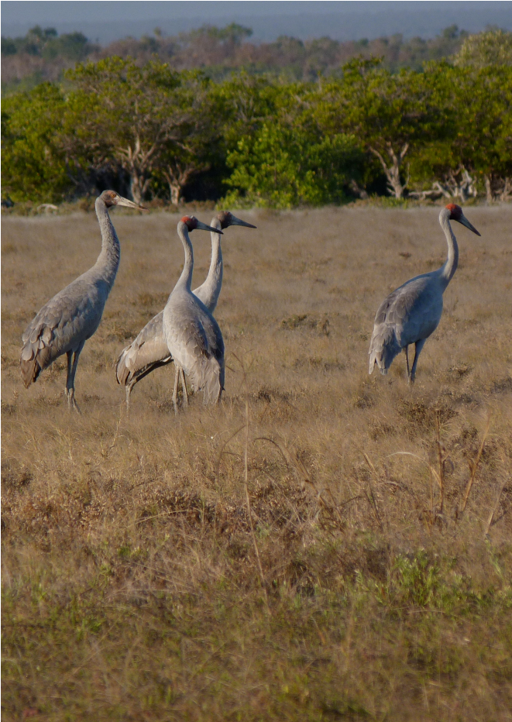
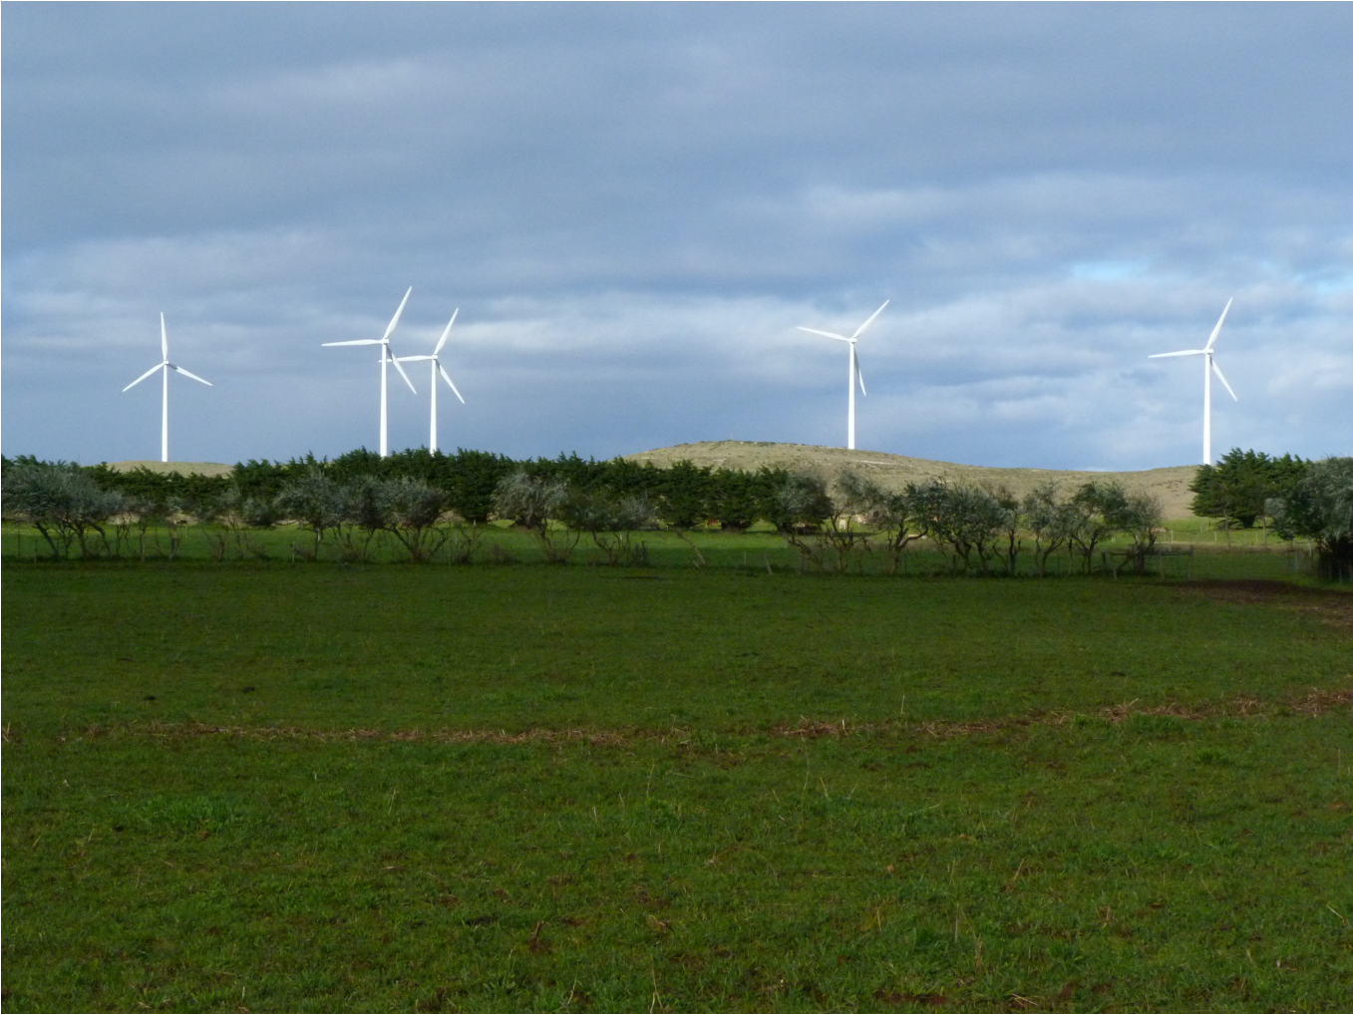
Indirect impacts
Notes:
Indirect impacts can include:
Habitat degradation, for example
decline in condition of native vegetation resulting from groundwater drawdown adjacent to open-cut coal mines [or other large excavations]) waterlogging resulting from a new impoundment for hydro-power generation
avoidance behaviour by wildlife leading to effective loss of habitat value even if the habitat itself remains “available”
Collision hazards for birds (and bats) additional to specific power generation & transmission infrastructure – eg fences (wire and chain-mesh) and structures (buildings, masts, anemometers, guys, etc), lighting as a distraction and disorienting factor. These may be relevant to other facilities and installations but are common to power generation. Lighting can include security lights, navigation warning lights, floodlights.
Another indirect impact could be genetic swamping/ competition/ predation by increasing access to an area for an invasive species eg Mallard, Yellow-throated Miner, Yellow Crazy Ant, Brown Rat etc
Latter indirect impacts may be common to long-established power generation installations and may be ongoing, as distinct from the one-off direct impacts incurred long since (eg clearance of vegetation).

Slide 6
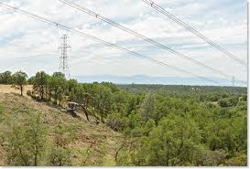
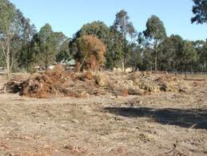
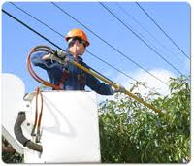
Habitat loss
Notes:
Issues of older forms of energy generation having pre-dated assessment, eg Latrobe Valley brown coal, Snowy Mountains scheme hydro, compared to newer forms eg windfarms, so difficult to compare biodiversity impacts on level terms.
*Although it happens directly just once, clearing of habitat can be seen as an ongoing direct impact – ie the absence of the lost habitat (if not offset) results in a permanent net reduction of available habitat for affected species.
*Victoria has system for quantifying native vegetation losses by vegetation type and quality, and currency for offsets/ compensation. Although currency is called “habitat hectares”, there is no calculated quantification of the habitat values of the vegetation for fauna.
*Powerlines have been implication in bushfires – possible envt damage due to need for risk minimisation.
Tendency to focus on “threatened” species and communities. Both national and State level listing systems, reflecting status at different scales – eg Brolga is threatened in Victoria but not nationally. Relatively less attention on losses of habitat for species which are “least concern”. Therefore potential for substantial cumulative impacts arising from multiple developments, and incremental decline of relatively (or apparently) secure species.

Slide 7
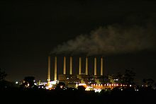
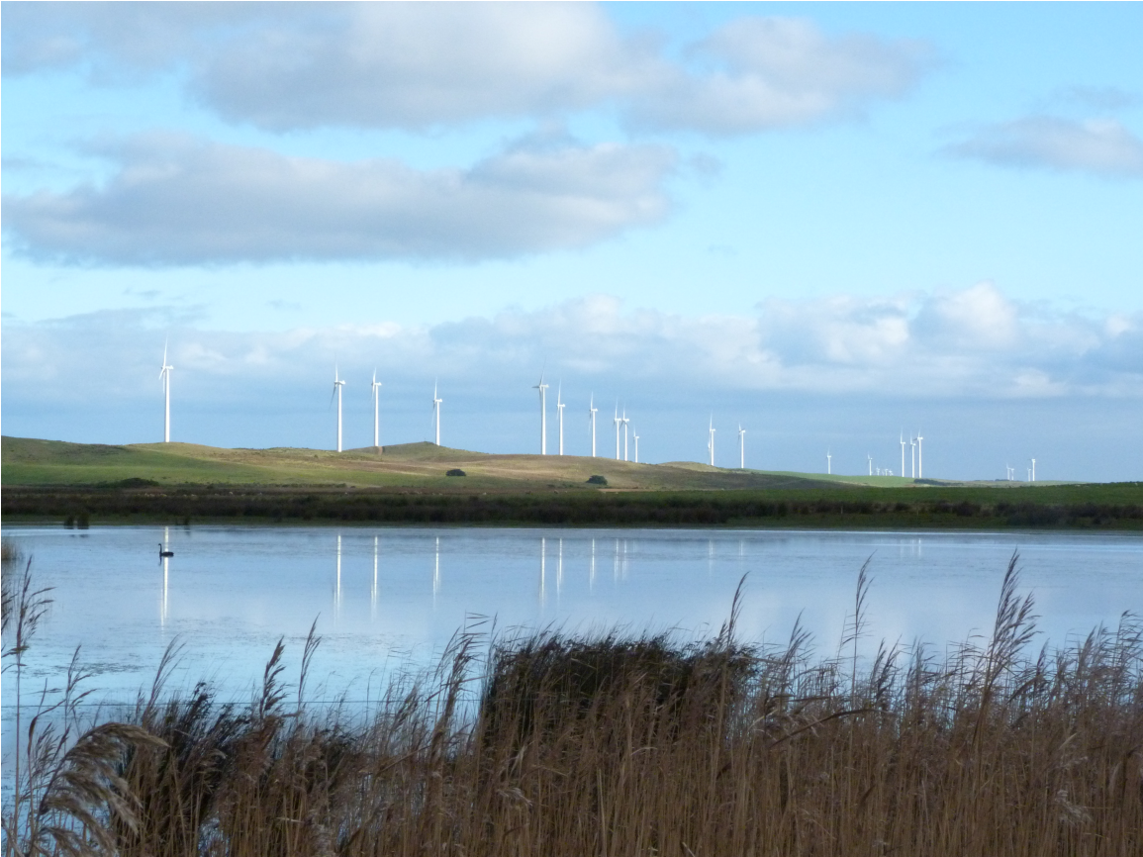
Distraction +
Avoidance +
Deterioration +
Climate change +
Cumulative +
= “Too hard”?
Attritional
Notes:
*Indirect impacts may be comparably significant to direct impacts but are generally less well recognised/ quantified/ assessed
*One option is to monitor environmental values in a more general sense against benchmarks (eg use of nearby wetlands by birds before and after) – issue of attribution but at least gather objective data.
What are potential mitigation actions for indirect impacts - eg groundwater monitoring and injection wells, marking of collision hazards, design & layout options (eg avoiding concentration points for birds, *aligning lights downwards with baffles etc), "adaptive management"'
*Challenge of attributing indirect impacts – eg lack of Brolga records in Yambuk area following wind farm construction, but period coincided with drought which might have been part or all of real reason for lack of records (especially for a species for which availability of breeding habitat might not be limiting factor).
Up to 8km avoidance of wind turbines by Sandhill Cranes in Texas (Navarrete 2011) – habituation?
*Gradual impacts can lead to deterioration (eg overhsadowing)
*Newer energy generation methods are often seen as beneficial in greenhouse gas emission terms.
*Cumulative impacts can lead to *attritional losses, but (especially in project EIA) sometimes it’s all just
*Too hard.

Slide 8
Key messages
Indirect impacts may be as important as direct impacts
More effort required to quantify indirect impacts
Some cumulative impacts may be indirect
Mitigation may require further research
Monitoring may illuminate indirect impacts
Innovative renewable energy generation options may emerge unfavourably because older forms of power generation were not exposed to modern assessments, even though indirect impacts may continue.
Notes:
Key messages (signposts for thinking, not solutions):
*Indirect impacts may be comparably as important as more obvious/ dramatic direct impacts
*It might require more effort to quantify indirect impacts, or at least put them into perspective.
*Some cumulative impacts may be indirect
*Options exist for mitigating indirect impacts but may require further research (and mitigation might be tangential)
*Well-designed monitoring programs may be able to improve understanding of indirect impacts
*Innovative renewable energy generation options may emerge unfavourably from modern assessments because older forms of power generation were not exposed to modern assessments, even though direct impacts might have been much worse and indirect impacts may continue.

