Slide 1
IAIA 2012 Portugal Australian EIA Practitioners views on addressing climate change
Dr Garry Middle,
Curtin University

Slide 2
Methodology
Survey Monkey survey
Australian IAIA members emailed – snowballing
63 respondents
Most common from State EIA assessing agency (37%)
Most from Western Australia (54%)

Slide 3
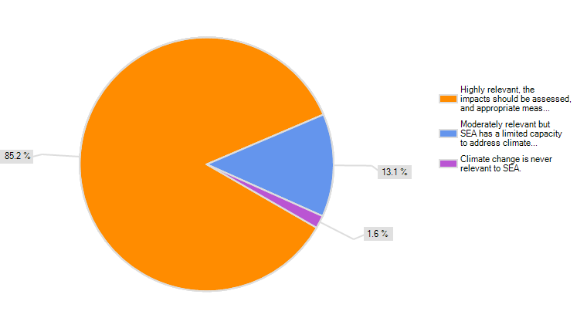
Relevance of CC to EIA
Project EIA
SEA

Slide 4
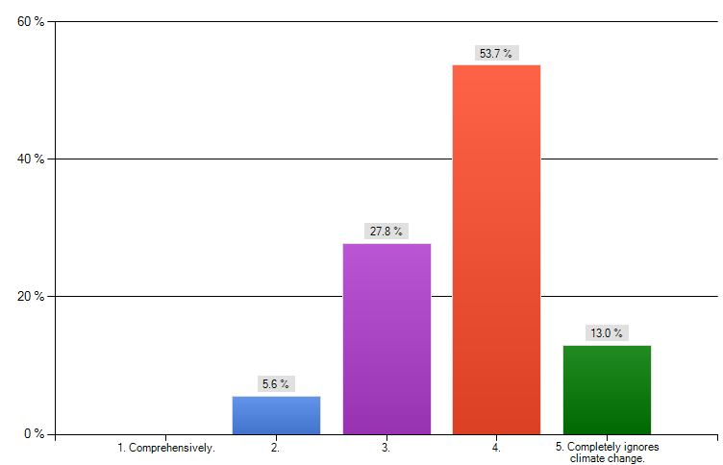
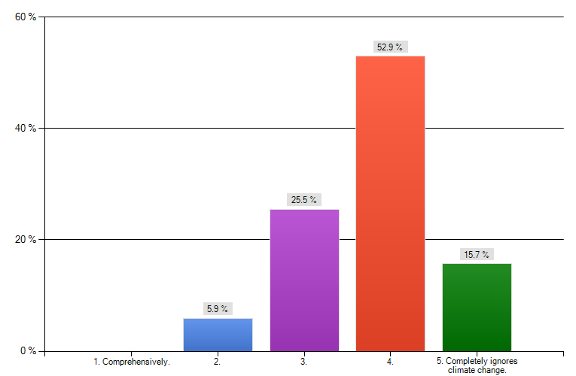
Degree to which EIA dealt with CC mitigation
Project EIA
SEA

Slide 5
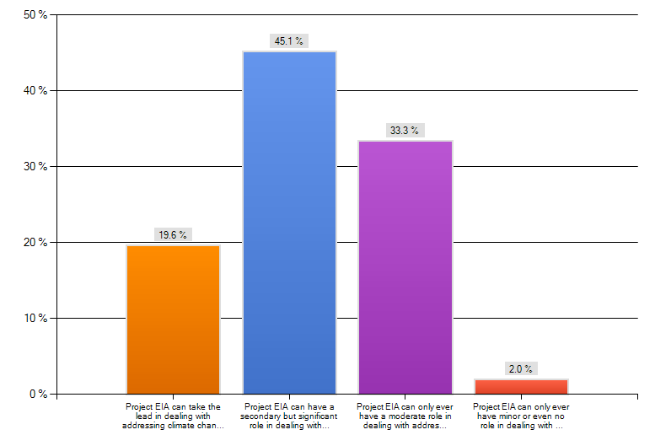
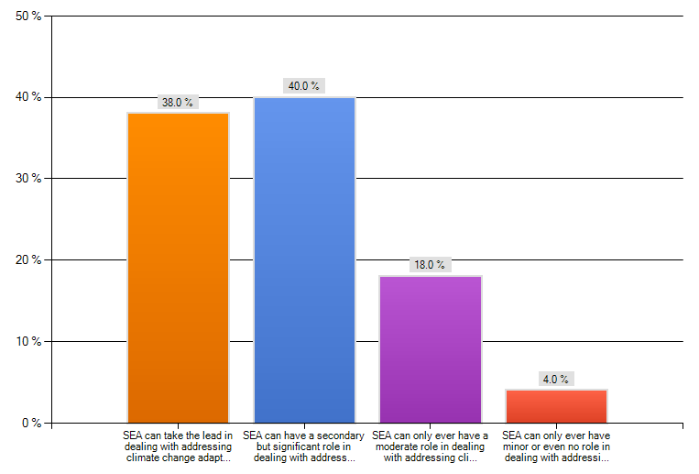
Capacity EIA dealt with CC adaptation
Project EIA
SEA

Slide 6
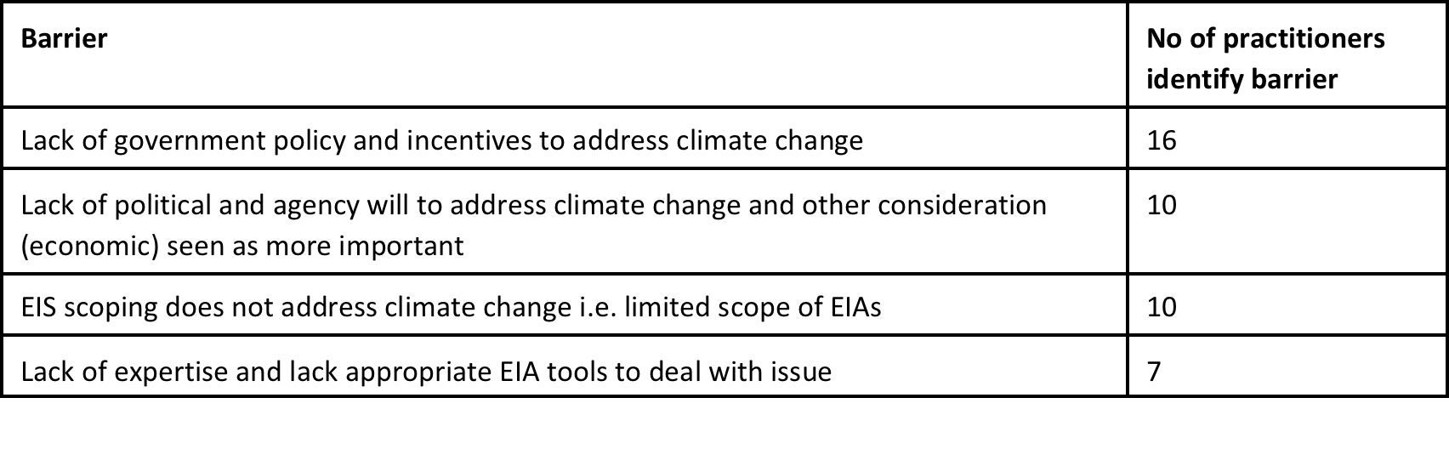
Main barriers to project EIA being able to address climate change

Slide 7
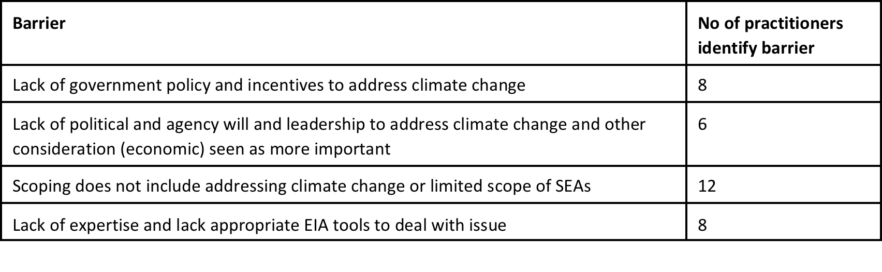
Main barriers to SEA being able to address climate change

Slide 8
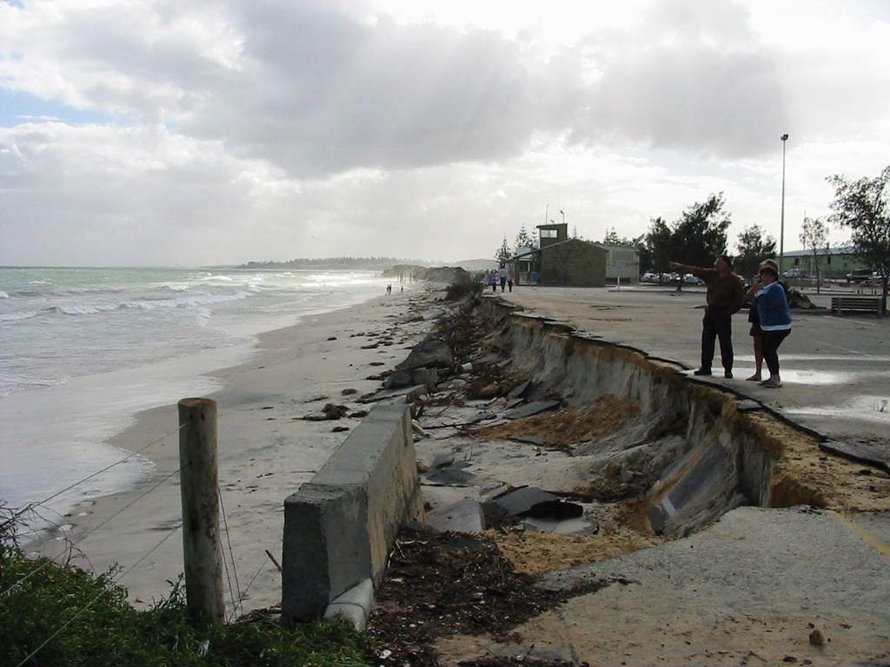
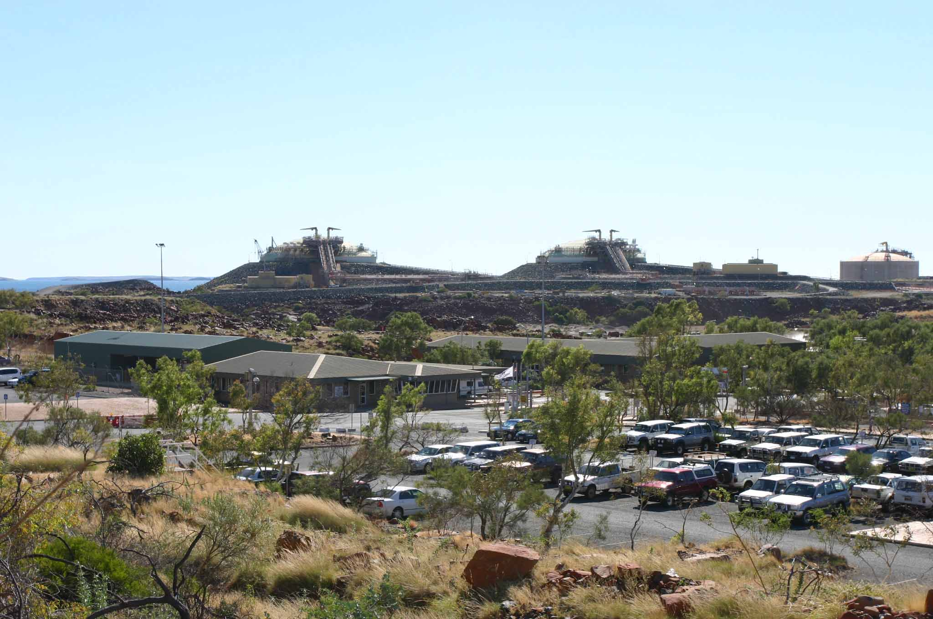
Case study: Effectives of the WA EIA process in addressing EIA
EIAs between 2000 and 2011
45 non-urban proposals that had climate change raised as part of the assessment
24 EIAs of urban or tourist proposals either on or near the coast or were inland and subject to storm surge (flooding)

Slide 9
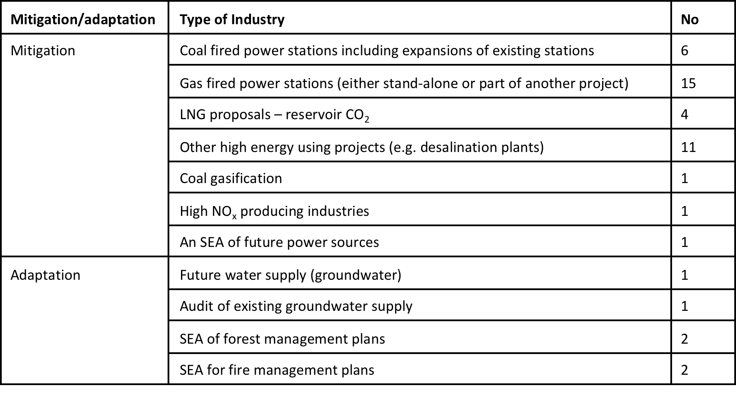
Non-urban

Slide 10
Non urban - mitigation
The strongest responses – 2 desalination plants (a government agency)
offset some emissions by wind power.
1 LNG plant required to implement carbon capture and storage for the reservoir CO₂
Another LNG plant to biologically offset the reservoir CO₂.
Others the EPA assessment was less stringent.

Slide 11
Non urban - adaptation
EPA noted that the climate was changing and that this needed to be more prominent in future planning
Increased monitoring of the impacts and implement adaptive management (not specified) in response to changes
IN SUMMARY – mixed on mitigation and weak on adaptation

Slide 12
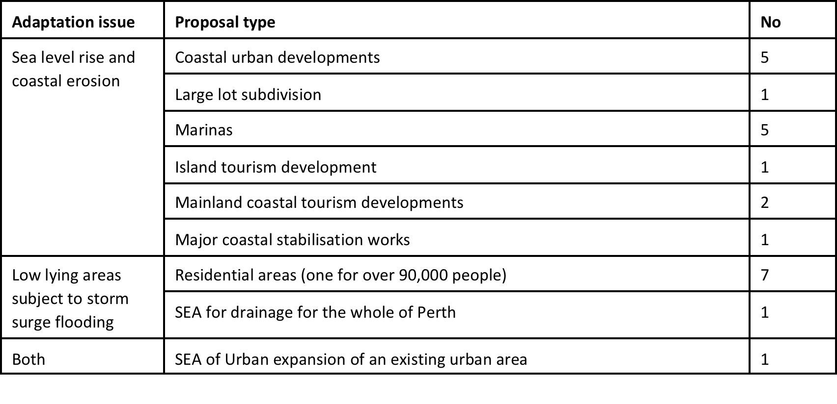
Urban – adaptation is an issue

Slide 13
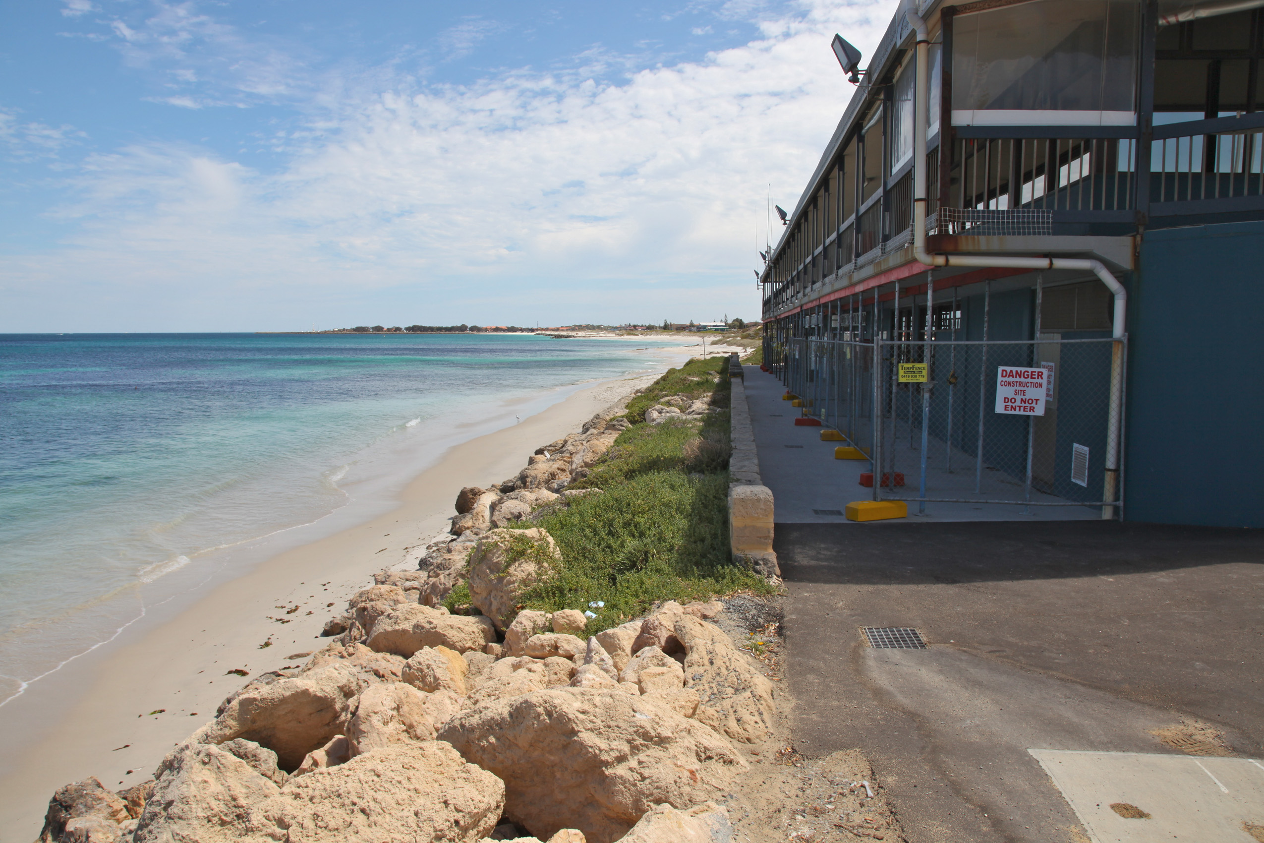
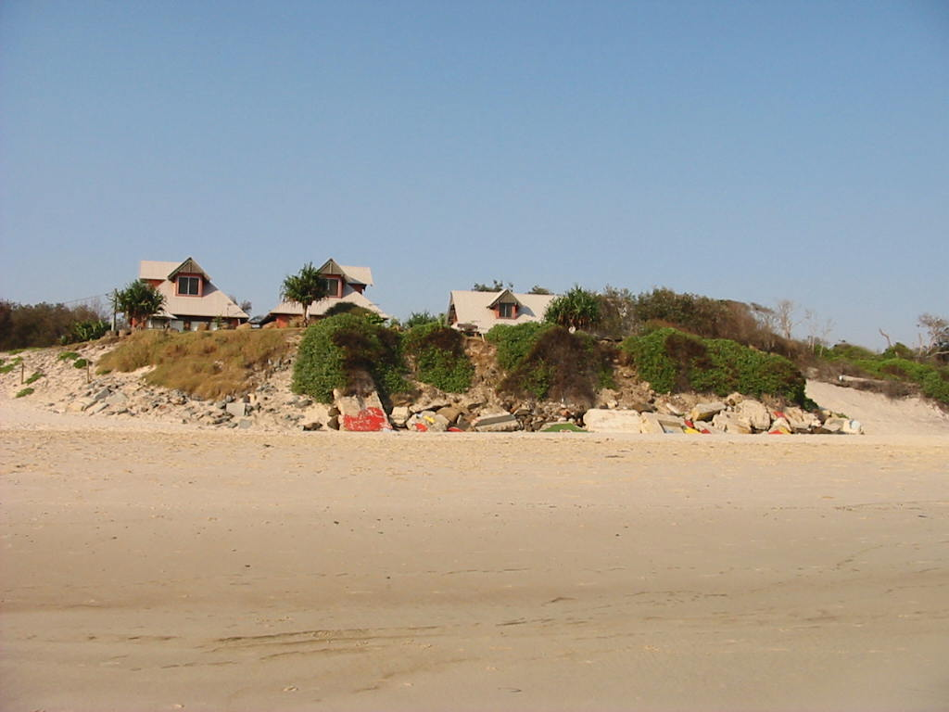

Slide 14
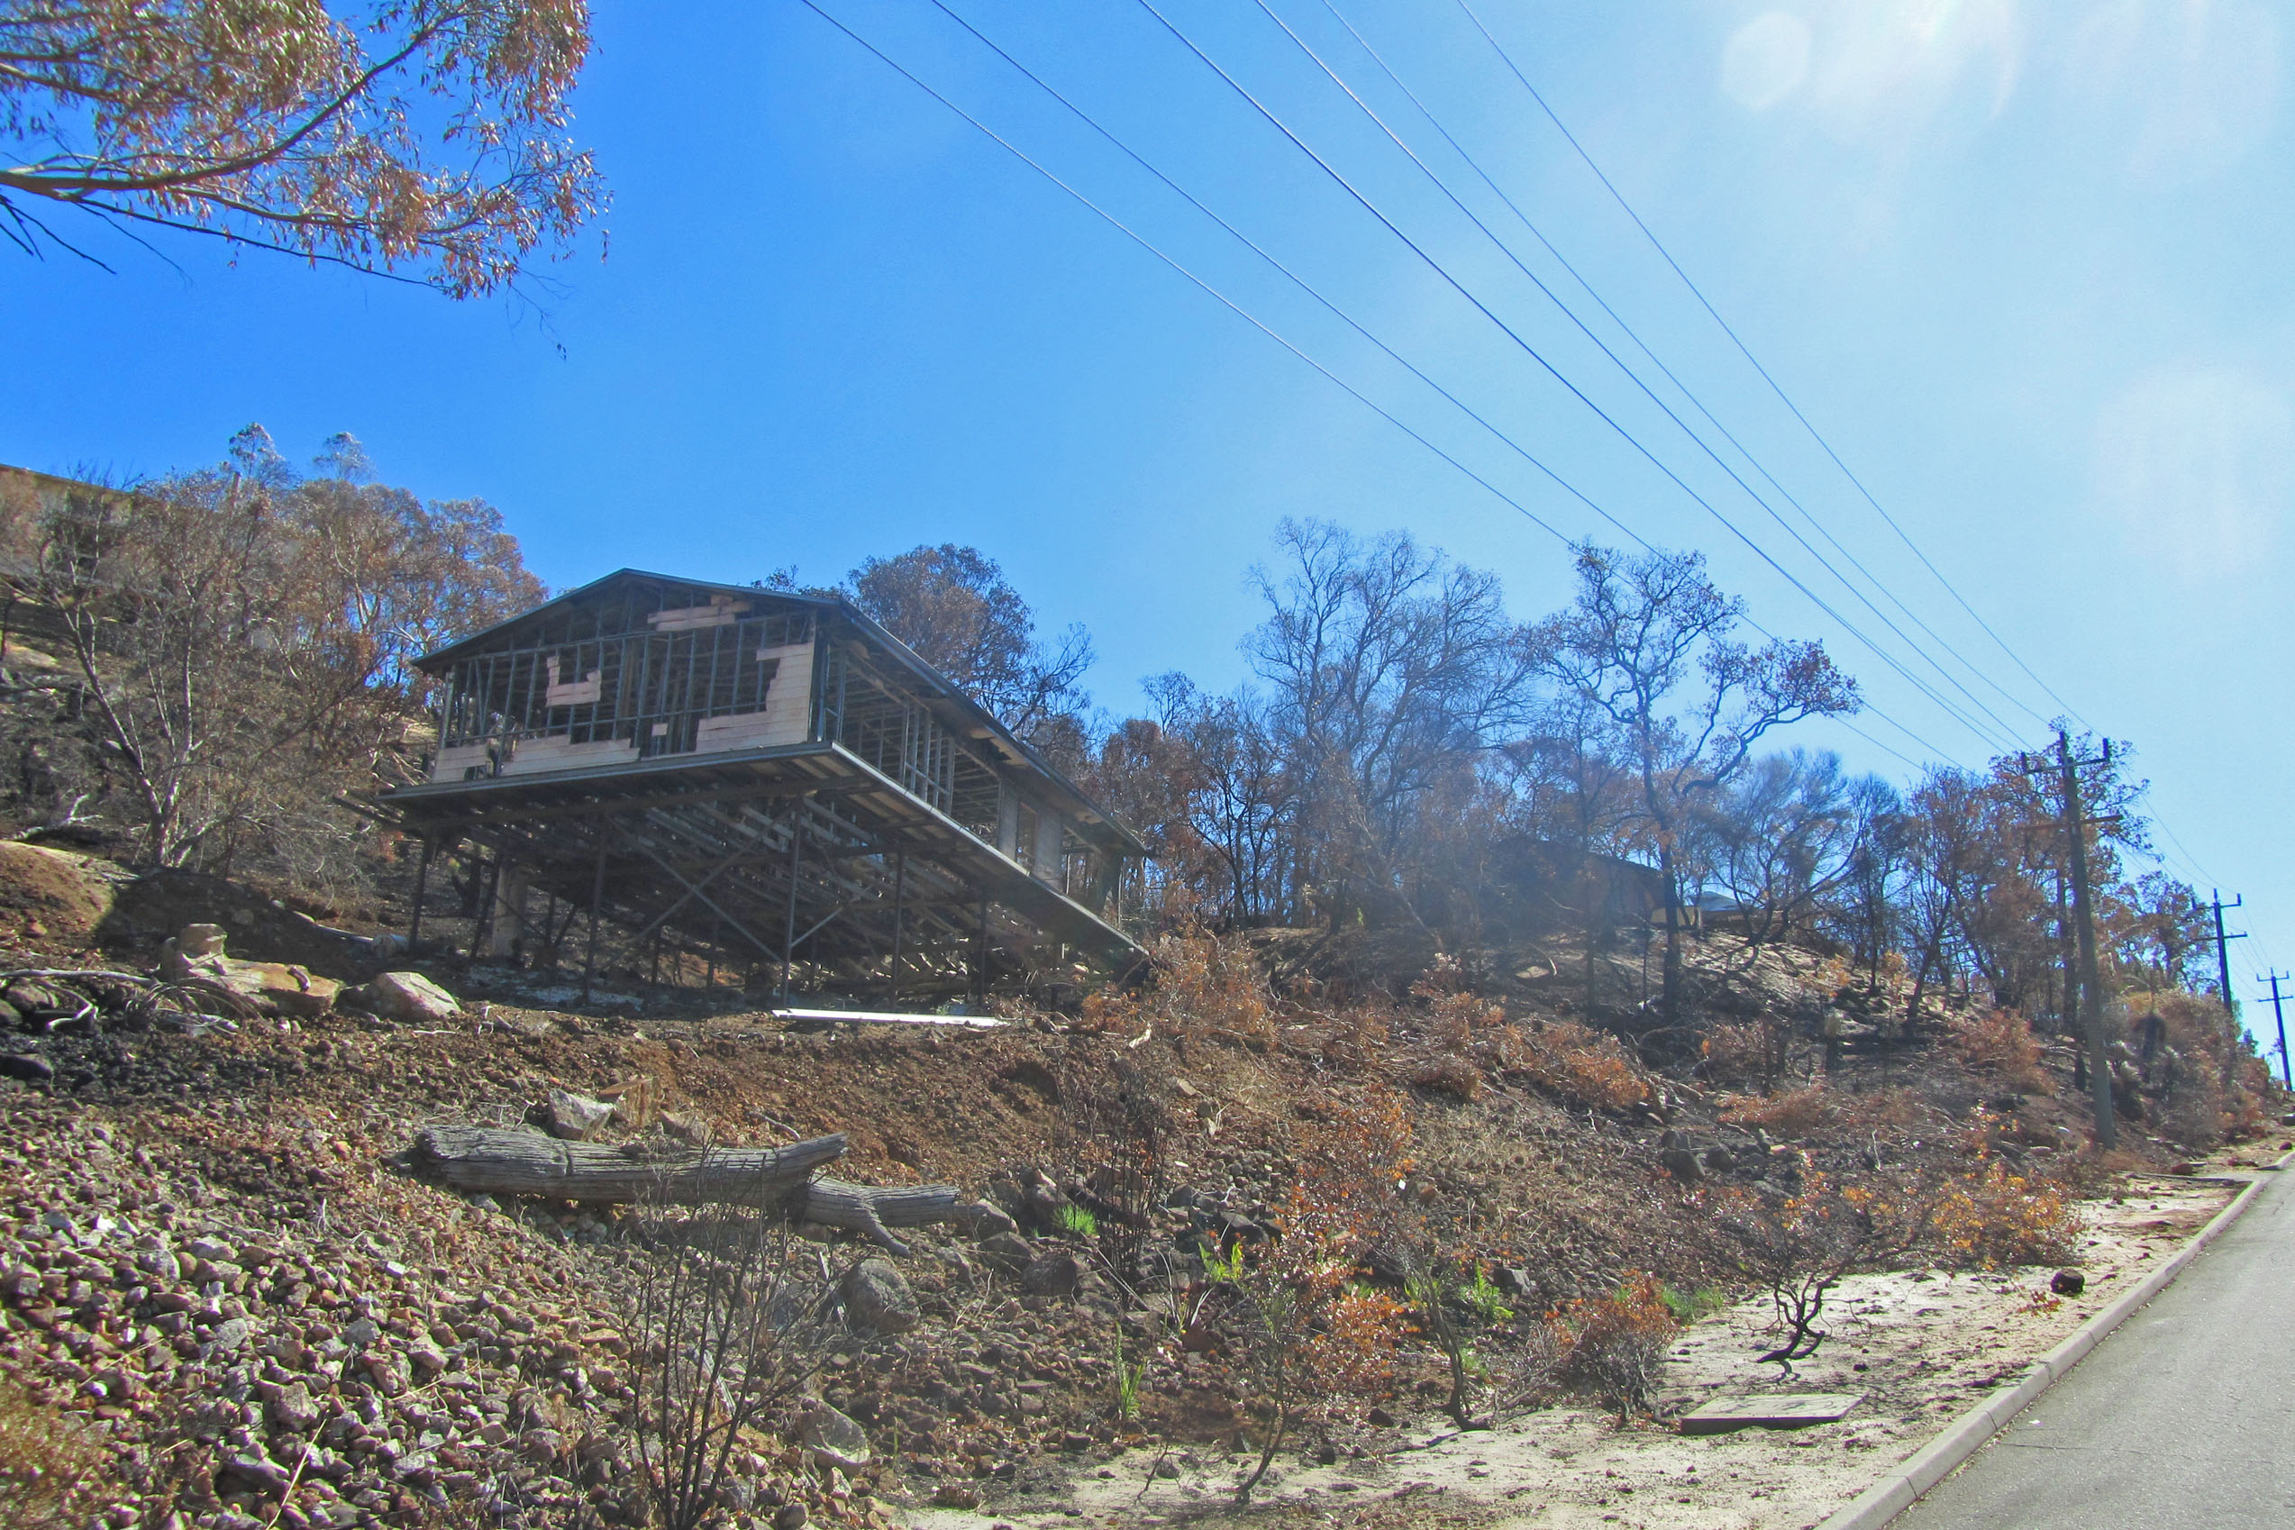
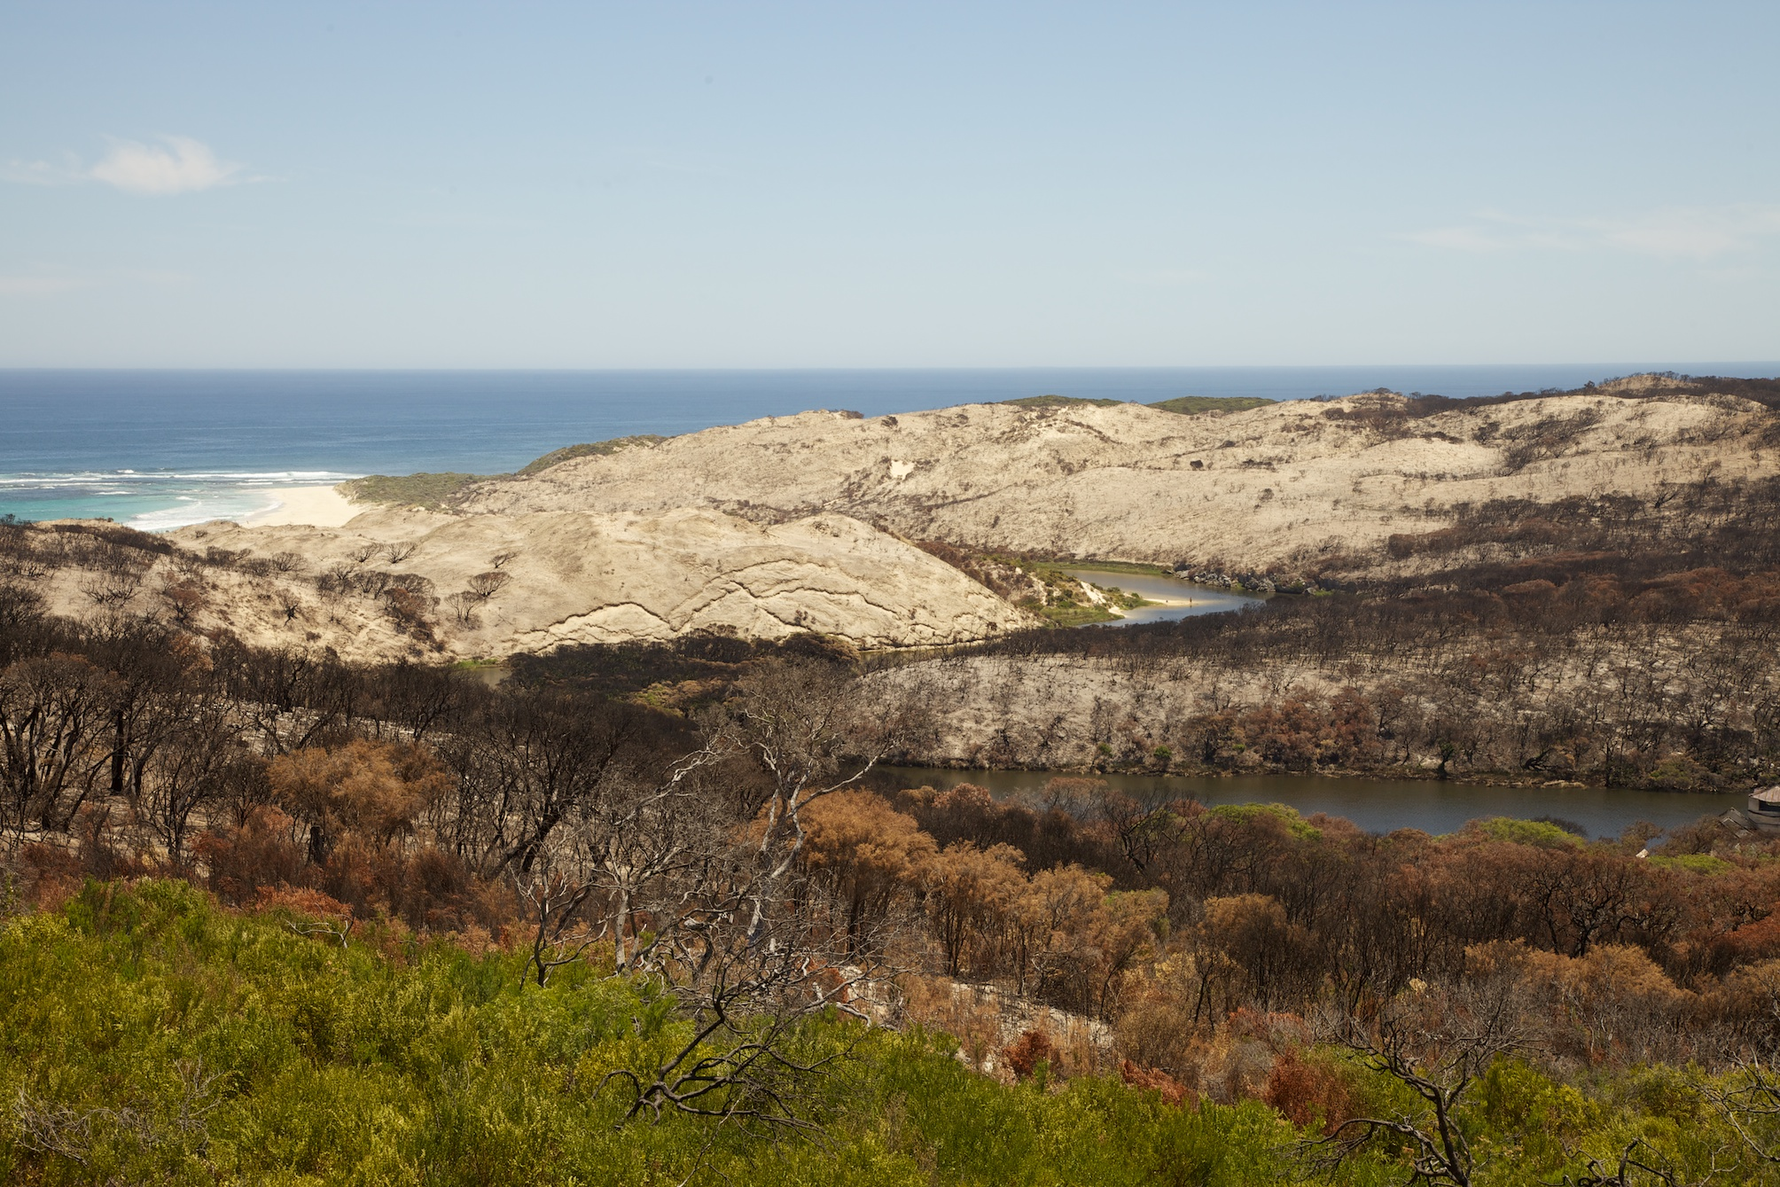

Slide 15
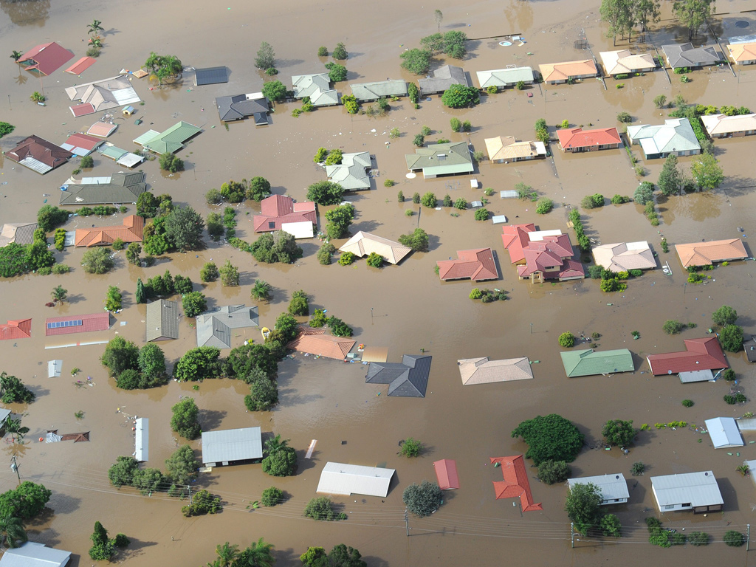
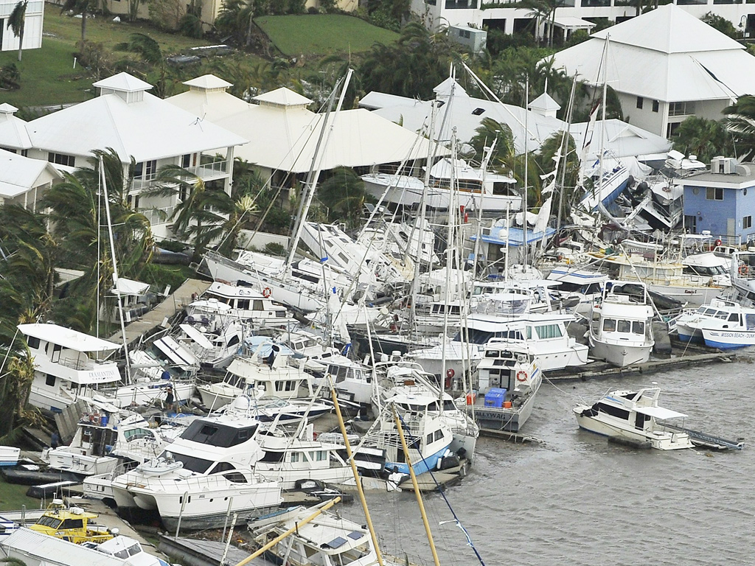

Slide 16
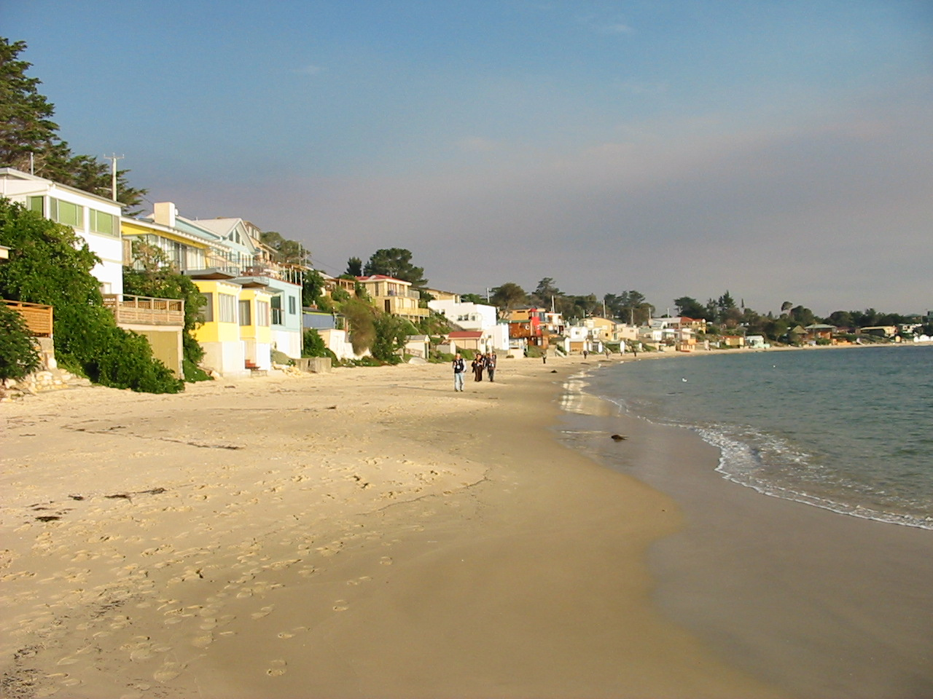
Assessments
Climate change adaptation not mentioned;
Impact of environment on people not an environmental factor?

Slide 17
Conclusions
EIA has capacity to deal with CC
SEA more than project EIA
EIA under performing
Case study backs up survey
Key barriers –
lack of policy framework
Lack of will – political and agency (less so)

