Slide 1
HIA of oil and gas projects: cumulative impacts
Martin Birley
Salim Vohra
Balsam Ahmad

Slide 2
Content
Objections
Role of IA
Water scarcity and waterborne diseases
Climate change and general morbidity

Slide 3
Objections to advertised paper
Too specific
Excess secrecy
Too general

Slide 4
Role of impact assessment?
Complicity with client
Complacency about impacts
Challenge to client groupthink

Slide 5
Cumulative impacts and policy
Cumulative impacts
Policy/strategy vacuum

Slide 6
Water scarcity
Oil fields
river
villages
irrigation

Slide 7
Reducing domestic water supply
Increasing waterborne diseases
Increasing cost of water
Poverty
Inequality

Slide 8
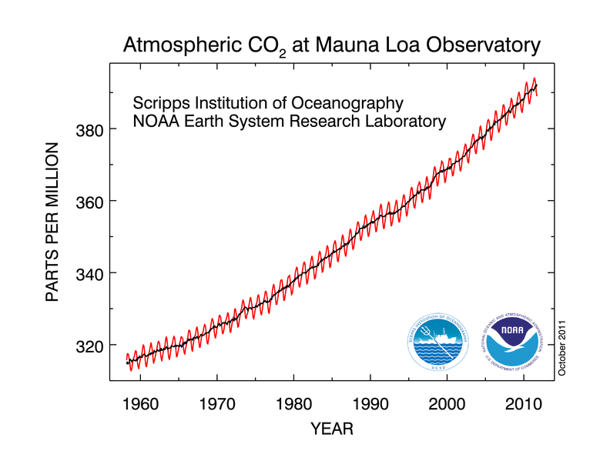
Climate change
Global cumulative impact
>150,000 annual deaths globally
Within lifetime of new projects
Denial
Urgent
Oct 2011
Safe

Slide 9
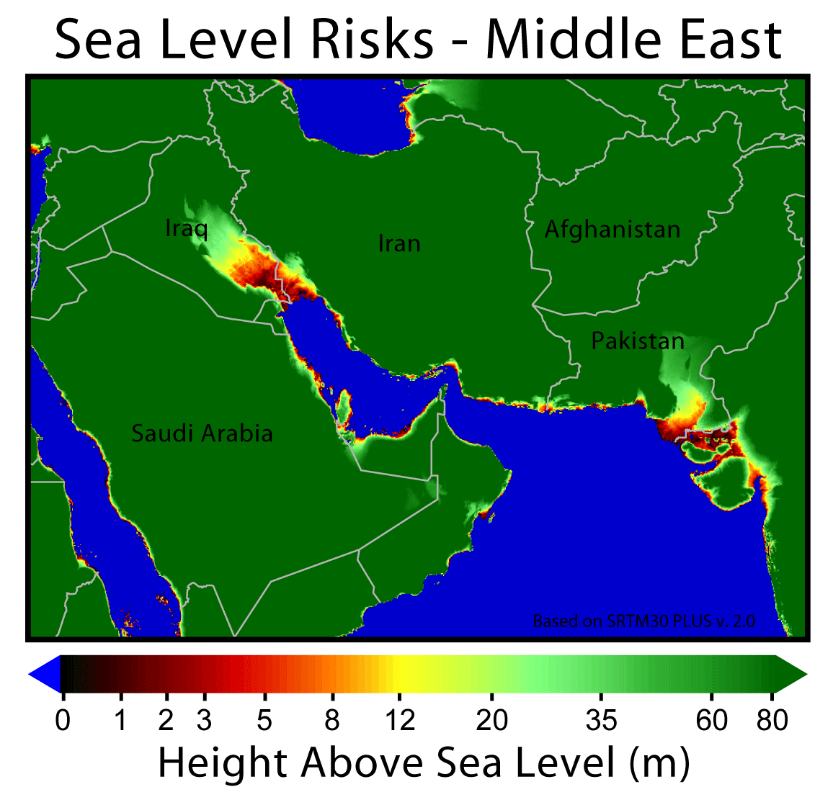
National climate change impacts vary – Middle East example
Increasing water scarcity
Temperature extremes
Reduced food supply
Sea flooding

Slide 10
Corporate climate change policies
Acknowledge issue?
Propose mitigation?
Monitor and report?
Independent evaluation?

Slide 11
Conclusions
Excessive secrecy
Challenge v complicity
Cumulative impacts poorly managed/ policy vacuum
Water management
Climate change management
Denial, urgency, acknowledgement, delivery

Slide 12
End

