Slide 1
Sustainable Portugal
Impact Assessment for Sustainable Development
C. P. Wolf
Social Impact Assessment Center
New York City

Slide 2
Overview+
“What Time Is This Place?”
The Portuguese Connection
Questioning Sustainability
Sustainable Societies
Sustainable Portugal
Impact Assessment for Sustainable Development
“Assessing Korea”
Towards a Desirable Future

Slide 3
“What Time Is This Place?”
The Sense of the Question
2010 International Year of Sustainable Energy for All
Rio+20 UN Conference on Sustainable Development
Rio+10 World Summit on Sustainable Development
- 10th Anniversary of KSEIA
Rio-20 UN Conference on the Human Environment

Slide 4
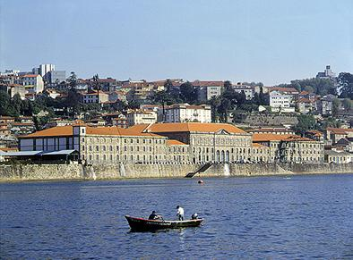

Slide 5
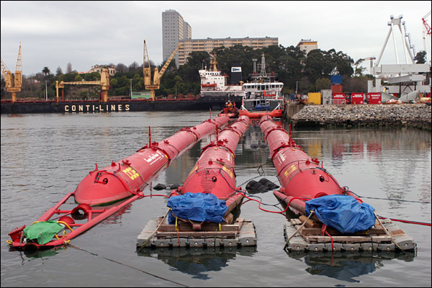
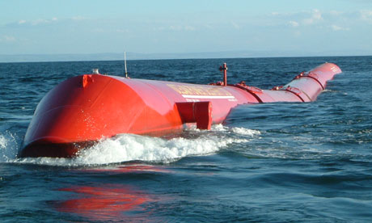
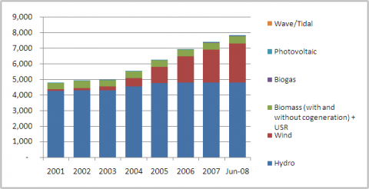
Portuguese Renewable Energy:
Policies & Facilities

Slide 7
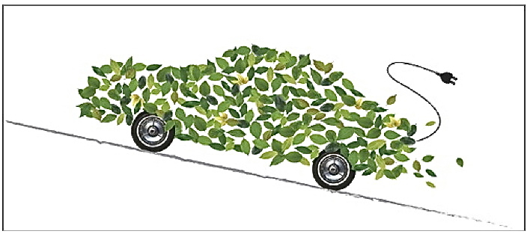
“Green Growth”

Slide 8
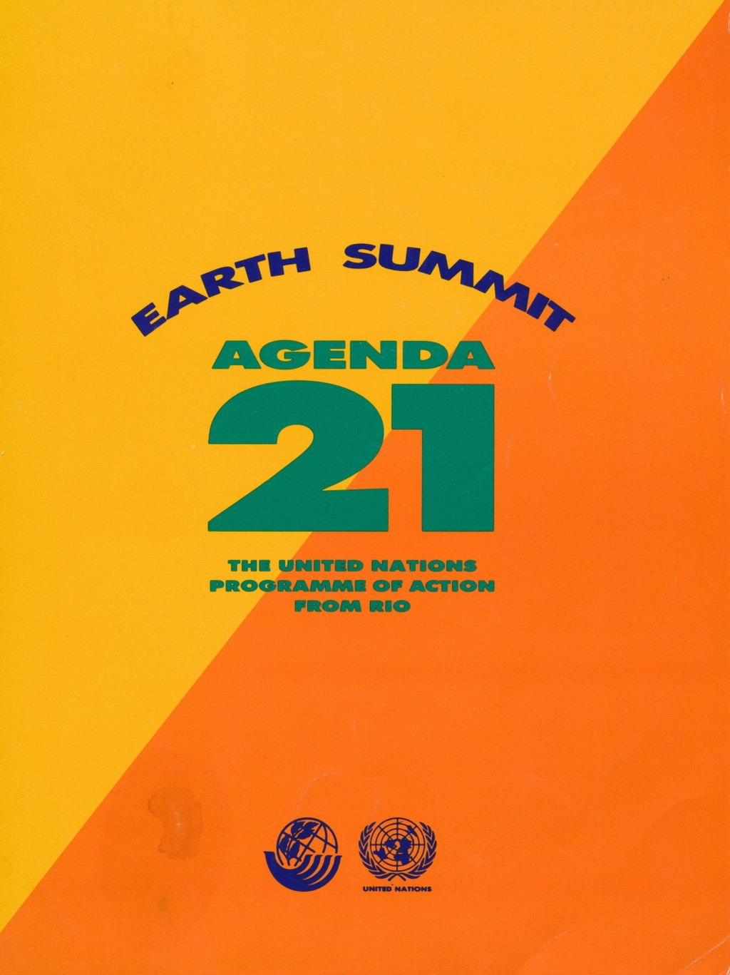
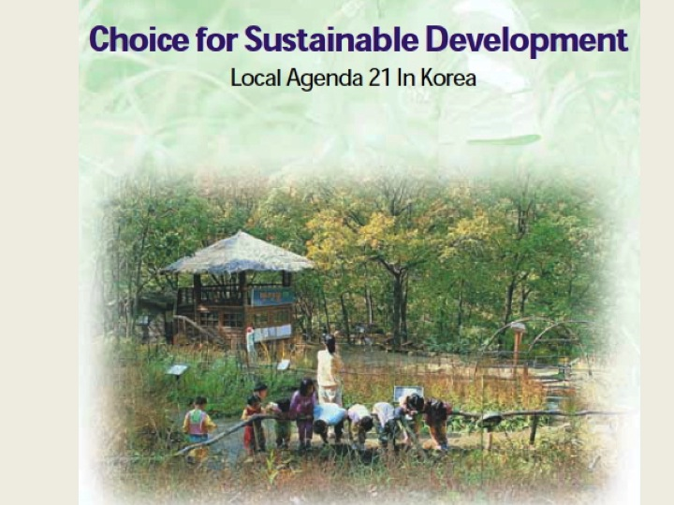

Slide 9
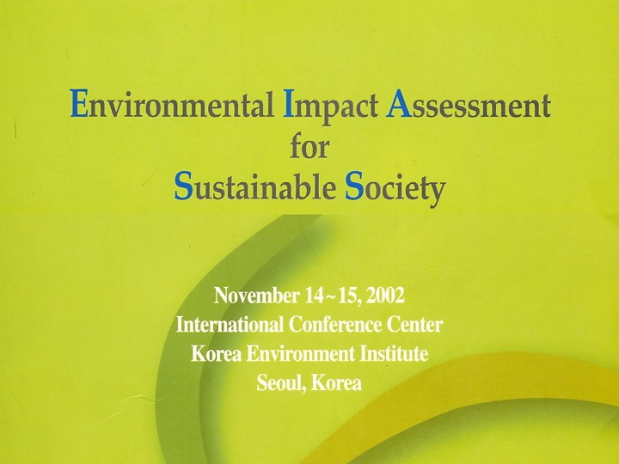

Slide 10
The Portuguese Connection
Impact History
- The Age of Exploration
Impact Tourism
- The Douro Valley
Foz Tua Dam
Impact Assessment
- The “Euro Crisis”

Slide 11
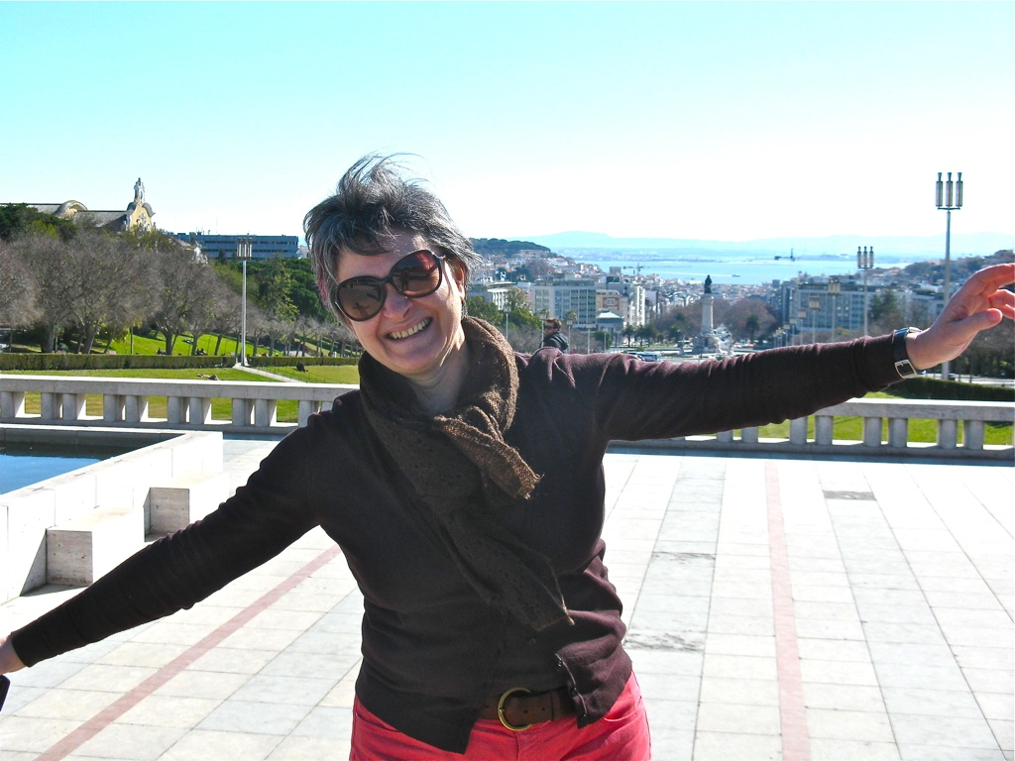
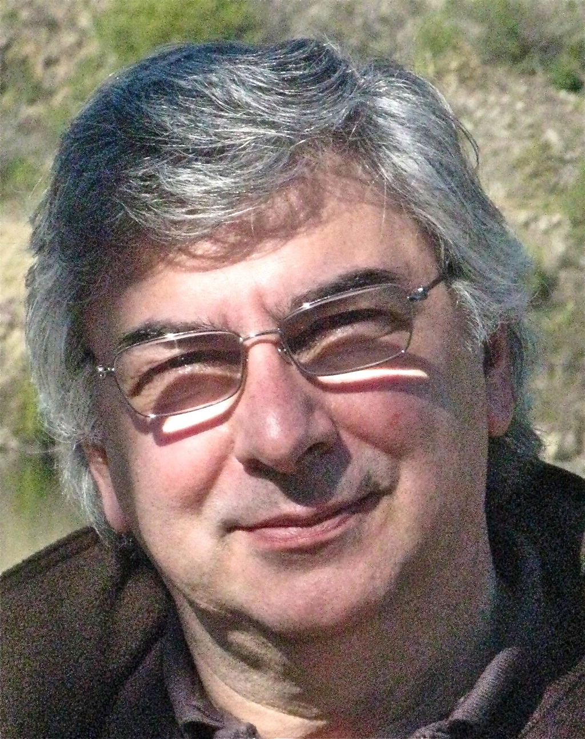

Slide 12
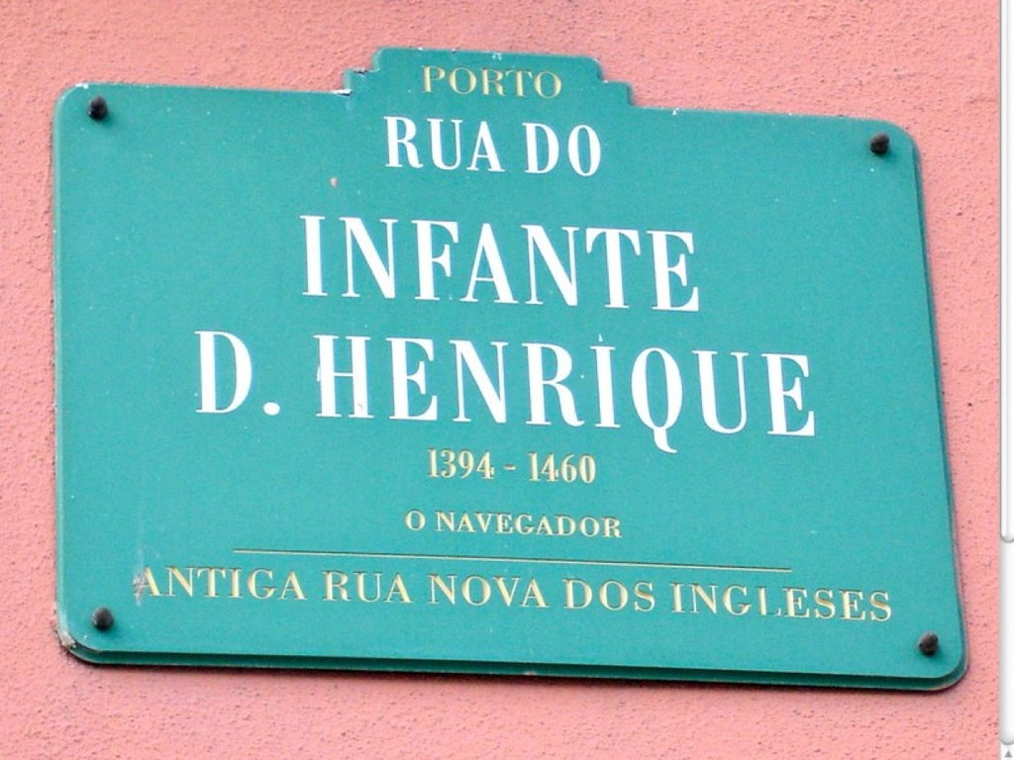
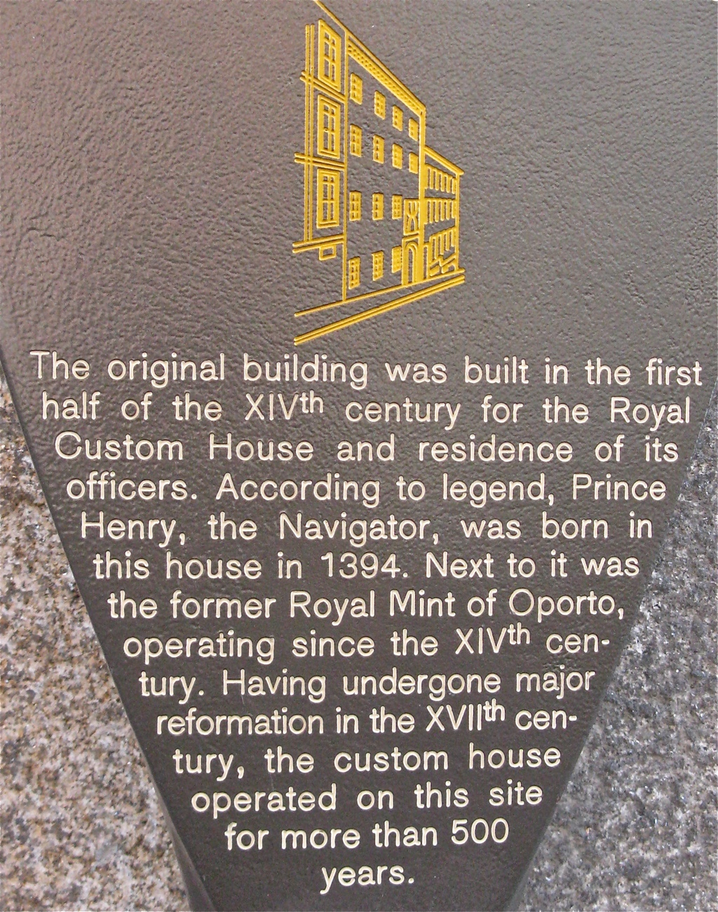
Impact History

Slide 13
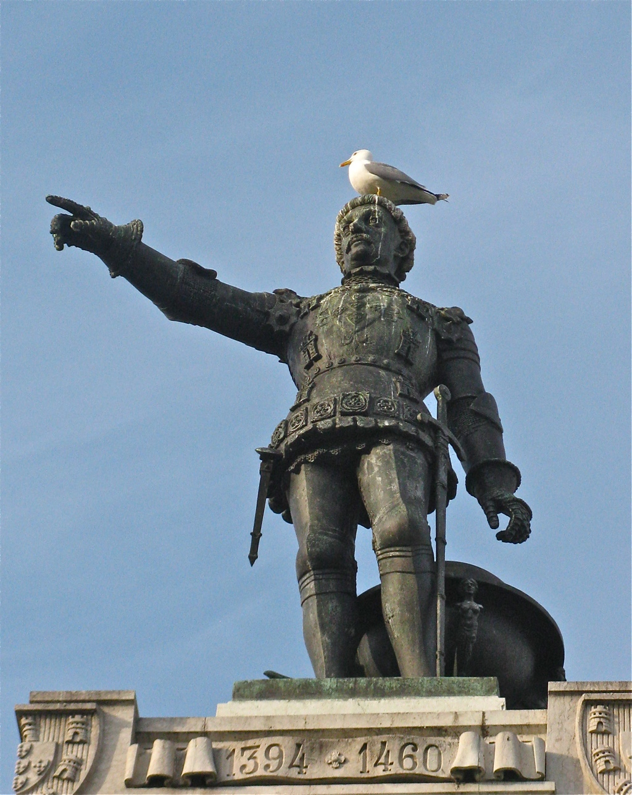
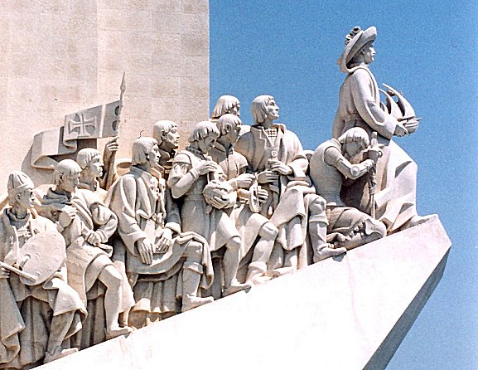
Prince Henry the Navigator

Slide 14
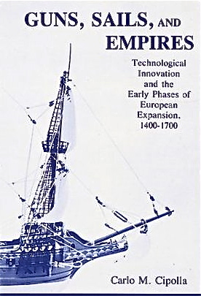
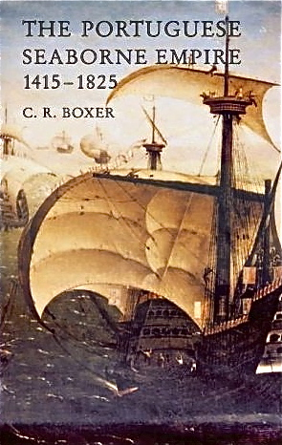

Slide 15
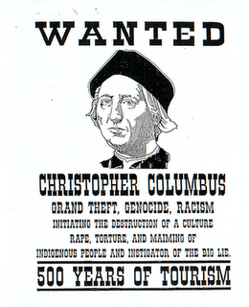

Slide 16
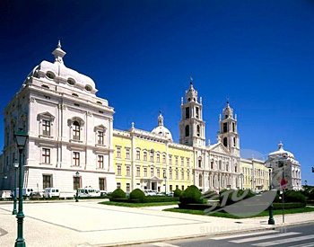
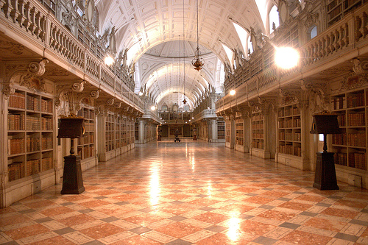
Mafra Place
Library

Slide 17
Impact Tourism

Slide 18
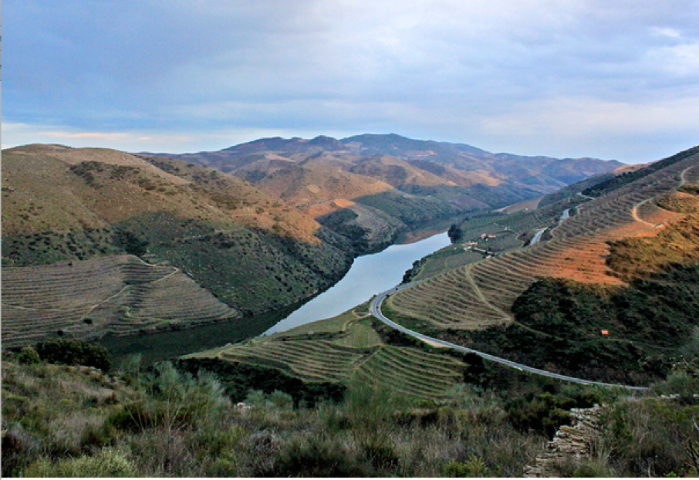
Alto Douro Wine Region

Slide 19
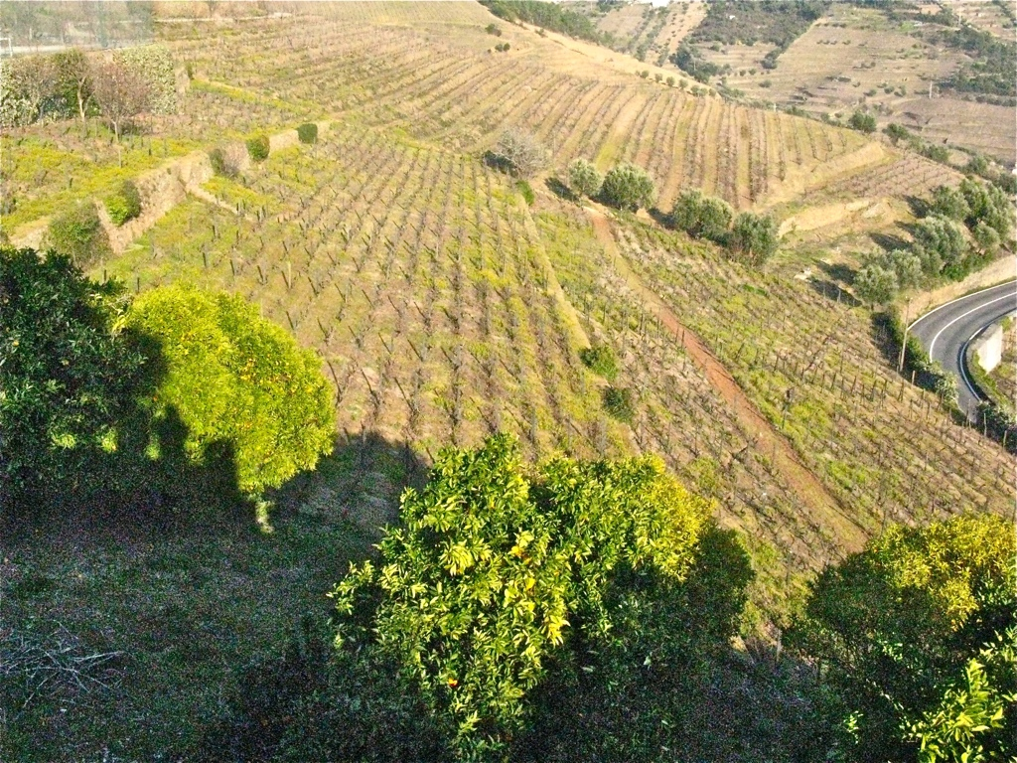

Slide 20
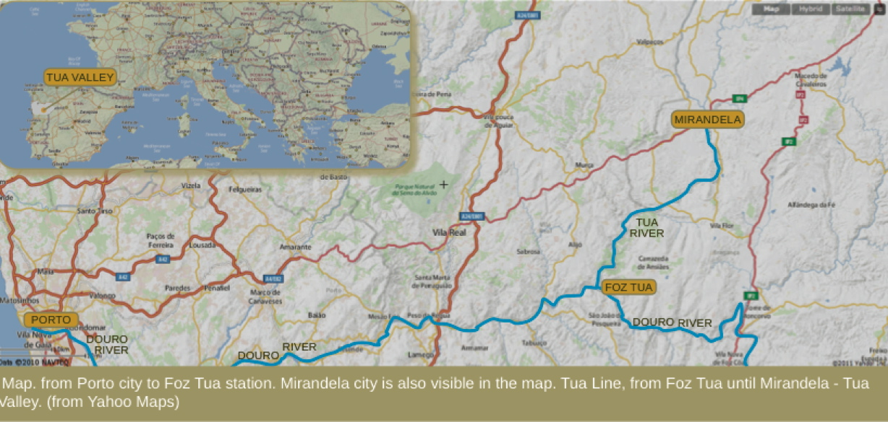
Tua Valley

Slide 21
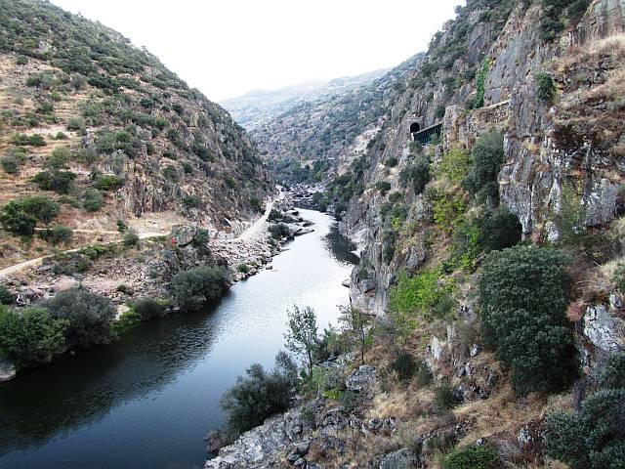
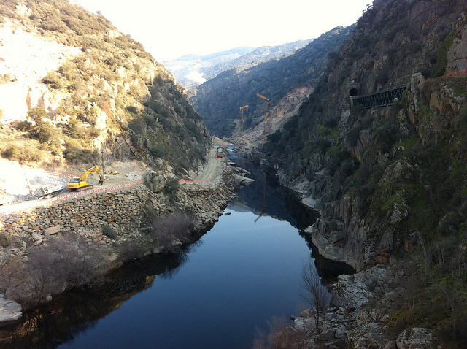
Foz Tua Dam Site

Slide 22
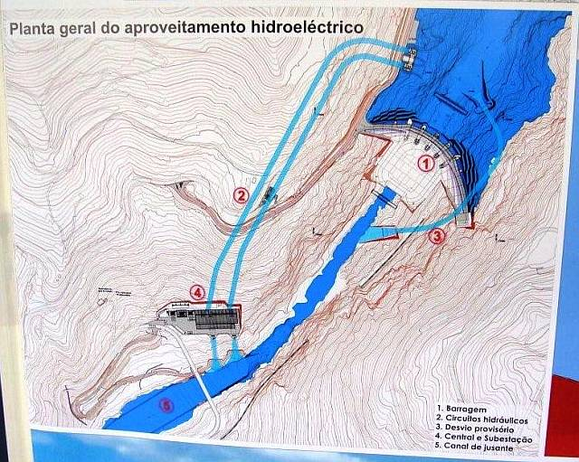

Slide 24
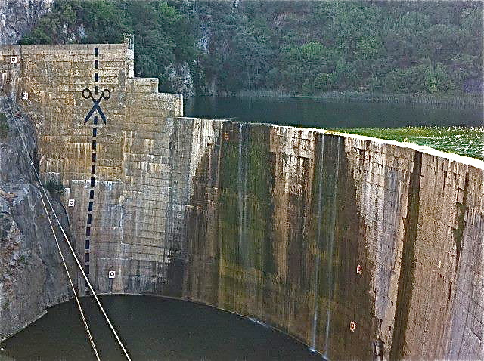

Slide 25
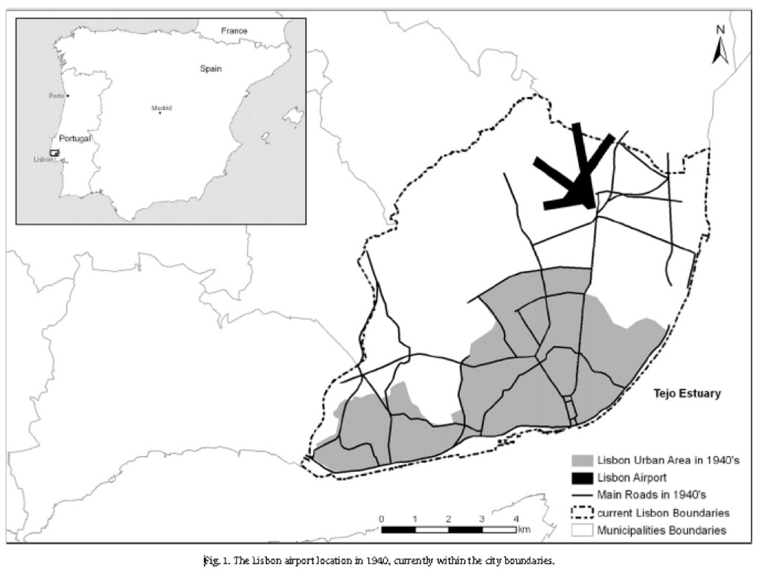
Impact Assessment

Slide 26
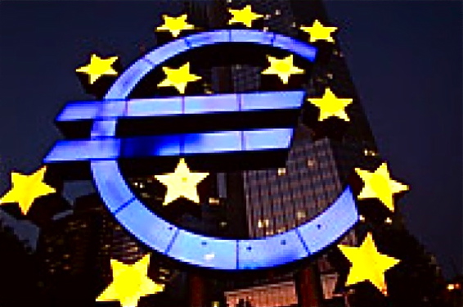
The “Euro Crisis”

Slide 27
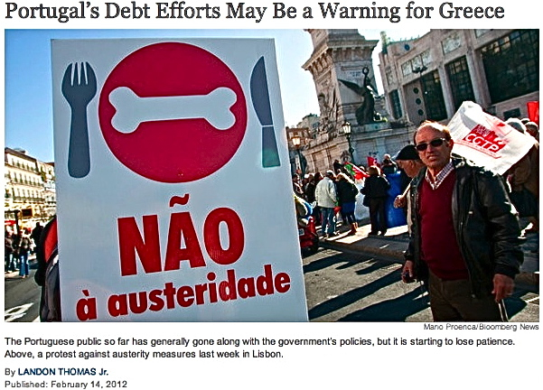

Slide 28
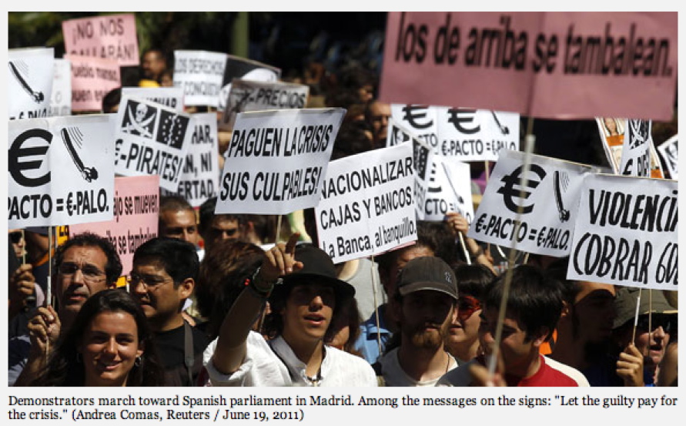

Slide 29
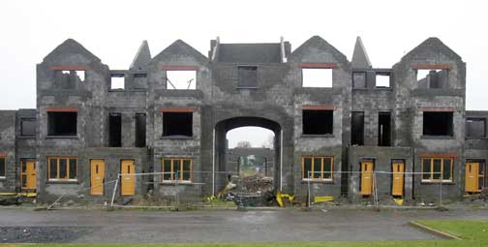
“Ghost Estates” (Ireland)

Slide 30
Questioning Sustainability
Sustain What?
- Dimensions of Sustainability
- Sustainability Levels, Scales
Sustain for What?
- Value Commitments
- Physical Necessity
Sustain for Whom?
- Future Generations
- Developed and Developing Countries

Slide 31
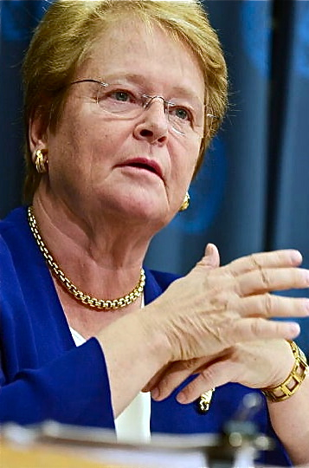
World Commission on Environment and Development
“Sustainable development is development that meets the needs of the present without compromising the ability of future generations to meet their own needs …”
Gro Brundtland

Slide 32
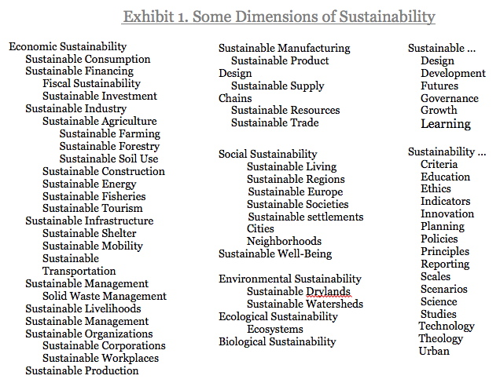

Slide 33
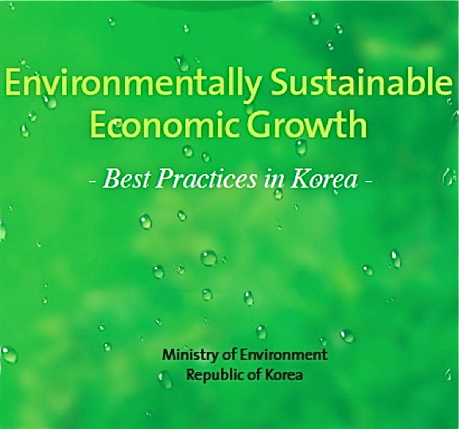

Slide 34
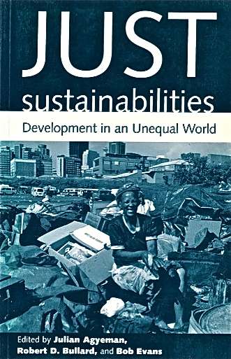
Equitable and Sustainable Development

Slide 35
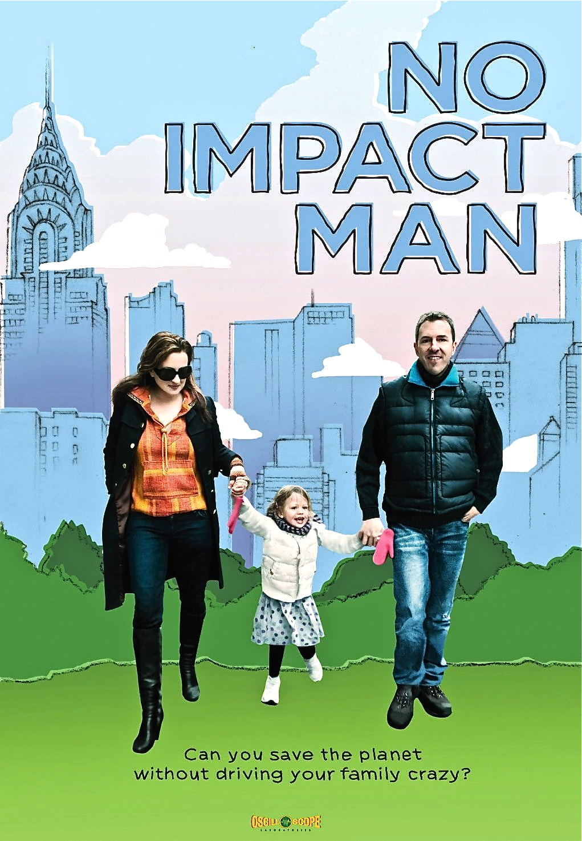

Slide 36
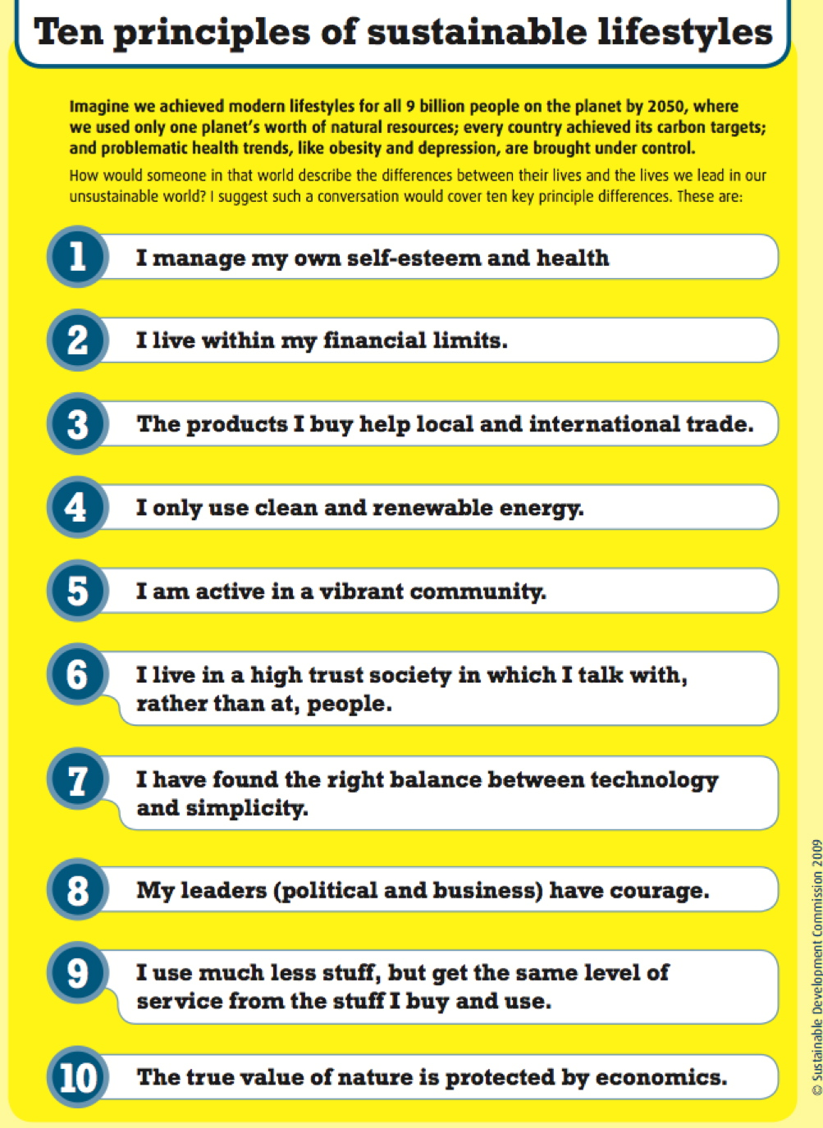

Slide 37
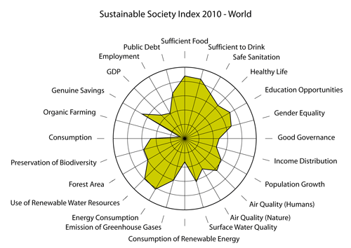

Slide 38
Impact Assessment: Vision/Mission
“Develop local and global capacity to anticipate, plan, and manage the consequences of change so as to enhance the quality of life for all.”

Slide 39
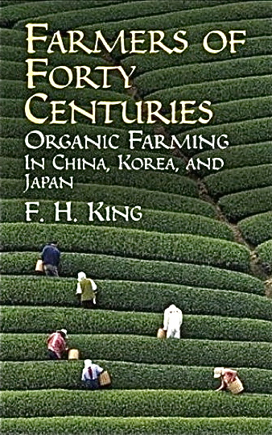

Slide 40
Sustainable Societies
Limits to Growth
- Physical
- Social
Societal Development
- Imagining
- Designing
- Building
“Progressive” & “Stationary States” (Mill)
- Economic and/or Sociocultural

Slide 41
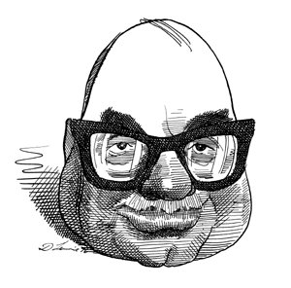
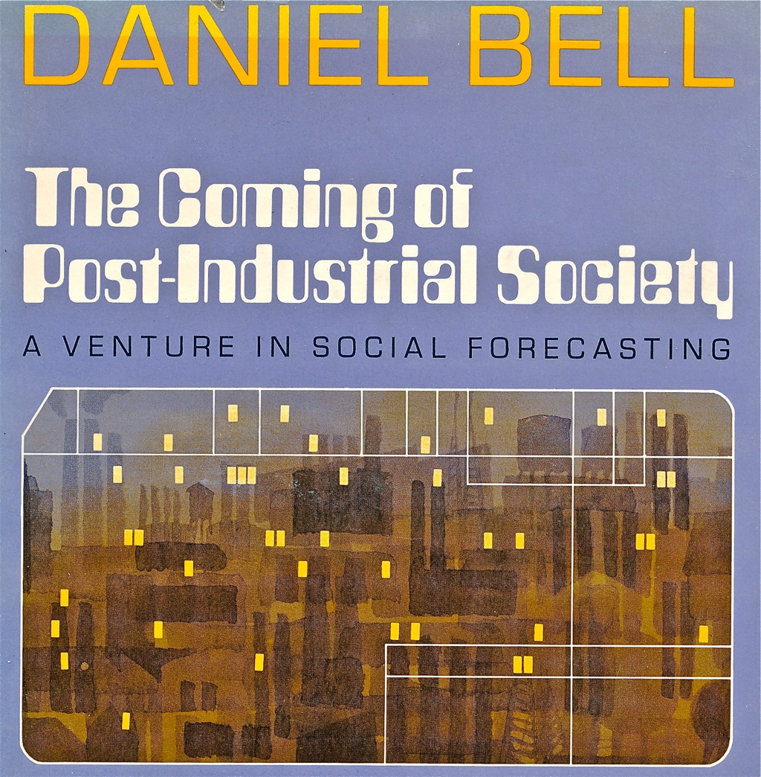

Slide 42
Types of Postindustrial Societies
Information Society
Network Society
Knowledge Society
Cultural Society
Value-Creation Society

Slide 43
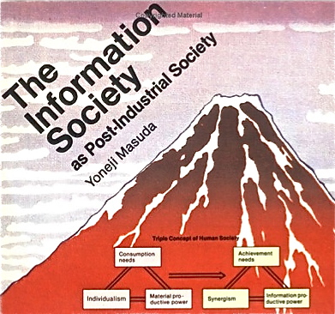
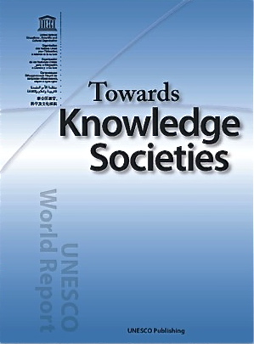

Slide 44
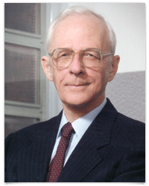
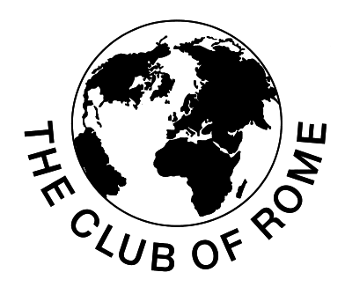
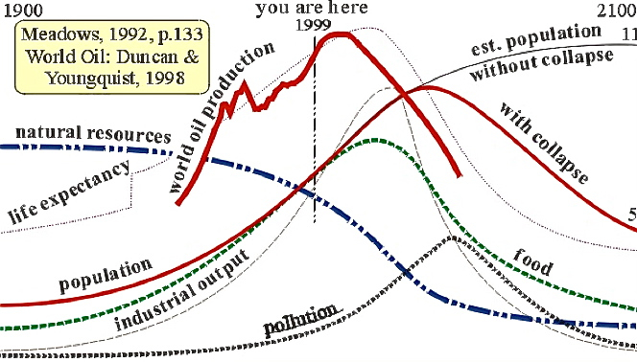
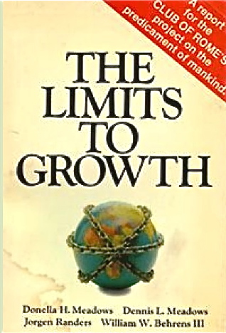
Limits to Growth
Jay Forrester

Slide 45
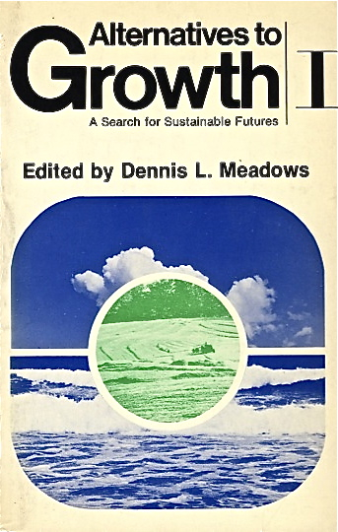

Slide 47
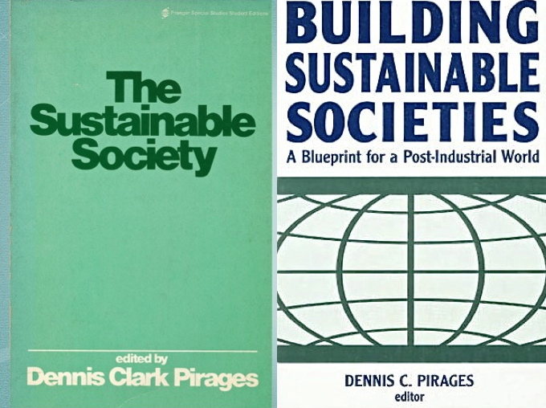

Slide 48
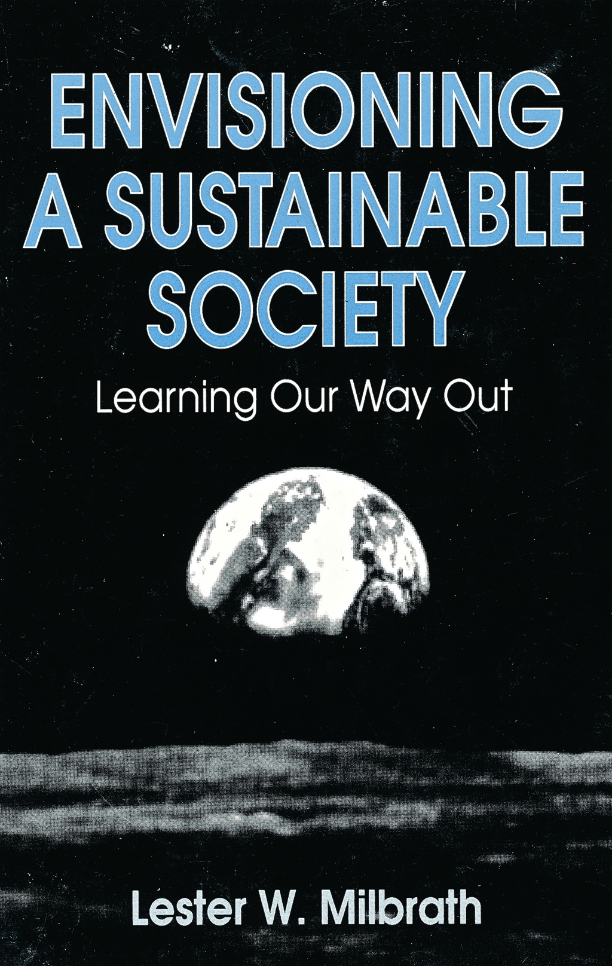

Slide 53
Sustainable Portugal
A Modest Proposal
“Pillars” of Sustainable Development
The Lisbon Strategy
- Europe 2020
The Bilbao Effect

Slide 54
Portuguese National Sustainability Strategy

Slide 56
Soci

Slide 59
The Bilbao Effect

Slide 60
Casa do Musica
Invest in art for our future.

Slide 61
Impact Assessment for Sustainable Development
Sustainability Transitions
- Sectoral
- Adaptation and Social Learning
- Indicators
- Alternative Pathways
Enter Impact Assessment
- Sustainable Development and Sustainability Assessment
- Assessment Effectiveness(?)

Slide 64
The IPAT Model
I = PAT
Impact = Population x Affluence x Technology
Population = number of people
Affluence = per capita consumption
Technology = environmental damage from consumption
Source: P. R. Erhlich and J. R. Holdren, “Impact of Population Growth,” Science, 171 (1974), 1212-17.

Slide 66
“Sustainable development is the core goal of the expanding field of sustainability assessment.”
Bond and Morrison -Saunders 2008

Slide 67
“Assessing Korea”
Substantive Focus
- Sectoral, Regional, Topical
- Cultural, Institutional, Behavioral
Methodological Approach
- Impact Assessment
Applications

Slide 68
Sustainable Development National Strategy (Korea)

Slide 69
Exhibit 4
Assessing Korea
Impact Assessment for Sustainable Development
Draft Table of Contents 3.7
Part 1. Assessing Korea
1. Impact Assessment
2. Sustainable Development
3. The Korean Connection
PART 2. The Korean Economy
4. The “Miracle on the Han”
5. Regional and Community Development
6. Globalization and Development
7. Knowledge Economy and Society
PART 3. The Korean Society
8. The State of Society
9. Korean Political Development
10. Korean Social Development
11. Korean Cultural Development
PART 4. The Korean Environment
12. The State of the Environment
13. Environmental Resources and Risks
14. Water Resources
15. Future Environments
PART 5. THE FUTURE OF KOREAN SOCIETY
16. Unification?
17. Alternative Futures
18. Sustainable Korea?
19. The Future of Impact Assessment
20. Hindsight, Foresight, and Presence

Slide 70
Exhibit 5. Draft Analytic Outline Level 3 Detail
Chapter 6. Globalization and Development
Globalization
1. Regional Cooperation
2. International Migration
3. International Development
2. International Trade
1. Efficiency and Equity
2. The WTO Model
3. Free Trade Agreements
3. Greening the Economy
1. The Green New Deal
2. Green Technologies and Industries
3. Eco-efficiency
Chapter 7. The Knowledge Economy
Science, Technology, and Society
1. Infrastructure
2. Education
3. Innovation
2. The Information Age
1. The IT Revolution
2. The Wired Society
3. The Network Society
3. The Learning Society
1. The Information Society
2. The Knowledge Society
3. The Wisdom Society

Slide 71
Exhibit 6. Impact Assessment Applications
Part 1. Assessing Korea
1. Impact Assessment
2. Sustainable Development Sustainability Assessment
3. The Korean Connection
PART 2. The Korean Economy
4. The “Miracle on the Han” Economic Impact Assessment
Development IA
5. Regional and Community Development Regional Assessment
Community Impact Assessment
Urban Impact Assessment
6. Globalization and Development Trade Impact Assessment
7. Knowledge Economy and Society Technology Assessment
Knowledge Assessment
PART 3. The Korean Society
8. The State of Society Societal Assessment
9. Korean Political Development SEA
Regulatory Impact Assessment
10. Korean Social Development Demographic IA
Social Impact Assessment
11. Korean Cultural Development Cultural Impact Assessment
PART 4. The Korean Environment
12. The State of the Environment EIA
13. Environmental Resources and Risks Resource Assessment
Ecological Risk Assessment
14. Water Resources Water Resources Assessment
15. Future Environments
PART 5. THE FUTURE OF KOREAN SOCIETY
16. Unification? Conflict Assessment
17. Alternative Futures
18. Sustainable Korea? Sustainability Assessment
19. The Future of Impact Assessment
20. Hindsight, Foresight, and Presence Retrospective IA

Slide 72
Toward a Desirable Future
Twenty years ago, there was the Earth Summit. Gathering in Rio de Janeiro, world leaders agreed on an ambitious blueprint for a more secure future. They sought to balance the imperatives of robust economic growth and the needs of a growing population against the ecological necessity to conserve our planet’s most precious resources—land, air and water. And they agreed that the only way to do this was to break with the old economic model and invent a new one. They called it sustainable development.
Global economic growth per capita has combined with a world population (passing 7 billion last year) to put unprecedented stress on fragile ecosystems. We recognize that we can not continue to burn and consume our way to prosperity. Yet we have not embraced the obvious solution — the only possible solution, now as it was 20 years ago: sustainable development.
Secretary-General Ban
“The Future We Want”
The New York Times, 23 May 2012

Slide 73
Obrigado!

Slide 74
Leading Questions
1. How can the conference event serve to advance the interests of our hosts?
2. Sustain/develop what?
3. Sustainability for what?
4. Sustainability for whom?
5. What state of society would we be willing to call "sustainable"? (Or is that the wrong question?)
6. What is distinctive about sustainability assessment principles, procedures, and practices?
7. What has impact assessment to contribute in the transition to sustainable development?
8. "Are Impact Assessment Procedures Actually Promoting Sustainable Development?"
9. What is the evidence of accomplishment? What are the impediments?
10. Should sustainable development be a priority concern for IA/IAIA?

