Slide 1


HIA and Waste Planning in
Wales
Wales Health Impact Assessment
Support Unit
Liz Green
Principal HIA Development Officer

Slide 2
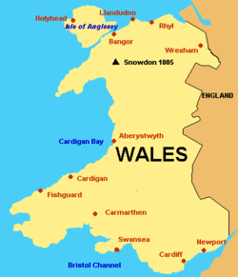
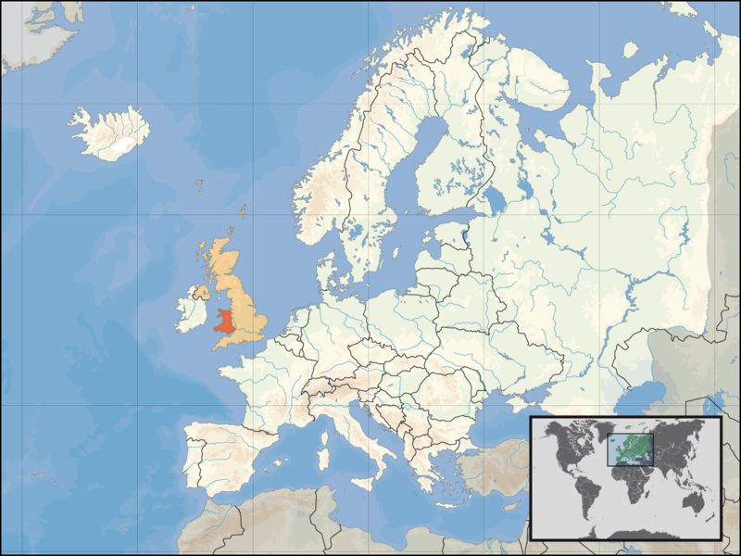
Locating Wales
Notes:
Devolved Nation – responsible for Planning Policy and own Health Policy amongst others
Strong tradition of PH and HIA and HiAP since devolution in 1998.

Slide 3
Health and Planning: Strategic Drivers
Wales: A Better Country (2003)
One Wales: A Progressive Agenda for the Government of Wales (2007)
Making the Connections
Our Healthy Future’ and ‘Fairer Outcomes for All’ – Public Health Strategy for Wales
Consideration of Health in All Policies (HiAP)
SEA/EIA - consideration of ‘human health’ and ‘population health’

Slide 4
Waste Planning - HIA
TAN 21: Technical Advice Note 21(2002)
Part of Planning Policy Wales
Describes the use of HIA in developing national plans and strategies.
Notes:
Broad definition of health and wellbeing – wider determinants of health

Slide 5
National and Regional Strategic Waste HIAs
HIAs completed for:
Regional Waste Plan First Review (2008)
Wise About Waste: Wales Waste Strategy (2002 and 2009)
Wales Waste Strategy Sector Plans (2011- present)

Slide 6
National and Regional Waste HIAs
All commissioned by Welsh Government
Involved national waste planners and policy makers
WHIASU integral to all of them
All of them have:
Considered the social determinants of health/positive concept of health
Multi-sector Steering Groups (participatory)
Comprehensive
Notes:
Involved national waste planners and policy makers -understand HIA and health and wellbeing
WHIASU integral to all of them – close links and worked together and built up good relationships over a number of years
Participation was by key organisational stakeholders and community advocates/representative

Slide 7
Local Site Specific HIAs
Proposed Biomass Plant, Llangefni, Anglesey (2010 - Locally led HIA) and (2011 - Private consultant HIA).
Proposed Waste Incineration Development, Splott (2010)
Brig-Y-Cwm Energy from Waste Facility (2010)
Nantygwyddon Landfill Site (1997 and 2005 - remediation)
Penybont Landfill Site, Flintshire (2001)
Notes:
Better consideration of health and wellbeing impacts including impact of perception of fear, stress, community
Considers vulnerable groups
However, the HIAs have been mixed – some good following the welsh model and had community representation, some not so good with none at all and very health risk focussed and no consideration of communities or impacts on them.
Enhancing the final proposal and including realistic mitigation of impacts
Open, democratic and participatory – involves local stakeholders including PHW, LA, community health leads and local people
A way of enhancing communication a facilitated 2 way dialogue with stakeholders

Slide 8
Sounds Good?
Notes:
Moved the Goalposts – focus on ‘top down’ which has been successful and worked. Broad, holistic consideration of health and wellbeing and inequalites and vulnerable groups.
However, but now have to focus on ‘bottom up’ and proving difficult for a number of reasons

Slide 9
Why? Issues and Challenges
Still small number of HIAs vs EIA
Definitions of ‘health’ – narrow vs broad
Understanding at a strategic planning level vs local planning level – not just HIA but health and wellbeing
Fears that process resource intensive or duplication
Community consultation vs involvement – fears from and benefits for both sides
Context and political frameworks at a local level
Quality of HIA’s being completed - public vs private commissions
Notes:
Resources – misunderstanding that LA will have to ‘do’ the HIA or that health is already covered in EIA so why bother?

Slide 10
Opportunities
The RWPFR and WWS HIA’s recommend that HIA’s are conducted at a local level in the siting of waste management facilities.
The Collections, Infrastructure and Markets (CIM) Sector Plan (2012) recommend as best practice that HIAs are conducted in the planning and siting of facilities, collections and retailing of waste products in Wales
Regional Waste Transactors – key role to play
Potential Public Health Bill of Wales?
Notes:
Several Levers
Recommendations of RWPFR and WWS don't seem to have been enough.
CIM goes a step further and is very specific with regard to expectations around HIA – nature, stakeholders, involvement, methodology. However, this is still only ‘best practice’ and is unenforcable
Waste Transactors are a key layer of Regional advisors – they are the links between WG national policy makers and LA Planning Departments and Developers. They are the translators of policy and advise Planning Departments on expectations for a development and any impact assessments – key people.
PH Bill Green Paper – consultation December 2012 – January 2013. Could make HIA statutory in frameworks such as waste, land-use and transport planning (as well as health services and PH)

Slide 11
Way Forward
Engaging with local waste planners
Need to improve the understanding of HIA at a local level and the quality of any HIAs
Encourage the commissioning of more standalone HIAs at a local level from the start (CIM and WT role)
HIAs following Welsh HIA Guidance
Use mandatory ‘consultation’ as a framework for community involvement
Political process – elected members
Notes:
Engaging and increasing understanding - training – WHIASU and LPHTs. Both overview and QA. Opportunities with LDP plans.
So, HIAs that are not health risk focussed but also look at any opportunities and benefits.
WHIASU QA at least 2 of the HIA reports – produce QA guidance set to a Welsh context
Make sure that the HIA is appropriate to scale, size, scope and nature of the development.
Presentation to the Waste Transactors meeting in November 2012.
HIAs specific - – participatory, broad, consider social and community impacts (not simply environmental health element of an EIA)

Slide 12
Wales Health Impact Assessment Support Unit
www.whiasu.wales.nhs.uk
Liz.green@wales.nhs.uk

