Slide 1
EU-EIA Policy for IPA Projects in Turkey
Ali Albayrak
Ministry of Environment and Urbanisation

Slide 2
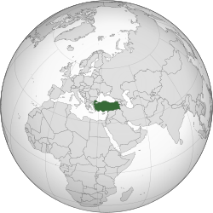
COUNTRY PROFILE
Republic of Turkey Türkiye Cumhuriyeti
Flag
President : Recep Tayyip ERDOGAN Prime Minister : Prof. Dr. Ahmet DAVUTOGLU

Slide 3
COUNTRY PROFILE
Legislature | Grand National Assembly
Area
- | Total | 783,562 km² (37th) 302,535 sq mi
- | Water (%) | 1.3
Population
- | 2013 estimate | 75,627,384^{[3]} (18th)
- | Density | 97/km² (108th) 239.8/sq mi
GDP (PPP) |  | 2012 estimate
- | Total | $1.358 trillion^{[4][5]} (15th)
- | Per capita | $18,348^{[5]} (54th)
GDP (nominal) |  | 2012 estimate
- | Total | $789.257 billion^{[5]} (17th)
- | Per capita | $10,666^{[5]} (64th)

Slide 4
GDP (PPP) 1990-2014

Slide 5
Turkey-EU relations
Turkey , member of the Council of Europe , in1949,
Turkey first applied for associate membership in the European Economic Community in 1959,
"Agreement Creating An Association Between The Republic of Turkey and the European Economic Community", signed in 1963
Turkey's application for full membership to EU in1987.
Turkey signed a Customs Union agreement with the EU in 1995.
Officially recognised as a candidate for full membership in 1999, at the Helsinki summit of the European Council.
Negotiations were started on 3 October 2005
Chapter on Environment is opened in 8 December 2009
Notes:
Turkey's application to accede to the European Economic Community, the predecessor of the European Union (EU), was made on 14 April 1987. Turkey has been an associate member since 1963.[2] After the ten founding members, Turkey was one of the first countries to become a member of the Council of Europe in 1949, and was also a founding member of the Organisation for Economic Co-operation and Development (OECD) in 1961[3] and the Organization for Security and Co-operation in Europe (OSCE) in 1973. The country has also been an associate member of the Western European Union from 1992 to its end in 2011, and is a part of the "Western Europe" branch of the Western European and Others Group (WEOG) at the United Nations. Turkey signed a Customs Union agreement with the EU in 1995 and was officially recognised as a candidate for full membership on 12 December 1999, at the Helsinki summit of the European Council. Negotiations were started on 3 October 2005, and the process, should it be in Turkey's favour, is likely to take more than a decade to complete.[4] The membership bid has become a major controversy of the ongoing enlargement of the European Union.[5]

Slide 6
IPA implementations in Turkey-1
Environment Operational Programme for 2007-2013
Environment and Climate Change Sectoral Operational Programme (2014-2020)
Which projects ?
water supply, urban wastewater
integrated solid waste management, rehabilitation and closure of old dumpsites

Slide 7
IPA implementations in Turkey-2
EU Integrated Environmental Approximation Strategy (UCES)
The total sectoral budget required for Acquis implementation for the period 2007-2023 is EUR 58.5 billion.
Turkey’s current investment provided from national Budget for environmental investments and their operation is 2,5 billion EUR.

Slide 8
Sectoral Distribution of Environmental Investments in Turkey between 2007-2023
SECTORS* (totals) | INVESTMENT NEEDED (total per sector)
 | (Million TL) | (Million EUR) | Rate (%)
Water sector | 63,114 | 33,969 | 58
Solid waste sector | 17,762 | 9,560 | 16
Air sector | 69 | 37 | 0
IPPC Sector | 27,415 | 14,755 | 25
Nature protection sector | 490 | 264 | 0
Total | 108,851 | 58,585 | 100

Slide 9
Ipa I Period, 2007-2013
Country | 2007 | 2008 | 2009 | 2010 | 2011 | 2012 | 2013
Albania | 61.0 | 70.7 | 81.2 | 94.1 | 94.4 | 94.5 | 95.3
Bosnia & Herzegovina | 62.1 | 74.8 | 89.1 | 105.3 | 107.4 | 107.8 | 63.6
Croatia | 141.2 | 146.0 | 151.2 | 153.5 | 156.5 | 156.1 | 93.5
The former Yugoslav Republic of Macedonia | 58.5 | 70.2 | 81.8 | 91.6 | 98.0 | 101.8 | 113.2
Iceland | - | - | - | - | 12.0 | 12.0 | 5.8
Kosovo* | 68.3 | 184.7 | 106.1 | 67.3 | 68.7 | 68.8 | 71.4
Montenegro | 31.4 | 32.6 | 34.5 | 33.5 | 34.1 | 35.0 | 34.5
Serbia | 189.7 | 190.9 | 194.8 | 197.9 | 201.8 | 202.0 | 208.3
Turkey: Total : 4.799 | 497.2 | 538.7 | 566.4 | 653.7 | 779.9 | 860.2 | 902.9
Multi-Beneficiary Programme | 129.5 | 137.7 | 188.8 | 141.7 | 186.2 | 176.2 | 177.2
http://ec.europa.eu/enlargement/key-figures/global_2014_en.htm

Slide 10
Distribution of IPA I
Component | 2007 | 2008 | 2009 | 2010 | 2011 | 2012 | 2013
Transition Assistance and Institution Building | 256,702,720 | 256,125,297 | 239,550,810 | 217,809,826 | 231,268,023 | 227,499,161 | 238,500,014
Cross-border Co-operation | 2,097,280 | 2,874,709 | 3,049,190 | 3,090,174 | 5,131,977 | 2,174,617 | 2,218,109
Regional Development | 167,500,000 | 173,800,000 | 182,700,000 | 238,100,000 | 293,400,000 | 356,836,341 | 366,882,353
Human Resources Development | 50,200,000 | 52,900,000 | 55,600,000 | 63,400,000 | 77,600,000 | 83,930,000 | 91,167,077
Rural Development | 20,700,000 | 53,000,000 | 85,500,000 | 131,300,000 | 172,500,000 | 189,785,003 | 204,184,796
TOTAL | 497,200,000 | 538,700,006 | 566,400,000 | 653,700,000 | 779,900,000 | 860,225,122 | 902,952,349

Slide 11
Ipa II Period, 2014-2020
Country | 2014 | 2015 | 2016 | 2017 | 2018-2020 | TOTAL 2014-2020
Albania | 83.7 | 86.9 | 89.7 | 92.9 | 296.3 | 649.5
Bosnia & Herzegovina | 39.7 | 39.7 | 42.7 | 43.7 | * | 165.8
The former Yugoslav Republic of Macedonia | 85.7 | 88.9 | 91.6 | 94.9 | 303.1 | 664.2
Kosovo* | 83.8 | 85.9 | 88.7 | 91.9 | 295.2 | 645.5
Montenegro | 39.6 | 35.6 | 37.4 | 39.5 | 118.4 | 270.5
Serbia | 195.1 | 201.4 | 207.9 | 215.4 | 688.2 | 1,508.0
Turkey | 620.4 | 626.4 | 630.7 | 636.4 | 1,940.0 | 4,453.9
Multi-country | 348.0 | 365.0 | 390.0 | 410.4 | 1,445.3 | 2,958.7
IPA II 2014-2020 indicative allocations, * Amounts to be decided at a later stage.
http://ec.europa.eu/enlargement/instruments/overview/index_en.htm

Slide 12
How IPA works in Turkey?
Turkey implements IPA funds itself, under the Decentralised Implementation System.
Turkish authorities are in charge of ;
procurement,
contracting and
payments
for IPA projects with prior appraisal by the Commission (EU Delegation in Ankara).

Slide 13
EIA Regulation in Turkey
EIA Regulation (7th February, 1993)
EIA Training and Information Centre (2006)
e-EIA implementation (2012)
(61.500.000 A4 paper ) = (300 tons paper saved)/year
5100 trees saved
132 000 tons of water saved
2 280 000 kWh energy saved.
1 000 tons CO2 equivalent emission prevented
Notes:
ÇED Raporu ve Proje Tanıtım Dosyalarının kâğıda basılı doküman olarak hazırlanmasına gerek duyulmaması sayesinde, yıllık olarak yaklaşık 61.500.000 adet A4 kâğıdından tasarruf edilmekte, böylece yaklaşık olarak 50 hektar ağaçlandırmadan elde edilen yutak alan kapasitesine eşdeğer 1.000 ton CO2 eşdeğerinde emisyon salınımı engellenmektedir. Bu sayede elde edilecek 300 ton kâğıt tasarrufu ile yıllık olarak; 5.100 adet ağaç kesilmesi engellenmiş, 132.000 ton temiz su ve 2.280.000 kWh enerji israf edilmemesi sağlanmış olmaktadır.

Slide 14
EIA Procedure for EU investment projects
EIA Regulation has been implementing in Turkey since 7th of February, 1993.
EIA regulation has been revised recently on 25th of November, 2014
IPA Projects vs EIA regulation
Annex I: The list of the projects that requires EIA Report
a) Facilities that contains sanitary landfill (100 tons/day and above capacity) including recovery, waste combustion facilities.
b) Waste water treatment facilities with capacity of 30 000 m3/day and/or 150 000 equivalent population.

Slide 15
Environmental Report prepared for IPA Application.
Consultants prepare IPA Application Form and submits to DoEUI and DoEUI distributes to other stakeholders.
Non-technical summary is a part of IPA Application Form and includes the result of EIA process including public participation.
Table of contents
A. Addresses and references , B. Project details
C. Results of feasibility studies , D. Timetable
E. Cost-benefit analysis ,
F. Analysis of the environmental impact
G. Justification for the public contribution
H. Financing plan
I. Compatibility with community policies and law
J. Endorsement of competent national authority

Slide 16
IPA Application
Annex i: Feasibility study (summary & full version)
Annex ii: Cost Benefit Analysis
Annex iii: EIA Non-Technical Summary
Annex iv: Declaration by authority responsible for monitoring sites of nature conservation importance
Annex v: Copies of relevant decisions permits & other documents with English translation
Annex vi: Maps
Environmental report assessed by European Commission (EC) DG Regio.

Slide 17
EC Comments regarding Environmental Reports
Common comments of EC as follows:
a) requires an environmental management plan and a monitoring plan needs to be prepared for the purpose of this project;
b) requires an emergency response plan and these should be included in the contracts of the Supervisor and Contractor.
c) demands an additional info about the project details, components of projects and its environmental impacts
d) requires EIA report, if not available, demands screening process
e) requires additional information regarding the potential sources of emissions from the landfill
Notes:
EC evaluates IPA Application Form by means of internal and external experts. Environmental evaluation of IPA Application Form generally realized by means of external experts and comments of EC may vary accordingly.

Slide 18
EC Comments regarding Environmental Reports
f) requires providing the estimate of the cost of mitigation measures of the negative environmental impact caused by the construction of the landfill and other infrastructure.
g) states that the environmental impact of the project and related non-technical summary prepared is weak and needs improvements.
h) Requires providing additional info to the public for the components of the projects that are not part of EIA Report.

Slide 19
V. Plans of EU Investment Department
An environmental management plan shall be included to IPA Application form
Monitoring plan shall be prepared and replaced on IPA form.
An emergency response plan shall be included in the contracts of the Supervisor and Contractor
IPA application forms should be updated regularly according to response of EC.
Notes:
After obtaining the comments of EC, DoEUI organise a meeting with each project owner and inform them. Required technical consultancy studies carried out and new IPA Application Form has been prepared. Please see below the necessary measure to be taken by DoEUI not to face any problems regarding ion Forms.

Slide 20
Conclusion
IPA funds support Turkey for environmental infrastructure projects.
Solid waste management projects are subject to EIA system
EIA Regulation should be applied to all IPA Projects.

Slide 21
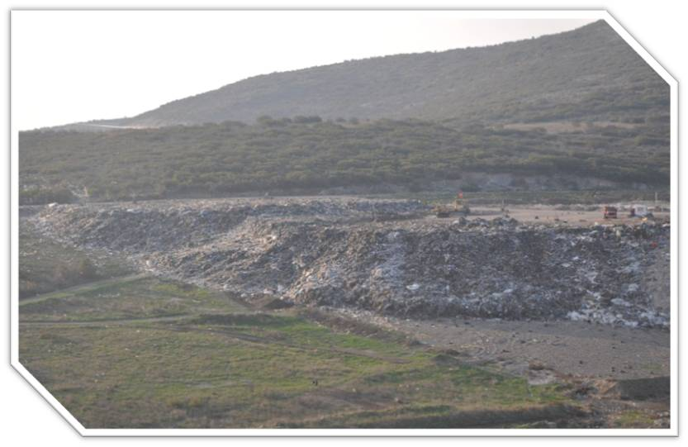
Rehabilatation of dump sites Before

Slide 22
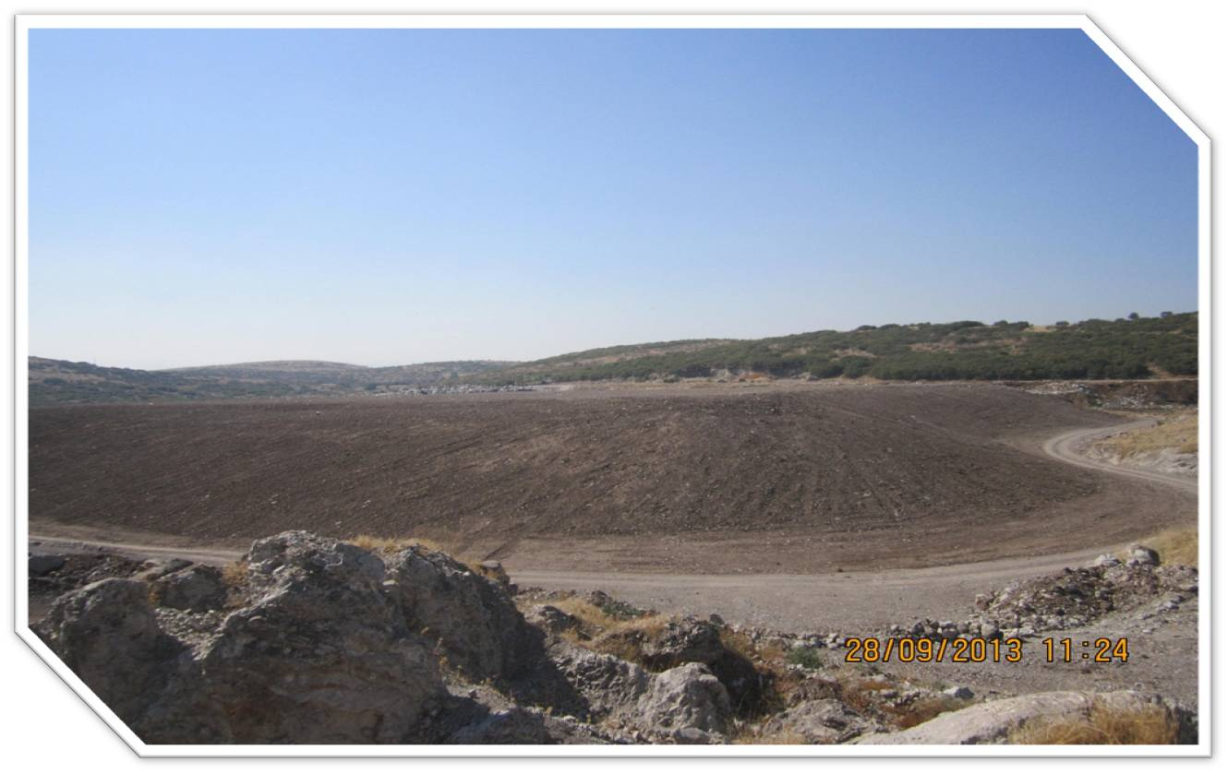
Rehabilatation of dump sites After

Slide 23
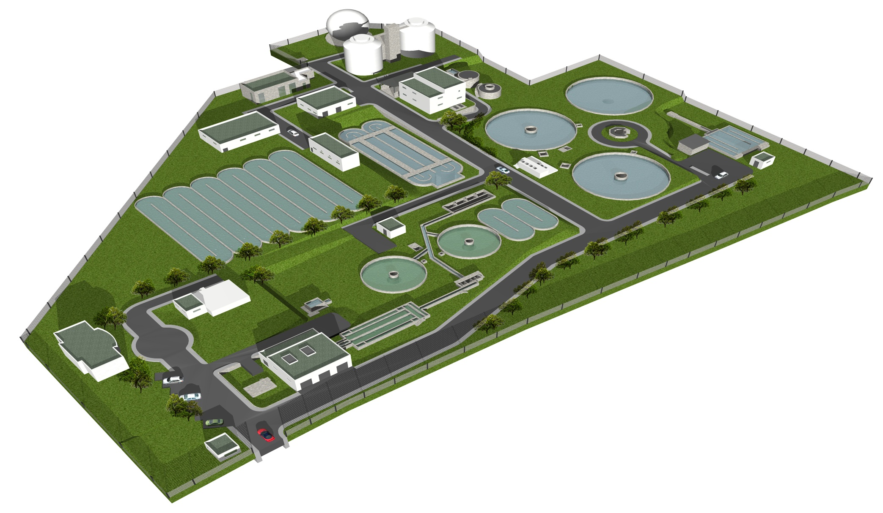
Siverek Wastewater Treatment Plant

Slide 24
Lüleburgaz Wastewater Treatment Plant

Slide 25
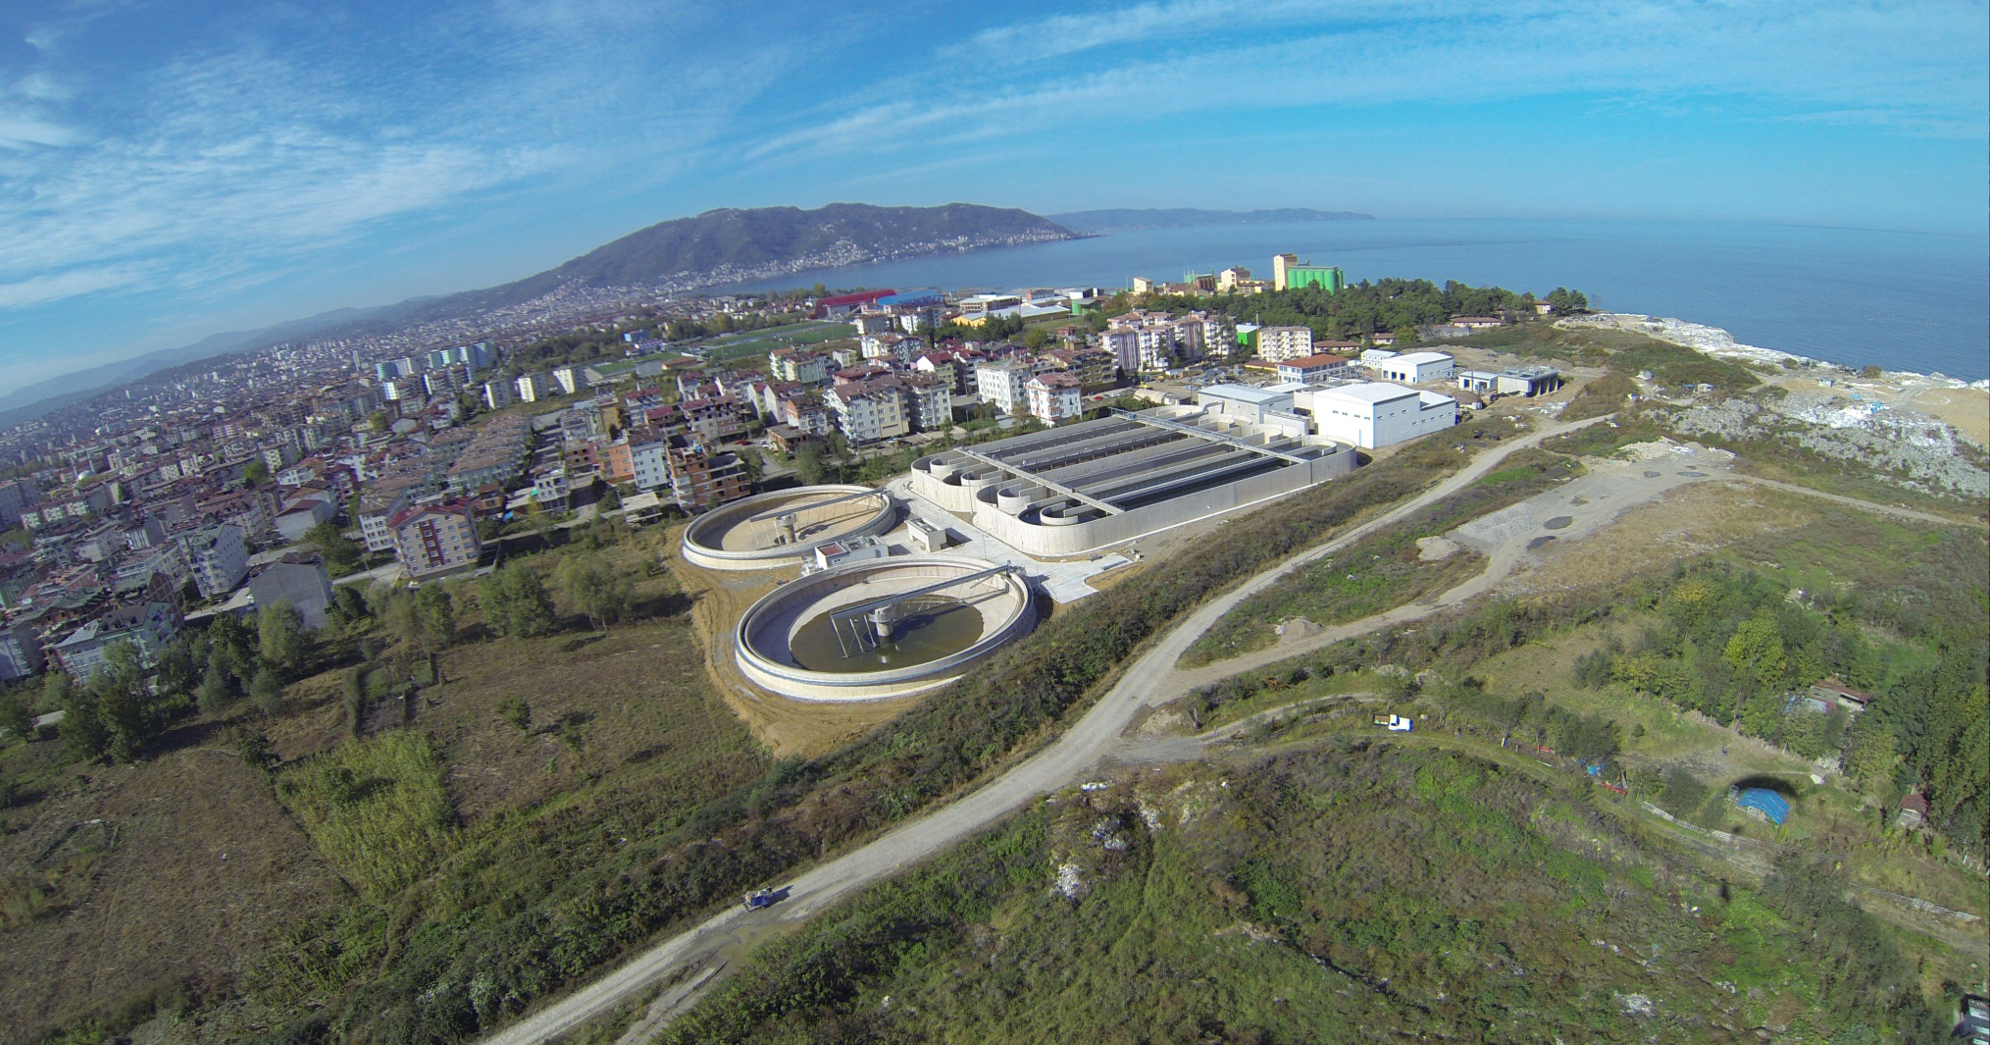
Ordu Wastewater Treatment Project

Slide 26
Erdemli water supply project, opening ceronomy

Slide 27
Opening Ceronomy of Dogu Beyazıt Project

Slide 28
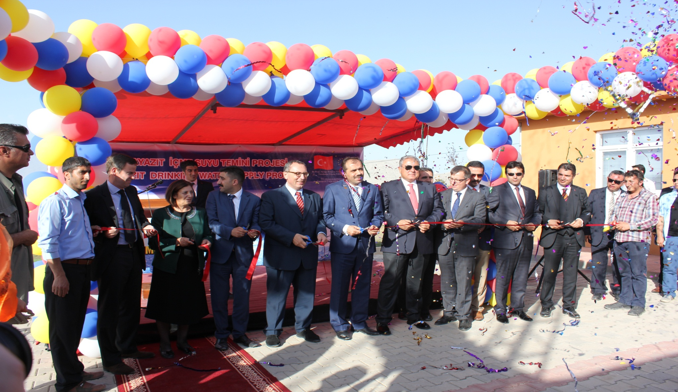
Thank you for your attention

