Slide 1
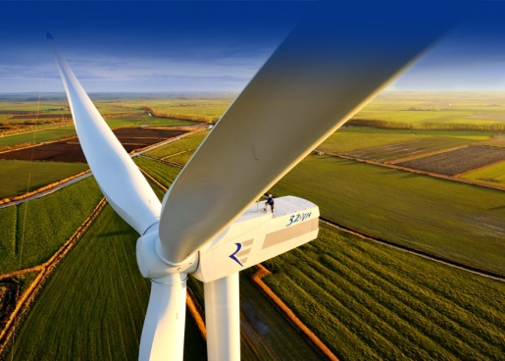
Wind energy and species protection in Germany and the U.S.
M.Sc. Victoria Gartman
IAIA 2015
http://www.evwind.es/
Notes:
I examined trans-Atlantic commonalities and differences at and around onshore wind facilities in terms of the use of the mitigation hierarchy and compensatory measures for endangered species and species of protection.

Slide 2
Outline
Introduction
Why is this good to know?
Policies & wind and the concerns
Materials & Methods
Steps taken!
Study Area – Case studies
Results
Comparative analysis
Case studies
Laws, regulations
Future research – How does this impact YOU?

Slide 3
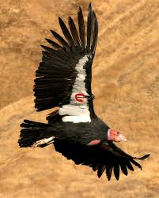
Intro – Why is this good to know?
3 main questions
Mitigation hierarchy differences?
Policy comparison (state, national, international)?
Trans-Atlantic measures?
State of research
Elements of Focus
Regulatory measures
Wind facility logistics
Species of concern
Avoidance and minimization measures
U.S. Wind facilities & Germany windparks
Notes:
3 main questions: In wind energy development, how do executions of avoidance and minimization mitigation for protected species overlap and differ between the U.S. and Germany? How does the U.S.’s habitat conservation plans (HCP), the EU’s continued ecological functions (CEF), and Germany’s Artenschutzprüfung (ASP), compare and differ? To what extent can these measures become trans-Atlantic?
1st bullet: through review of literature, policy analysis, and case comparison
2nd bullet: through review of literature and policy analysis
3rd bullet: continuation of literature review and case-comparison analysis
State of research: No in-depth analysis of trans-Atlantic commonalities and differences between the procedures set up for protecting endangered species at/around onshore wind facilities between the U.S. and Germany
Elements of focus:
Regulatory measures (international, federal, state)
Wind facility logistics (size, capacity, location)
Species of concern (listing, illegal and legal take)
Avoidance and minimization measures (and compensatory mitigation)
U.S. Wind facilities & Germany windparks (18 cases)

Slide 4
Intro – Policy & Wind in U.S. & Germany
The U.S.
Germany (EU)
Guidelines for WE
BLM, USFWS, USFS, NGOs
German state guidelines
Species Protection
EU’s Annex II, IV
Germany’s BNatSchG
United States’ ESA
ITP
Migratory Bird Treaty Act (1918)
Bald & Gold Eagle Protection Act (1940)
National Environmental Policy Act (1969/70)
EA, EIS, FONSI
Endangered Species Act (1973)
Section 7, 9, 10
Habitat Conservation Plan (HCP), Biological Opinion (BO) ≈ Incidental Take Permits (ITP)
Federal & NGO guidelines
EU’s EIA Directive (amend. 2009)
EU Habitats Directive (1992)
Annexes II, IV
Article 12: FCS, CEF measures
EU Birds Directive (1979 amend. 2009)
Natura 2000
Germany EIA Act (UVPG) (1990)
BNatSchG (1976 revised 2009)
§15, 31-36, 44-45
Artenschutzprüfung (ASP)
German State guidelines
Instruments & Measures
Habitat Conservation Plans (HCP)
Biological Opinion = ITP
Artenschutzprüfung (ASP) (endangered species impact assessment)
Review of area/region
Continued Ecological Functionality (CEF)
Measures to offset impacts within ASP
Avoidance and Minimization
Within HCP and ASP
Notes:
ESA: (7) if a BO is issued by the USFWS if action complies with the jeopardy and critical habitat standards, an ITP will be issues, (9) details take regulations, (10) authorizes the taking of endangered species if HCP is developed and will minimize and mitigate impacts of the take.
HCP: tool used to resolve endangered species conflicts in allowing some loss of endangered species in exchange for compensatory activities which minimize and mitigate for the loss
BO: issued by USFWS saying action complies with ESA, HCP or similar documents fulfill ESA
ITP: permits “incidental take” (legally proceeding with an activity for the duration of the permit) of listed species occurring in connection with otherwise unlawful activities
Fed & NGO guidelines: USFWS “Land-Based Guidelines in Wind Energy”, HCP Handbook Addendum or “Five Point Policy”, BLM “Programmatic EIS in Wind Energy Development on BLM lands in Western U.S.”, NWCC “Mitigation Toolbox”
_______________________________________________
EU Habitats Directive: In German called FFH or “Fauna-Flora-Habitat Richtlinie”,
Article 12: protecting the individuals of the listed species, breeding sites, resting places, contributing to the goal of FCS for these natural habitats and species of community interest. FCS: Favorable conservation status, described as a situation where a habitat type or species is doing sufficiently well in terms of quality and quantity and has good prospects of continuing to do so in the future. CEF: Continued Ecological Functionality; measures for the permanent preservation of impact regulation measures for species protection
UVPG: Umweltverträglichkeitsprüfung (Envir. Impact Assess.)
BNatSchG: Bundesnaturschutzgesetz (Federal Nature Conservation Act)
BNatSchG §15: Refrain from impairments of nature and landscape. Injuries are avoidable if reasonable alternatives. As far as impairments can not be avoided, this should be justified. Compensatory measures to be maintained. §31-36: Natura 2000, FFH compatibility, activities for imperative reasons such as those of a social or economic nature (i.e. WE). §44-45: Requirements for special protection and certain other animal and plant species, and its exceptions to taking
Artenschutzprüfung (ASP)- endangered species impact assessment, triggered in revisions of 2009 BNatSchG updates, which examines if a project or activity meets the standards and limitations of §44-45.
State guidelines: Umsetzung des Arten- und Habitatschutzes bei der Planung und Genehmigung von Windenergieanlagen in Nordrhein-Westfalen (Implementation of species and habitat protection in the planning and approval of WT in NRW)
**POLICY IN US IS OVER 40 YRS OLD, EU ONLY 25 YRS**
_______________________________________________________________________
Created by federal bureaus and NGOs in the U.S. and German federal state guidelines, recent guidelines to help develop wind facilities while minimizing impacts to the environment of species.
Species protection are established from these main pieces and the legal taking via the ITP in the U.S.
------------------------------------------------------------------------
HCP is an entire document for the purpose of receiving an ITP approved by the USFWS BO
ASP is a review of a particular area or region that notes potential impacts to the area’s species and their surrounding habitats
CEF measures are lists of measures to offset impacts to the environment and to species of concern.
CEF measures are found within the ASP and there are many avoidance and minimization measures in both the HCP and ASP.

Slide 5
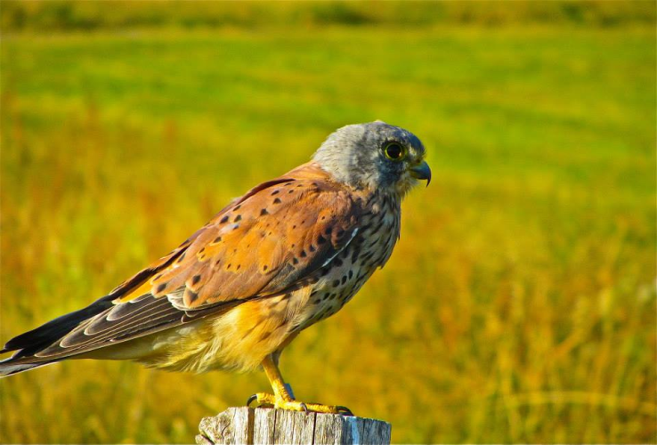
Materials & Methods –Steps taken!
Explanatory and Comparative Case Study Analysis (Yin 2009)
Explanation Building
Multiple-cases study
Comparative Analysis
Criteria and Conditions
Literature Research
Onshore wind facilities
Federally and internationally endangered species of birds, mammals, insects
Eurasian Kestrel. Photo by: Austin Teague
Notes:
Explanatory and Comparative Case Study Analysis (Yin 2009)
Explanation Building: U.S. situations, EU/Germany situations in terms of species concerns
Multiple-cases study: Commonalities and differences between the 18 cases
Comparative Analysis: U.S. and German policies and measures, Elements of Analysis
Criteria and Conditions
Literature Research: online databases (TTU, TU), Government websites (BLM, BMUB, EC),Government policies, regulations, guidelines, News articles, Books, Availability (German)
Onshore wind facilities
Federally and internationally endangered species of birds, mammals, insects: Germany: Habitats Directive, BNatSchG, U.S.: Incidental Take Permit

Slide 6
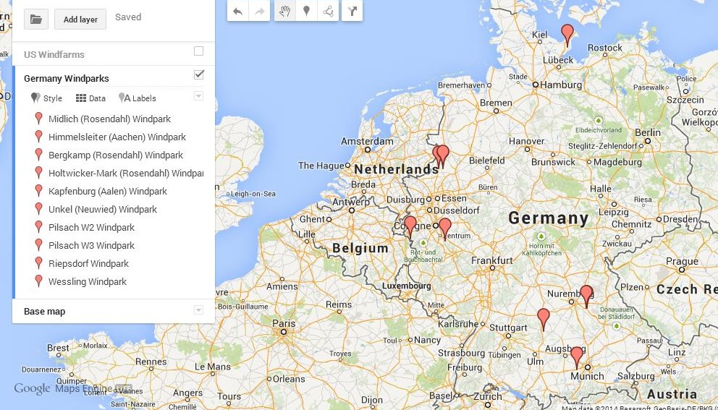
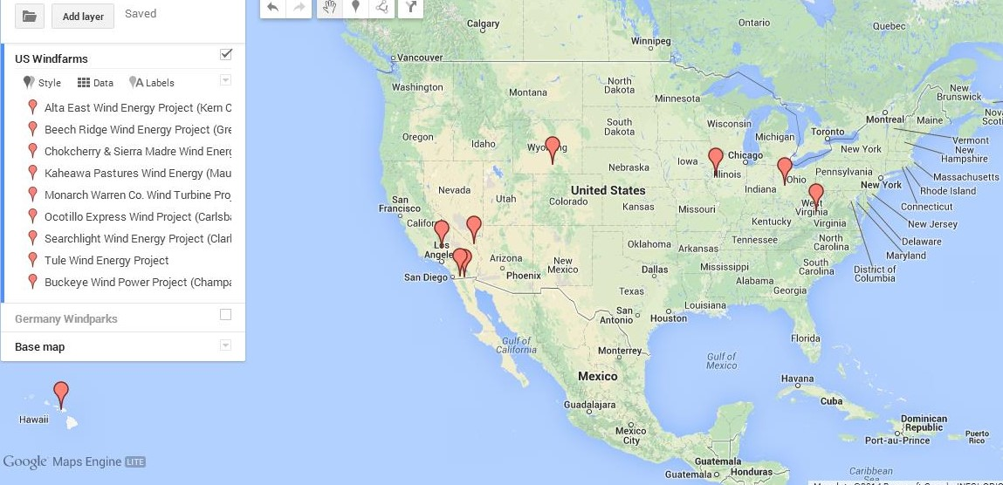
Materials & Methods –Study Area/Cases
Wind Facility
Alta East Wind Energy Project (CA)
Beech Ridge Wind Energy Project (WV)
Buckeye Wind Power Project (OH)
Chokecherry & Sierra Madre Wind Energy Project (WY)
Kaheawa Pastures Wind Energy Generation Facility (HI)
Monarch Warren County Wind Turbine Project (IL)
Ocotillo Express Wind Project (CA)
Searchlight Wind Energy Project (NV)
Tule Wind Project (CA)
Windpark Locations
Himmelsleiter (Aachen, NRW)
Bergkamp (Rosendahl, NRW)
Holtwicker Mark (Rosendahl, NRW)
Midlich (Rosendahl, NRW)
Kapfenburg (Aalen, Bayern)
Pilsach W2, W3 (Bayern)
Riepsdorf (SH)
Unkel (Neuwied, NRW)
Weßling (Starnberg, Bayern)
Notes:
There are nine U.S. cases (3 in CA, 1 in NV, WY, IL, OH, WV, HI)
Each case is selected based on availability of information provided for public observation.
They consist of possible locations with a specified # of WT for development and written up measures for A&M measures
In the U.S. each case as a BO and/or HCP which contains an ITP. These cases have been approved for an ITP.
CLICK
There are nine German cases (3 in Bayern, 5 in Nordrhein-Westfalen, 1 in Schleswig-Holstein)
In Germany, the cases have possible locations for WTs based around a land development plan and consists of an ASP with CEF measures or reviews containing CEF measures with A&M measures.
The selected cases in DE, except one, pertain to the last 3 years and in turn have not been completed.
Certain information is unavailable for some of these cases, chosen because of recent 2009 policy amendments
CLICK
This same year (2009) the BGEPA allowed for the taking of potential eagles as long as there was a Eagle Protection Plan attached to the HCP.

Slide 7
Results
Measures | The U.S. | Germany
Micro-Siting (land optimization) | Roosting areas, hibernacula, linear, small grouping of WT | Breeding/ foraging areas, nesting, FFH, agricultural fields, singular
Wind Turbine Logistics | Number of WT, monopoles, lighting measures | Replacement of old WT, few turbines, monopoles, painting, gaps
Construction | Seasonal, speed limits, WEAP, cables | Seasonal, tree checking, existing roads, cables
Surveying | Pre- & Post- Monitoring, Biological Monitors (Biologists), “Response Team” | Pre-construction, monitoring, turn-off periods
Attractiveness | Carcass removal, limiting on-site vegetation, native vegetation, dust abatement | Food management for raptors, Luderplätzen
Additional Measures | Plans, Programs: Condor Monitoring & Avoidance Plan, Eagle Conservation Plan, Bighorn Sheep Monitoring Program, Avian & Bat Protection Plan | Vegetation: Seasonal mowing, hedges, “food-poor” area, re-vegetation, re-cultivation, fallow lands
U.S. Wind facilities | Approximate capacity & area | Legal Take at WF
1,153 wind turbines at nine facilities | Maximum 3,025.2 MW, 284,677 acres (115,204 ha) | 6 bird species, 3 bat species, 1 mammal species 1 reptile species, 1 insect species
Germany windparks | Approximate capacity & area | Identified at WP locations
Up to 42 wind turbines (no definite number) at nine locations | Unknown in capacities, unknown in land area | 79 bird species, 16 bat species, 2 mammal species, 5 amphibian & reptile species, 1 insect species
Notes:
No definite number of turbines because some have not been finalized, and thus maxiumum capacity is unknown and land area is not described in all cases.
*I looked up each individual species in U.S. and Germany to get a better understanding of these birds particularly in Germany (I have pictures of every species mentioned in all 18 cases)
CLICK
Micro-siting: avoiding upwind sites on ridge crests (Alta), hibernacula (Beech), roosting areas for bats (Buckeye), WT single rows (Kaheawa), small clusters (Monarch)
WT Specifics: lowered numbers of WT than originally planned (Beech), All using monopoles, all following FAA lighting
Construction: Only one concerned about seasonality (Lambing season (Ocotillo)), all enacted speed limits during constr. & during operations, Workers Envir. Awareness Program (Alta, Ocotillo, Tule), burying cables (Alta, Kaheawa)
Additional Plans/Programs: Condor Monitoring & Avoidance Plan (Alta), Eagle Conservation Plan (Alta), Bighorn Sheep Monitoring Program (Ocotillo), Avian & Bat Protection Plan (Alta, CCSM, Searchlight), ADDITIONALLY Sage-Grouse Implementation Program (CCSM), Weed Mgmt Plan (Tule)
Surveying: All require pre- and post-construction surveys, four require a full-time Biologist or Biological Monitors to help in supervising, there is even a “Condor Initial Response Team” at Alta if a Condor were struck. Monarch only facility which stated specific years of monitoring.
Attractiveness: Carcass removal (Alta), limiting on-site vegetation (Kaheawa), native vegetation & dust abatement (Tule)
___________________________________________________________________________________________
*Biggest aspect was the heavy concentration on the impacts the WT would have on the area,
Micro-siting: 100m- 150m away from Kiebitz breeding (Bergkamp, Midlich) wheat and corn fields (Pilsach), 1000m buffer to FFH areas (Unkel)
WT Specifics: replacement of old WT (Riepsdorf), all monopoles, no large WP highest discussed is 16 but most are 10 or less. Violet (Kapfenburg) or Red and White markings (Pilsach) to improve visibility, sealing gondolas and/or netting to secure gaps to avoid nesting possibilities (Himmelsleiter, Pilsach), off-white (Unkel)
Construction: each states constr. will occur outside breeding and/or migration times, depending on location and species of largest concern. Tree checking (Himmelsleiter, Wessling), existing roads (Riepsdorf), burying cables and dismantling catenary masts (Unkel)
Surveying: monitoring at over half (Berkamp, Holtwicker, Midlich, Kapfenburg, Wessling) w/ 3 monitoring first two years of operation, but does not discuss the details to how they are monitoring or what their strategy is. Based on that information will determine turn-off times (Bergkamp, Midlich, Kapfenburg), Midlich briefly discusses it. Night-time turn-off (Pilsach, Wessling) for bats
Vegetation: Seasonal mowing (Kapfenburg), hedges (Holtwicker, Midlich, Pilsach), “food-poor” area (100m around bases of WT)(Rosendahl sites), re-vegetation, re-cultivation, fallow land (discussed in compensatory measures.
Attractiveness: Food management for raptors aka “food poor” area (Holtwicker), Luderplätzen (hunting devices for birds of prey),

Slide 8
Results, Discussion
U.S. Compensation | Germany CEF
Beech Ridge: Complete an offsite conservation project within 1st two years of receiving ITP Kaheawa: Construct a release facility, $200,000 hoary bat research Ocotillo: $200,000 Bighorn sheep research, $500,000 Carrizo Marsh restoration | Himmelsleiter: Bat boxes Holtwicker Mark: Veg. strips, fallow lands Midlich: Veg. strips, fallow lands Kapfenburg: Bird boxes (Baumfalken) Pilsach W2, W3: Bat boxes, fallow lands outside windpark Riepsdorf: Expand reed vegetation Unkel: Reforest. of damaged envir. Aid for Gelbbauchunke Weßling: Bat boxes Recreational areas
Strong federal (and international) laws pertaining to species protection
Little regulation for wind facilities
Guidelines, land development plans
Cases
Detail, documentation
Illegal/legal take
U.S. Incidental Take Permit
Germany / EU CEF measures
Availability
Land – energy distribution
Public information
Notes:
- Strong species protection, but little regulation for wind development. There are guidelines for helping in this development to possibly minimize impacts on surround species and the environment. And land development plans that shape the locality of wind turbines. But this is not the case with private lands in the US and should be analyzed in comparing them with other countries.
- All 18 cases gave documentation of development for a wind facility or windpark, and as described earlier had some similarities and differences in terms of A,M, & C. The amount of detail between the U.S. and Germany are significant
- The U.S. massive facilities, an ITP is appropriate. Germany with its smaller scale approach allows more off-site measures to be taken
-One last conclusion is the availability of information and land in the U.S. and Germany. As part of my criteria, the ability to receive this information is important point. U.S. federal actions are required to show all development information (private lands not so much). ability to gain this information in Germany is difficult, scarce, incomplete, and inconclusive. U.S. has massive tracks of lands and have to support such cities as Los Angeles (three of my cases are helping in that energy grid) unlike German windparks only supporting regions, communities, and nearby neighborhoods.

Slide 9
Future research- How does this impact YOU?
Are current measures working?
Large collaboration, data collection over time
What measures can be trans-Atlantic?
Small-scale approach v. regulatory national approach
Continued tax-breaks, subsidies, incentives
Can private lands be comparable?
Would they even be comparable at all?
Would conclusions be different if Germany made similar information more available?
Public information, development process
Recommendations
“Development by Design”
Strategies to optimize low-impact development
Current Research
Transdisciplinarity
Optimize ways to implement science into practice
Notes:
1st Q: are current A&M and compensatory measures truly offsetting adverse effects on animal species. Collaboration of biologists in different fields, landowners & developers, and politicians along with those in long-term research to get full perspective on how these measures are or are not affecting endangered species, or all species, around WE facilities
2nd Q: rapid expansion due to tax-breaks, subsidies, incentives and need to continue to do at various levels but smaller-scale approach through state and regional governments may be best in minimizing negative impacts during planning. A regulatory national approach is unlikely, a comprehensive approach similar to in the EU would be more beneficial in U.S. Many states have began this approach but needs to be continued in more states.
3rd Q: Private lands follow different regulations and do not have to follow same federal process and public involvement
4th Q: Public availability of information and better involvement is needed during WP development process.
CLICK
“Development by Design”: landscape-scale approach maps state energy resources against high-quality habitat and determines areas, establishing priority sites for wind facilities. Can be also used for species specific conservation areas with this approach.
Strategies: (1) is most important step, (2) integration of planning from other sectors and projects requiring licensing via regulatory intervention (causation-oriented) and EIA (pre-caution oriented) for policy and development cooperation, (3) U.S. discussing critical habitats and Germany’s FFH Directive areas
Current Research: Continuing my field in wind energy, I am looking into the interface between scientific research and policy-making, or rather between scientific research and corporate business, technological innovation, social capital, and organizational networks (transdisciplinarity) and ways to optimize implementation of science into practice.

Slide 10
Thank you for your attention!

