Slide 1
SOCIAL PARTICIPATION AS FOLLOW UP STRATEGY OF ENVIRONMENTAL IMPACTS
Edna das Neves Silva
Giulianna Calmon Faria
Silvana Coutinho Ramos

Slide 2
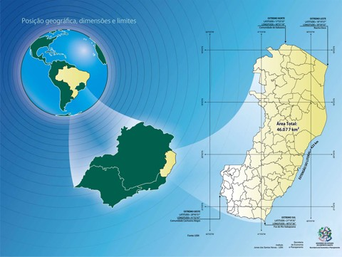
Espírito Santo State - Brazil
Steel Industry
Oil and Gas Industry
Ports
Paper Industry
Pelletizing Plants
The State, over the past decades, is going through a period of significant economic dynamism, with investiments made and planned in the ares of oil and gas, metals and mining, pulp and paper and others.

Slide 3
Legal Aspects on Environmental License Grant
DISPLAYS LICENSE APPLICATION WITH PROPOSED TERMS OF REFERENCE FOR PREPARATION OF EIA
SOCIAL PARTICIPACION TROUGH PUBLIC HEARINGS
EIA IS PRESENTED TO IEMA
INSTALLATION LICENSE
ENVIRONMENTAL AGENCY ANALYZES AND PERFORMS PUBLIC CONSULTATION FOR CONSTRIBUTIONS TO THE RT
PREVIOUS LICENSE
OPERATION LICENSE

Slide 4
Social Participation according to the Law
Social participation, under Brazilian law, sums up the discussion of environmental impacts indicated in the EIA prior to license issuance, is the evaluation of the preliminary period. Following the granting of the license to the project, the participation of society is held indirectly through representation on the Board of the Environment or other institution which organized civil society has seat.

Slide 5
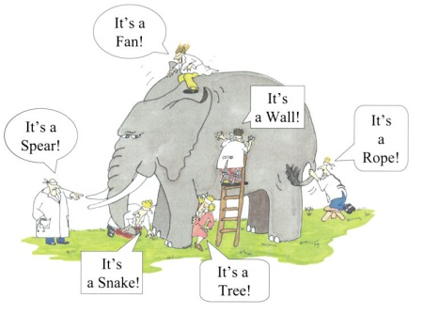
Why change?
MINIMIZE SOCIAL CONFLICT;
IMPROVING COMMUNICATION CHANNELS;
SEARCH BEST RESULTS SOCIOECONOMIC FOR LOCAL POPULATION;

Slide 6
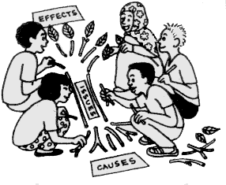
How to change?
EXPANDING THE SOCIAL PARTICIPATION IN THE LICENSE PROCESS
COMMITTEES ENVIRONMENTAL LICENSES (CALIAM)
Source: UNESCO

Slide 7
Methodology
EIA
COMMUNITY LEADERS ACTIVE IN THE REGION

Slide 8
How meetings happen
PRESENTS
IEMA STAFF PRESENCE RESPONSIBLE FOR THE ANALYSIS OF THE CONDITIONS OF EACH PART OF EIA;
MANAGES THE PUBLIC HEALTH SECTOR, PUBLIC SECURITY AND ENVIRONMENT;
CONSULTANTS;
COMMUNITY REPRESENTATIVES AFFECTED;
MUNICIPAL GOVERNMENT;
AND EVENTUALLY SOME GUEST WHEN THE AGENDA INVOLVES CONDITIONING THAT HAS MORE ACTORS.

Slide 9
Objective
COMMISSION SHALL MONITOR THE FULFILLMENT OF ALL CONDITIONS RELATED TO THE LICENSING PROCESS OF THE PROJECT AND NOT ONLY THE RELEVANT CONDITIONING FACTORS TO HUMAN ENVIRONMENT.
DESPITE THE NOT DELIBERATIVE CHARACTER OF THE MEETINGS, DEMONSTRATIONS AND RECOMMENDATIONS FROM THEM ARE ANALYZED BY IEMA, CONTRIBUTING TO TAKE TECHNICAL AND ADMINISTRATIVE DECISIONS.
THE DISCUSSIONS HELD IN THE COMMITTEES HAVE AN EDUCATIONAL CHARACTER, BECAUSE WHERE BEFORE, THE PREDOMINANT SUBJECTS WERE EMPLOYMENT AND INCOME, JOBS AND QUALIFICATION FOR LOCAL RESIDENTS, CURRENTLY DISCUSSIONS INVOLVING ATMOSPHERIC MONITORING, BIOTIC, WATER, AND SANITATION OF COASTAL LAGOONS AND OTHERS HAVE BECOME THE FOCUS OF COMMUNITY DISCUSSIONS.

Slide 10
Results and Learning
THE OBSERVATION OF MEETINGS SHOWS SOME RECENT SITUATIONS THAT DEMONSTRATE SOME WEAKNESSES IN THE PROCESS THAT MUST BE OVERCOME IN ORDER TO CONTRIBUTE TO THE ADVANCEMENT OF THE WORK:
SOME REPRESENTATIVES ADVOCATING PERSONAL INTERESTS;
REPRESENTATIVES OF CIVIL SOCIETY ARE MOSTLY CONTINUOUS AND NOT ALTERNATE;
THERE IS NOT MUCH ENGAGEMENT OF CIVIL SOCIETY PARTICIPATION IN MEETINGS;
DIFFICULTY OF UNDERSTANDING BY THE REPRESENTATIVES WITH POOR EDUCATION LEVEL (ALTHOUGH THERE ARE EFFORTS AND GUIDANCE FOR ADOPTION OF INFORMAL AND ACCESSIBLE LANGUAGE TO ALL PUBLIC)
EXISTENCE OF SOCIAL LIABILITIES LEFT BY OTHER INDUSTRIAL PROJECTS IN THE REGION;
EXCESSIVE INTERVENTIONS WITHOUT CONTINUITY AND FURTHER RESULTS BY CONSULTING COMPANIES IN THE COMMUNITIES, TO PREPARE ASSESSMENTS AND STUDIES THAT CREATE EXPECTATIONS IN THE POPULATION, LEADING TO A SITUATION OF DISBELIEF;
AND OTHERS

Slide 11
Results and Learning
STRONG ASPECTS HAVE BEEN IDENTIFIED AS:
HIGH PERFORMANCE OF THE PUBLIC PROSECUTION SERVICE RESTRICTIONS;
POSSIBILITY OF UNDERTAKING JOINT ACTIONS BETWEEN COMPANIES OPERATING IN THE SAME TERRITORY, GIVEN THE COMMON GOALS OF CERTAIN RESTRICTIONS;
EXISTENCE OF A CHARTER THAT REGULATES THE ACTIONS AND RESPONSIBILITIES OF COMMISSIONERS;
TECHNICAL IMPROVEMENTS OF DISCUSSIONS REGARDING THE IMPACTS AND COMMAND AND CONTROL MEASURES;
REAL-TIME MONITORING OF SOCIO-COMMUNITARIAN IMPROVEMENT OF CONDITIONS;
FEEDBACK OF SOCIETY IN RELATION TO MITIGATION MEASURES, OR MAXIMIZE POSITIVE IMPACTS.

Slide 12
Conclusion
THE EXPECTED RESULTS FOR THIS MONITORING METHODOLOGY OF IMPACT ARE:
SHARING KNOWLEDGE ABOUT THE ENVIRONMENTAL IMPACTS IN A MULTIDISCIPLINARY WAY;
DECISION-MAKING JOINT MEASURES FOR THE MITIGATION OF NEGATIVE IMPACTS AND ENHANCEMENT OF POSITIVE IMPACTS;
INVOLVE PUBLIC ENTITIES IN THE MONITORING AND EVALUATION OF SOCIAL AND ENVIRONMENTAL DEMANDS FROM THE LICENSING OF GREAT POTENTIAL POLLUTING / DEGRADING ACTIVITIES, SHARING AND DISCUSSING DATA FOR FUTURE DEMANDS;
IMPROVEMENT INSTITUTIONAL IMAGE OF IEMA.

Slide 13
Thank you!
giuliannacalmon@hotmail.com
gfaria@iema.es.gov.br
www.meioambiente.es.gov.br

