Slide 1
Usefulness of the Internet in Public Participation
IAIA15 Impact assessment in the digital era Florence, Italy 22.4.2015
Anne Vehmas, Ramboll Finland Oy
IMPERIA is a EU LIFE+ project develoging and testing practices and tools of environmental assessment
Notes:
Psychologist, consultant

Slide 2
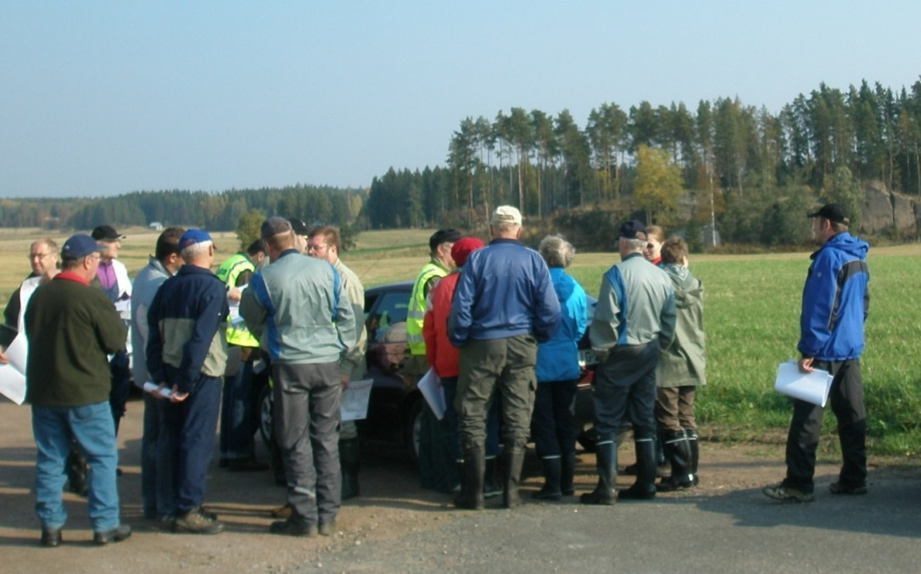
How to get people to participate in the project?
SIA is a mandatory part of statutory EIAs in Finland -> need to know local people’s opinions
Participants in public meetings are usually
Older men
Against the project
IMPERIA is a EU LIFE+ project develoging and testing practices and tools of environmental assessment
2

Slide 3
Web pages of the project
Most infrastructure projects have web pages
Real-time data bank
Lessons learned
To find pages – google search, easy address
Important to tell the date of data
Maps max 10 Mb files
Notes:
the old data indicates process and progress

Slide 4
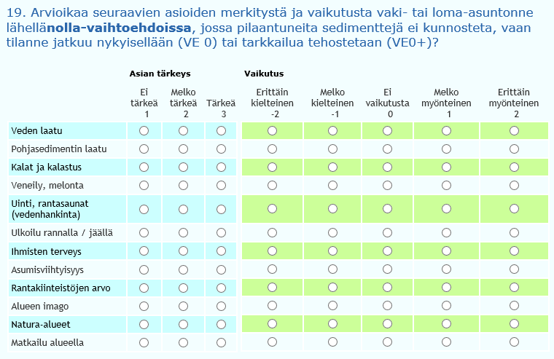
Online survey
In Tampere tramway planning project online survey; 1 264 - 2 590 respondent public meeting; 40 - 190 participants
Provides quantitative data on people's opinions, appreciated by the decision-makers
More women and young respondents than usual in the mail surveys or public meetings
No one asked for printed questionnare
Reach more inhabitants
Importance
Negative or positive Impact

Slide 5
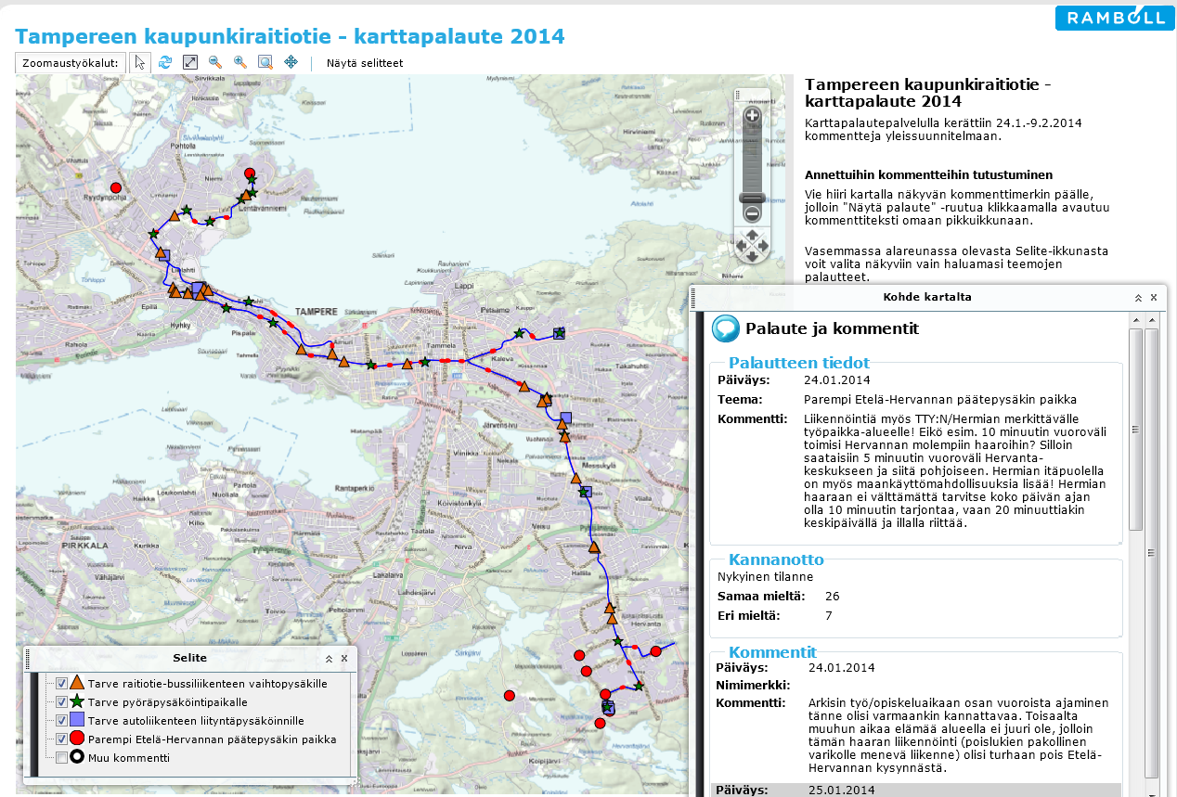
1 894 visitors
2 897 visits
5 481 comments
Map portal survey
Feedback
Agree
Disagree
Theme of feedback
Comments
5

Slide 6
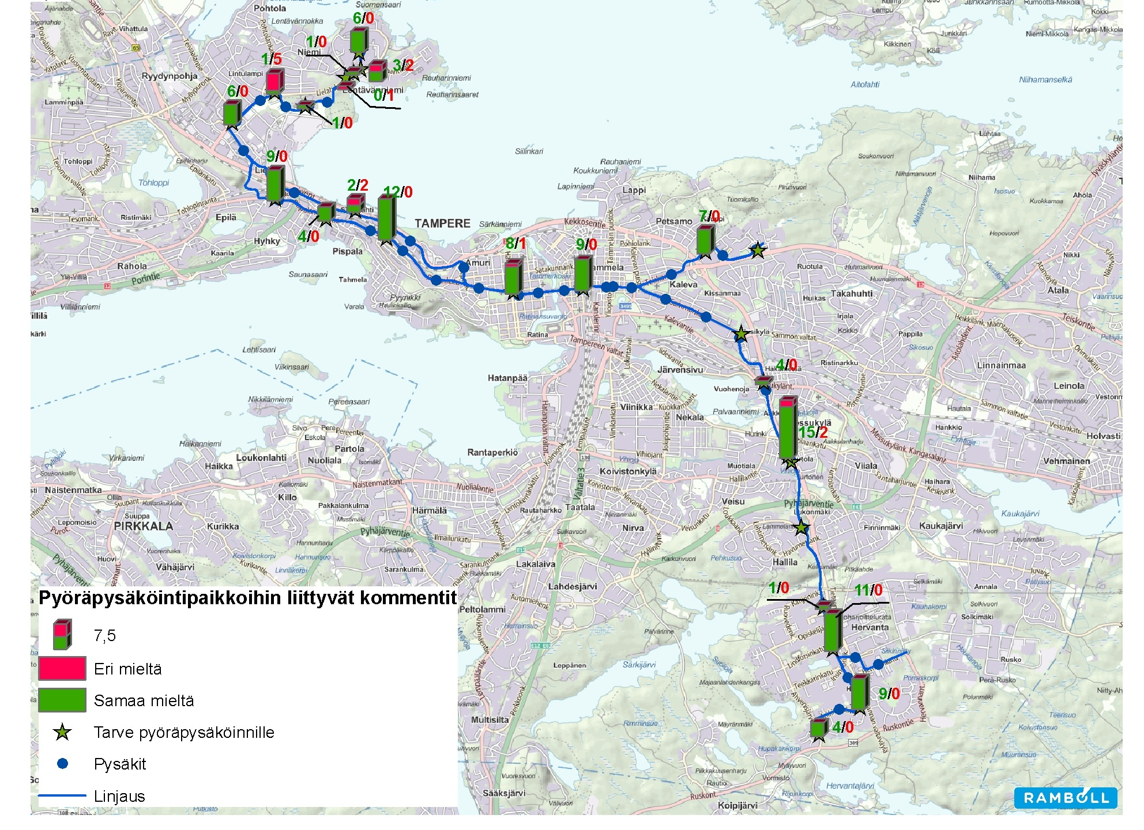
A need for bike parking
Disagree
Agree
6

Slide 7
Facebook, Twitter, Youtube,…
In the Tram project people had started two Facebook groups by their own initiative; for and against the project
The supporting group has been very active
Hundreds of answers to online survey before any information in printed media
Short, informal messages more often
Invitation to public meeting, survey, …
New material in web page
Possible to grow up online conversation
Takes more time
Continues after EIA
7
Notes:
one for the tram project and another one against it, The supporting group has been especially active in debating and sharing of information related to tramways. Social media Offers people easy way to give feedback or ask

Slide 8
The usage of Internet
Works better than traditional methods
with younger people, students
with people used to deal with computers
in urban area than in countryside
better Internet connections
younger population
facilitates public participation
to distribute information
to reach the involved
to get feedback (also from silent majority)
to create online discussion
9

Slide 9
Methods for public participation
Informing
Data collecting
Communication
Cooperation
Announcement
Newsletter
Lettes, e-mails
Web pages
Social media
Online survey
Mail survey
Map portal survey
Feedback-forms
Media analysis
Desk study
Interview
Observation
Map portal survey with interaction
Social media
Public meeting
Workshops
Stakeholder walks
Seminar
Meeting planner
Stakeholder group
Co-planning
Residential council
Project meetings
”Depth” of interaction
Notes:
Public participation methods can be divided into four groups according to their main purpose: information sharing, data collecting, communication, and cooperation.

Slide 10
Thanks! anne.vehmas@ramboll.fi

