Slide 1


Environmental and Social Framework Protecting People and the Environment in Investment Projects

Slide 2

“The World Bank Group is committed to supporting countries in reducing poverty and building shared prosperity in a sustainable manner.”*
To end poverty and promote shared prosperity, all aspects of social and environmental sustainability must be taken into consideration
Protecting the environment and the world’s poorest and most vulnerable people in our projects are central to this vision
* World Bank Group Strategy, October 2013

Slide 3

Environmental and social framework In a nutshell
A cornerstone of the World Bank’s work on investment project finance is helping to ensure strong protections for people and for the environment. At this time, we help do this through safeguard policies that serve to identify, avoid, and minimize harm to people and the environment. These policies require certain environmental and social risks to be addressed in order for countries to receive Bank support for investment projects.
The World Bank’s new Environmental and Social Framework is expected to take effect in 2018 and will thereafter apply to new investment projects.
The new comprehensive framework will boost protections for people and the environment; promote capacity- and institution-building and country ownership, and enhance efficiency for both the Borrower and the Bank.
It consolidates the Bank’s environmental and social policies and harmonizes them with those of other development institutions.
The framework makes important advances for the World Bank in areas such as transparency, accountability, nondiscrimination, and public participation.

Slide 4
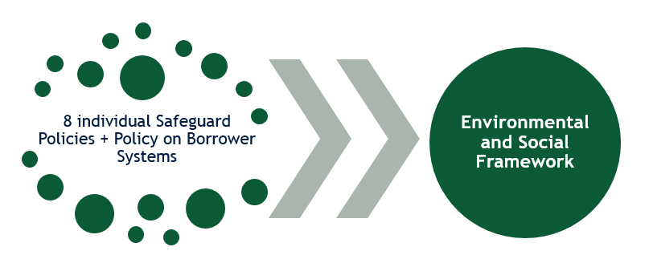
Environmental and social framework In a nutshell
World Bank environmental and social “Safeguard Policies” progressively developed and used from 1980’s through today
Updated to the World Bank’s new Environmental and Social Framework, approved August 2016
No change to policies on International Waters and Disputed Territories
ESF and Safeguard Policies will run in parallel until the last project applying current Safeguard Policies is closed (approximately 7 years)

Slide 5
How the ESF Contributes to Stronger Project Outcomes
Build on core principles of current safeguard policies and broaden coverage of environmental and social risks
Address new development demands and challenges and meet varied needs of borrowers
Strengthen environmental and social outcomes of Bank projects
Balance monitoring and implementation support with borrower responsibility

Slide 6

IMPROVEMENTS

Slide 7
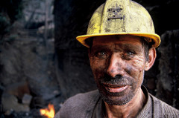
Why is the ESF a Step Forward?
Risk coverage
First policy on social impact assessment
Stronger emphasis on integrated environmental and social assessment and risk management
Broader coverage of social issues, including:
Inclusion and non-discrimination: explicit protection for disadvantaged and vulnerable groups
Clearer and broader focus on gender issues
Labor and working conditions
Introduction of Free Prior and Informed Consent (FPIC) for Indigenous Peoples/Sub-Saharan African Historically Underserved Traditional Local Communities
Expanded community health and safety provisions, including road safety
Introduction of loss of ecosystem services as a social impact
Better integration of environmental issues, including:
Estimation of project GHG emissions
Sustainable management of living natural resource and water

Slide 8
Why is the ESF a Step Forward?
Risk management
Greater emphasis on stakeholder engagement and meaningful consultation through enhanced requirements for transparency and stakeholder engagement throughout the project cycle and with regard to all environmental and social issues
Increased responsiveness and attention to project issues during implementation through adaptive risk management and proportionality
Greater emphasis on strengthening Borrower institutions and efficiency gains when relying on Borrowers’ environmental and social frameworks in certain circumstances
Clearer roles and responsibilities between World Bank and Borrower and clearer boundaries for application of requirements through, e.g., more explicit definitions of “projects,” “associated facilities,” and Borrower obligations relating to contractors and suppliers
More room for informed judgement, guided by ESF and guidance materials, stronger decision-making structures, support from technical specialists, and good international practice with consideration of specific project conditions

Slide 9
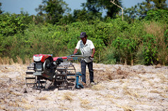
Why is this a Step Forward?
Risk rating
More modern risk management approach with four-tier risk classification with varied implications for requirements and oversight
High
Substantial
Moderate
Low
More responsiveness through risk rating that is changeable over life of the project
Greater emphasis on monitoring during implementation for projects with higher risk
Better management of risk and proportionate deployment of resources

Slide 10

Why is this a Step Forward?
Harmonization
Greater convergence with requirements of other development partners
World Bank can agree on a “Common Approach” for co-financing, on a project-by-project basis, including for Financial Intermediaries
Documentation
Carrying out and disclosing some aspects of environmental and social assessment documents after Board approval possible in some cases
Environmental and Social Commitment Plan (ESCP) as “one-stop-shop” for environmental and social risk documentation
Environmental and Social Review Summary (ESRS)
Stakeholder Engagement Plan (SEP)

Slide 11

Architecture and Content

Slide 12
How is the ESF Structured?
A Vision for Sustainable Development
World Bank Responsibilities
Borrower Responsibilities
Environmental and Social Policy
Review and due diligence
Environmental and Social Standards
1 - 10
Legal Agreement; E&S Commitment Plan
Environmental and Social Procedure
PROJECT LEVEL
Directive for Bank Staff
Environmental, Health, and Safety Guidelines (EHSG)
Assessment and implementation
Implementation Guidance, Information Management Systems
Guidance, Case Studies, Tools, etc.

Slide 13

What is the Environmental & Social Policy?
Sets out the mandatory requirements for the World Bank in relation to its investment project finance
Specifies requirements regarding
Due diligence
Support to Borrowers with regard to stakeholder engagement
Assist Borrowers in selecting methods and tools to assess and manage environmental and social risk
Conditions under which the World Bank agrees to provide support to a project
Monitoring of environmental and social performance
Defines environmental and social risks to take into account in Bank’s due diligence

Slide 14

What is the World Bank Directive on
Disadvantaged or Vulnerable Individuals or Groups?
Establishes directions for Bank staff regarding due diligence relating to assessment and management of risks and impacts on individuals or groups who may be disadvantaged or vulnerable because of their particular circumstances
Lists examples of circumstances that may make people more likely to be adversely affected by project impacts and may limit their ability to take advantage of a project’s benefits

Slide 15

What are the Environmental & Social Standards?
Designed to help Borrowers manage project risks and impacts, and improve environmental and social performance, consistent with good international practice and national and international obligations
Include objectives that define the environmental and social outcomes to be achieved
Include requirements that help Borrowers achieve ESS objectives through means appropriate to nature, scale and risks of the project

Slide 16
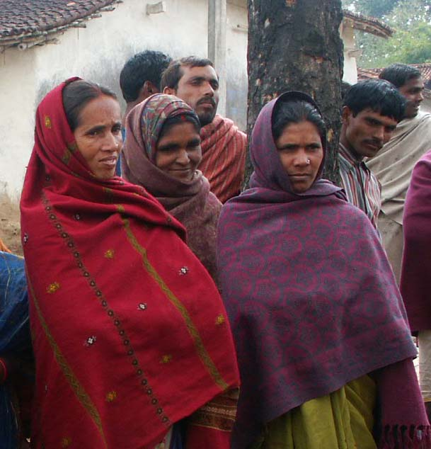
ESS1: Assessment and Management of
Environmental & Social Risks and Impacts
Identify, assess, evaluate, and manage environment and social risks and impacts
Adopt a mitigation hierarchy
Adopt differentiated measures so that adverse impacts do not fall disproportionately on the disadvantaged or vulnerable
Utilize national environmental and social institutions, systems, laws, regulations and procedures where appropriate
Promote improved environmental and social performance, in ways which recognize and enhance Borrower capacity
Highlights
Risk-based, outcomes-focused, tailored, and proportionate approach to project risks and impacts, recognition of practical project challenges, including Borrower control and capacity
Clearer provisions on the types of social and environmental risks and impacts
Clarity on the definition of the project and on treatment of Associated Facilities
Emphasis on non-discrimination and inclusion
Use of Borrower’s environmental and social framework where appropriate
Clear and actionable mitigation, monitoring agreements and other follow-up actions through the Environmental and Social Commitment Plan (ESCP)
Introduction of a common approach, when funding with other development partners
Annex on management of contractors

Slide 17
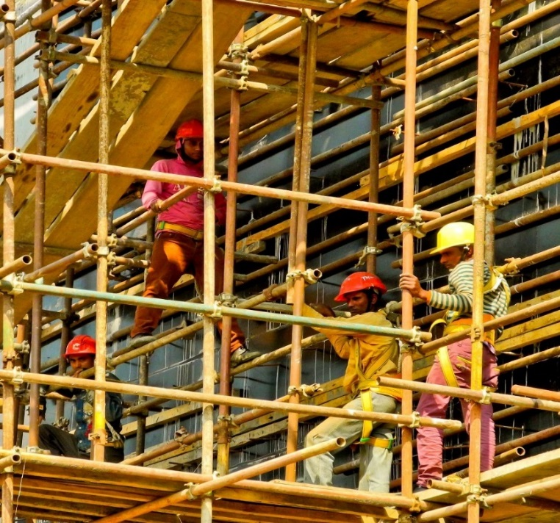
ESS2: Labor & Working Conditions
Promote safety and health at work
Promote the fair treatment, non-discrimination, and equal opportunity of project workers
Protect project workers, with particular emphasis on vulnerable workers
Prevent the use of all forms of forced labor and child labor
Support the principles of freedom of association and collective bargaining of project workers in a manner consistent with national law
Provide project workers with accessible means to raise workplace concerns
Highlights
More specific requirements on occupational health and safety, expanding on the WBG Environmental, Health and Safety Guidelines (EHSGs)
Introduction of labor management procedures
Emphasis on non-discrimination and equal opportunity
Specific requirements for the treatment of direct, contracted, community, primary supply, government civil servants
Recognition of workers organizations
Grievance mechanism for all project workers

Slide 18

ESS3: Resource Efficiency and
Pollution Prevention & Management
Promote the sustainable use of resources, including energy, water, and raw materials
Avoid or minimize adverse impacts on human health and the environment caused by pollution from project activities
Avoid or minimize project-related emissions of short and long-lived climate pollutants
Avoid or minimize generation of hazardous and non-hazardous waste
Minimize and manage the risks and impacts associated with pesticide use
Highlights
Implement technically and financially feasible measures to improve efficient consumption of energy
Emphasis on EHSGs and other Good International Industry Practice
Climate pollutants include all greenhouse gases and black carbon
Specific requirements where project has high water demand
Provisions on historical pollution
Requirements on management of wastes, chemical and hazardous materials
Requirement to estimate gross GHG emissions, where technically and financially feasible

Slide 19

ESS4: Community Health & Safety
Anticipate or avoid adverse impacts on the health and safety of project-affected communities during project life-cycle from routine and non-routine circumstances
Promote quality, safety, and climate change considerations in infrastructure design and construction, including dams
Avoid or minimize community exposure to project-related traffic and road safety risks, diseases and hazardous materials, and have in place effective measures to address emergency events
Ensure that safeguarding of personnel and property is carried out in a manner that avoids or minimizes risks to the project-affected communities
Highlights
Increased emphasis on community exposure to risks and impacts of project
Introduction of concept of universal access, where technically and financially feasible
Evaluate and monitor traffic and road safety and conduct road safety assessments
Identify impacts on provisioning and regulating ecosystem services
Measures on water-related, communicable and non-communicable diseases
Dam safety requirements take into account contextual risk
Requirement to assess risks associated with security personnel, and report unlawful and abusive acts to relevant authorities
Notes:
Photo: Provided by Sivaram Krishnamoorthy.

Slide 20
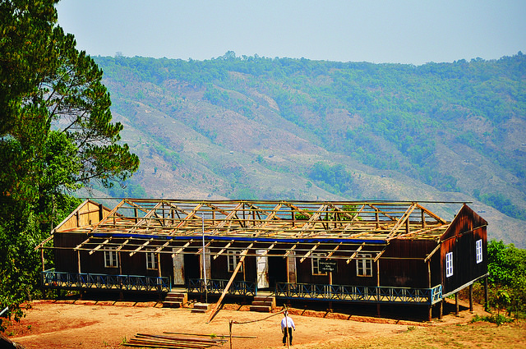
ESS5: Land Acquisition,
Restrictions on Land Use & Involuntary Resettlement
Avoid or minimize involuntary resettlement by exploring project design alternatives
Avoid forced eviction
Mitigate unavoidable adverse impacts from land acquisition or restrictions on land use through timely compensation for loss of assets at replacement cost and assisting displaced persons in their efforts to improve, or at least restore, livelihoods and living standards, in real terms, to pre-displacement levels or to levels prevailing prior to the beginning of project implementation, whichever is higher
Improve living conditions of poor or vulnerable persons who are physically displaced, through provision of adequate housing, access to services and facilities, and security of tenure
Ensure that resettlement activities are planned and implemented with appropriate disclosure of information, meaningful consultation, and informed participation
Highlights
Includes situations where project makes land physically unusable or inaccessible, even when there is no land acquisition
Covers restrictions on access to communal property and natural resources, including marine and aquatic, timber, freshwater, hunting and gathering ground, grazing and cropping areas
Contains criteria on voluntary transactions, land donations, forced eviction and eminent domain
Definition of replacement cost, including where inflation exists
Provides some flexibility where a party derived substantial income from multiple illegal rental units
Provisions to protect and support women, including documentation, training, access to credit and jobs

Slide 21

ESS6: Biodiversity Conservation & Sustainable Management of Living Natural Resources
Protect and conserve biodiversity and habitats
Apply the mitigation hierarchy and the precautionary approach in the design and implementation of projects that could have an impact on biodiversity
Support livelihoods of local communities, including Indigenous Peoples, and inclusive economic development, through the adoption of practices that integrate conservation needs and development priorities
Highlights
Addresses different types of habitats: modified habitat, natural habitat and critical habitat
Requirements for legally protected, designated or regionally/internationally recognized areas of high biodiversity value
Promotes sustainable management of living natural resources, including primary production and harvesting
Provisions on invasive alien species
Requirements on animal husbandry and large-scale commercial farming
Requirements relating to primary suppliers, where project purchasing natural resource commodities, including food, timber and fiber

Slide 22
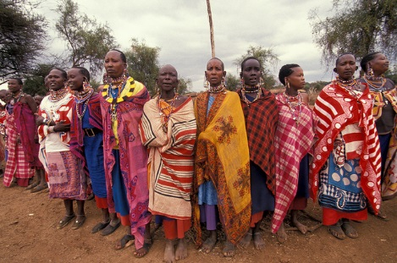
ESS7: Indigenous Peoples / Sub-Saharan African Historically Underserved Traditional Local Communities
Ensure that the development process fosters full respect for affected parties’ human rights, dignity, aspirations, identity, culture, and natural resource-based livelihoods
Promote sustainable development benefits and opportunities in a manner that is accessible, culturally appropriate and inclusive
Establish and maintain an ongoing relationship based on meaningful consultation with project-affected parties
Obtain the Free, Prior, and Informed Consent (FPIC) of affected parties
Recognize, respect and preserve the culture, knowledge, and practices of Indigenous Peoples, and to provide them with an opportunity to adapt to changing conditions in a manner and in a timeframe acceptable to them
Highlights
Increased emphasis on use of different terminology for Indigenous Peoples, while satisfying Bank criteria
Ability to use national screening processes, providing these meet Bank criteria and requirements
Coverage of forest dwellers, hunter-gathers, pastoralists and other nomadic groups
Protection for affected parties in voluntary isolation
Conduct meaningful consultation tailored to affected parties
Specification on FPIC process and outcome, nature of consent, unanimity not required

Slide 23

ESS8: Cultural Heritage
Protect cultural heritage from the adverse impacts of project activities and support its preservation
Address cultural heritage as an integral aspect of sustainable development
Promote meaningful consultation with stakeholders regarding cultural heritage
Promote the equitable sharing of benefits from the use of cultural heritage
Highlights
Covers tangible cultural heritage and intangible cultural heritage (material impact/commercial use)
Tangible cultural heritage may be located in urban or rural settings, be above or below land or under water, and includes natural features and landscapes
Intangible cultural heritage includes practices, representations, expressions, knowledge, skills
Recognition of need for confidentiality and access
Specific provisions on archaeological sites and material, built heritage, natural features with cultural significance, and movable cultural heritage
Requirements where use of cultural heritage is for commercial purposes

Slide 24

ESS9: Financial Intermediaries
Sets out how Financial Intermediaries (FI) will assess and manage environmental and social risks and impacts associated with the subprojects it finances
Promote good environmental and social management practices in the subprojects the FI finances
Promote good environmental and sound human resources management within the FI
Highlights
Requirement for FI to have an Environmental and Social Management System (ESMS), covering policy, procedures, organizational capacity monitoring and reporting and stakeholder engagement
All FI subprojects prepared and implemented in accordance with national law
In addition, apply relevant requirements of ESSs if FI subproject involves resettlement, adverse risks on IPs, or significant risks/impacts on environment, community health and safety, labor, biodiversity or cultural heritage
FI to develop categorization system for subprojects; all projects above to be categorized as high or substantial
FI subproject to conduct stakeholder engagement in a manner proportionate to the risks and impacts of the FI subprojects; FI may be involved if Bank requires
FI to require sub-borrowers to disclose documents

Slide 25
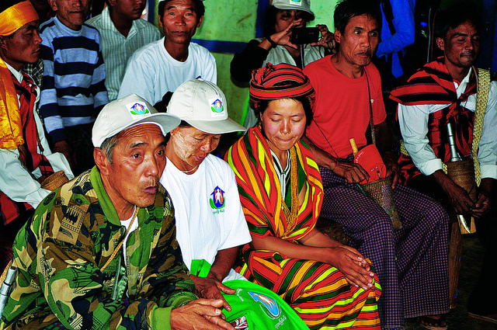
ESS10: Stakeholder Engagement & Information Disclosure
Establish a systematic approach to stakeholder engagement that helps Borrowers identify stakeholders and maintain a constructive relationship with them
Assess stakeholder interest and support for the project and enable stakeholders’ views to be taken into account in project design
Promote and provide means for effective and inclusive engagement with project-affected parties throughout the project life-cycle
Ensure that appropriate project information is disclosed to stakeholders in a timely, understandable, accessible and appropriate manner
Highlights
Emphasizes stakeholder engagement throughout the project life-cycle, and requires a Stakeholder Engagement Plan (SEP)
Encourages early identification of stakeholders, both project-affected parties and other interested parties
Engagement proportionate to the nature, scale, risks and impacts of the project, and appropriate to stakeholders’ interests
Specifies process and criteria for information disclosure and meaningful consultation
Requires an accessible and inclusive grievance mechanism, proportionate to risks and impacts

Slide 26

IMPLEMENTATION

Slide 27
What is the Timeline for Implementing the ESF?
Board Approval
Aug 2016
Effectiveness
Date
2018
Reporting back to Board on implementation
Phase I
Preparation
Phase IV
New Steady State
Phase II
Launch
Phase III
Embedding
Effectiveness Date* to be decided based on set of Readiness Indicators around capacity to implement
*Effectiveness Date means:
Projects with PCNs approved prior to Effectiveness Date to utilize existing Safeguard Policies
Projects with PCNs approval on or post Effectiveness Date to apply ESF

Slide 28
Capacity Building Road Map 2017-2018
Awareness Raising
Training of Trainers
Training Material Development
Training Delivery
Provide cohort of Trainers with soft skills to deliver effective training
March 2017 –
Deliver training to WB staff (E-Learning and Face-to-Face)
September 2016 –
Provide cohort with content and skills to deliver training
February 2017 –
September 2017 –
Borrowers, E & S and other staff
Deliver training to Borrowers (Face-to-Face).
Develop training materials including content (using e-Learning platform) and application of the ESF (to be delivered Face-to-Face)
Outline of new ESF
ESF Implementation roll-out process and schedule
Key stakeholders
Clients
June 2017
Bank staff
ESF Trainers (GENDR, GSURR, OPCS, LEG, ECR)
June 2017
August 2017
onwards
Capacity Building: Accreditation for E & S Specialists
Systems: Integrated Environmental and Social Risk Management Platform

Slide 29

What to Expect over the next 12 – 18 Months?
Development of Guidance Notes and other supporting materials
Capacity building for World Bank staff and for Borrowers:
Communications and awareness raising
E-Learning on the substance of the ESF
Face-to-face training on skills and tools for ESF application, tailored to different audiences
Change management process to create a supportive environment for new approaches
Accreditation for Environmental and Social Specialists at the World bank
New IT/information management systems, including integrated environmental and social risk tracking
ESF will become effective when readiness indicators are met

Slide 30

!
!
!
!
QUESTIONS?
COMMENTS?

